Slide 1

Session 08.1 – Land Consolidation: From Plan to Implementation
Presentation – Multifunctional Land Consolidation. An approach to a holistic and sustainable land use in rural areas
[Paper ID-Number – 11195]
Presenter – Torben Juulsager (DK)
(President of The Danish Association of Surveyors. Contact tgj@geopartner.dk)
Session date, time – Wednesday 23 June, 10:30-12:00

Slide 2
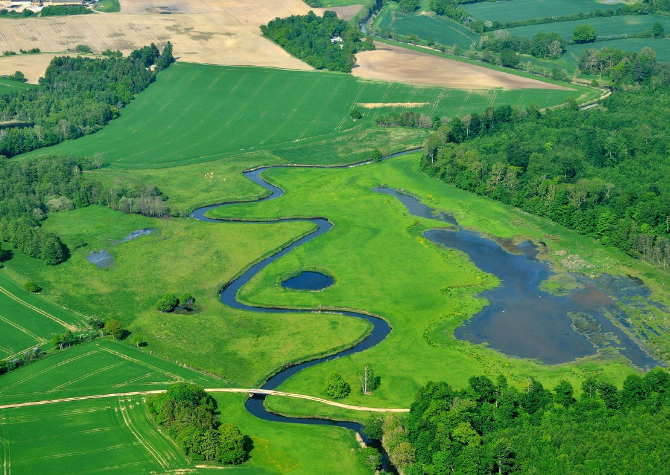


Agenda
250 Years in the Service of Society
Call for Land Professionals
To Be a Profession
Case Study – The Danish Surveying Profession
Final Remarks
Prelude
It calls for land professionals
to secure
land and property rights
for all
Multifunctional
Land Consolidation
An approach to a holistic and sustainable land use
in rural areas
Challenges
Targets
Approach
Solutions

Slide 3
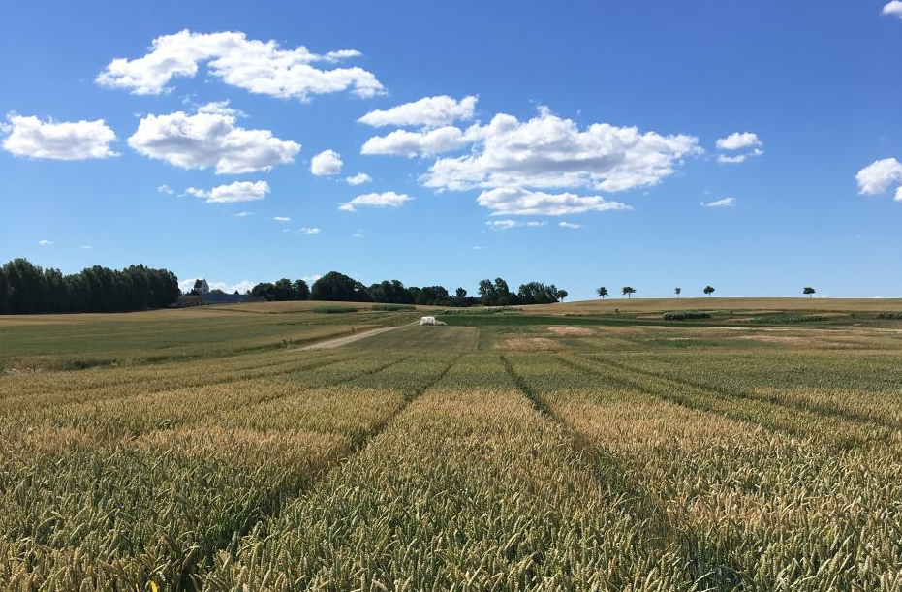

Challenges

Slide 4

Challenges
High intensive farming – 61% of the area of Denmark
- Large and fragmented farms – significant operating costs
- High carbon footprint – share of DK-CO2 emissions is 23% (2018)
- Leaching of nutrients to the aquatic environment
- Leaching of pesticides to groundwater
- Less biodiversity
2. Achievement of UN Sustainable Development Goals
- Particular on climate and environmental impact
3. Increased focus on other uses of rural areas
- Need for 140% of the total Danish area to fulfill all known plans and wishes for land use
“Silo thinking” in open land management
- The open land is regulated by sector plans, restrictions and bindings
- A weak tradition of interdisciplinary planning of open land

Slide 5
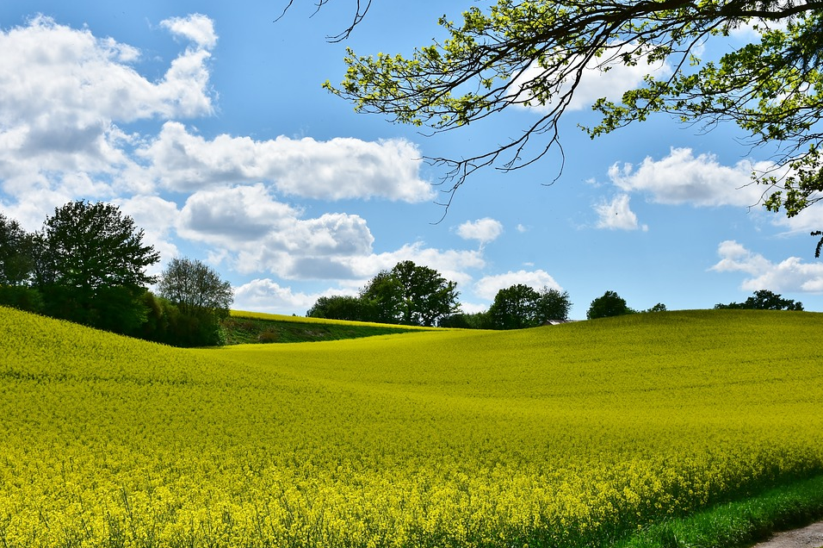
Targets

Slide 6


















Targets
Environment
- Clean drinking water and good water quality
Climate
- Reduction of greenhouse gases and floods
Nature
- Variation in nature and improvement of biodiversity
Leisure / recreation
- Facilities and access into the landscape
5. Economy
- Profitable agriculture
Rural development
- Place to live and stay

Slide 7
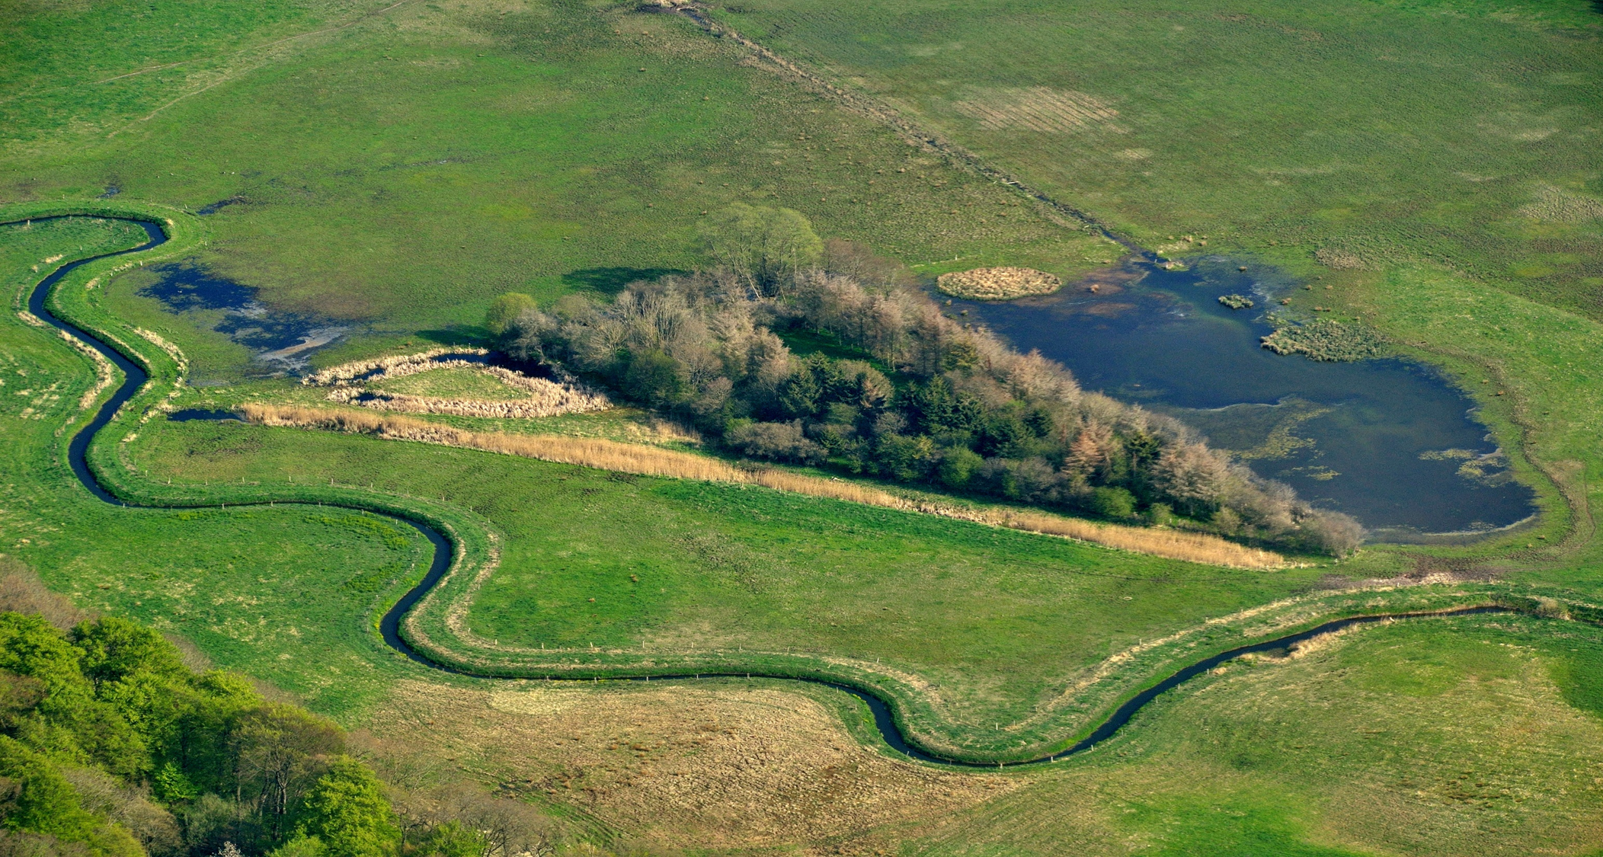
Approach

Slide 8
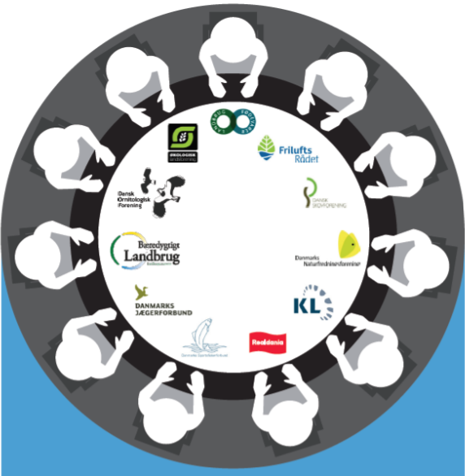
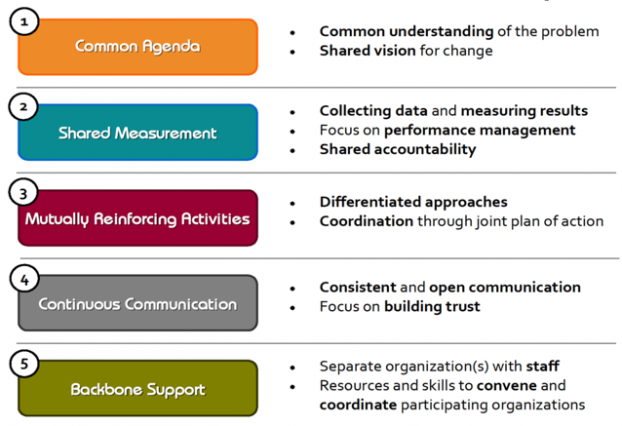
Approach
The Collective Impact methodology
- Bringing people together in a structured way, to achieve social change
- Builds on five conditions

Slide 9
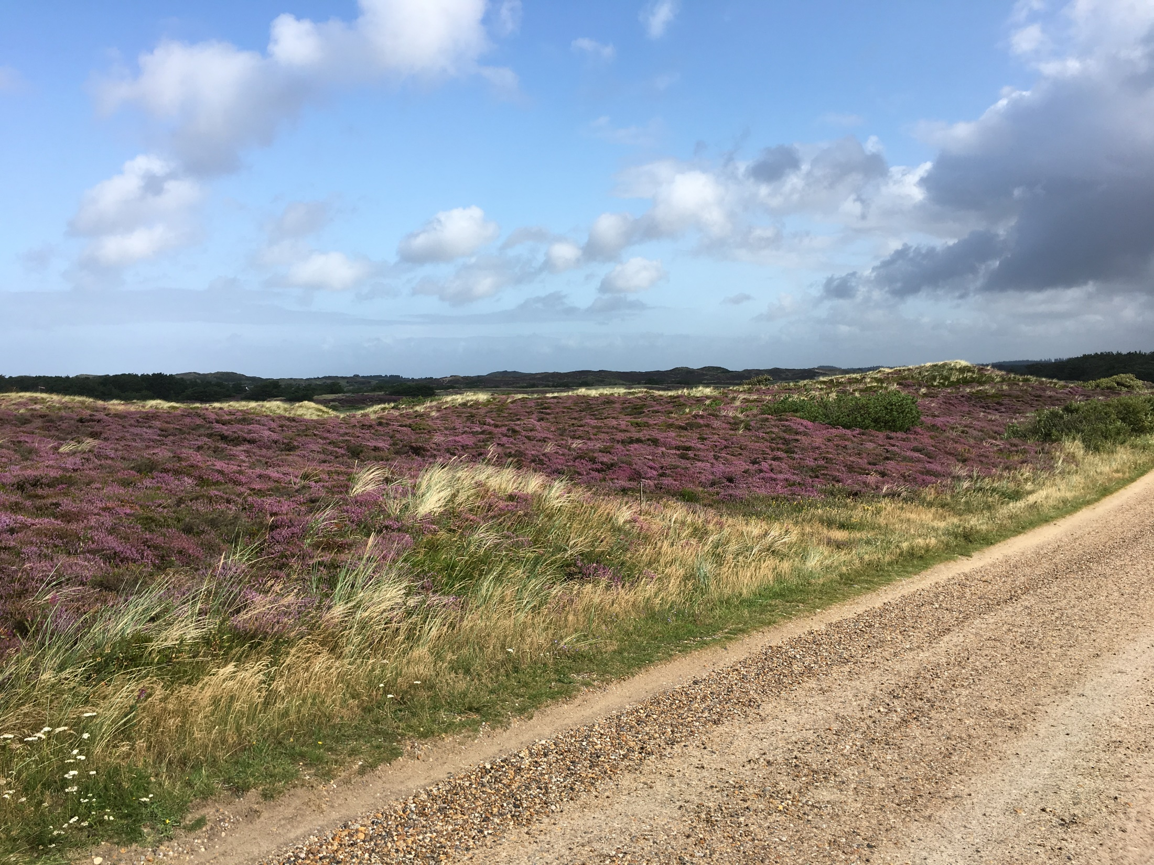
Solutions

Slide 10

Solutions
1. Free land consolidation
- Builds on dialogue-based solutions between authorities,
interest groups, stakeholders, rights holders and owners
- Under development to contain multifunctionality - multifaceted land use
Pilot projects in progress – conducted by Ministry of Food, Agriculture and Fisheries
- Opportunity to apply for financial support for the implementation of multifunctional land consolidation – in a two-year trial period
Requirements for the project
- Municipalities or the Danish Nature Agency must be applicants
- Projects must be locally based
- Project description must be available
- There must be a financing plan
- Projects must meet at least three national interests including at least one EU Directive implementing interest

Slide 11
Solutions
4. National interests
- EU Directive implementing interests
- Clean drinking water
- Clean aquatic environment
- Natura 2000
- Greenhouse gas reduction
- Other interests
-Climate adaptation
- Nature and biodiversity
- Afforestation
- Organic farming
- Outdoor life
- Rural development
- Land allocation of agricultural property

Slide 12
Solutions
4. Process Multifunctional Land Consolidation
Project development and financing plan
Assessment and measurement of impact
Application
Predesign
Studies of interests and project area
Land acquisition
MultifunctionalLand Consolidation
Sale of land
Development
Physical establishment and realization
Compensation
Realization
Updating public registers with property changes
Registration

