Slide 1

Global Geospatial Information Management: assisting the vision for
The Future we Want for All
Dr Vanessa Lawrence CB
Co-Chair UN-GGIM
Positioning geospatial information to address global challenges

Slide 2


“National Land Authorities and National Mapping Authorities are the custodians of BIG DATA”
Keith Bell, World Bank, FIG 2014

Slide 3

The Big Data revolution is changing our approach to information in 3 distinct ways
More: Big Data means harnessing vast quantities of information. Analysis is increasingly moving from limited samples to the whole population. N = All
Messy: The benefits of using more data often outweighs cleaner but smaller datasets.
Correlations: Instead of trying to uncover causality, the reasons behind things, it is often sufficient to simply uncover practical answers to questions

Slide 4

We must gain “Big Value” from “Big Data”
Tish Long, Director, National Geospatial Intelligence Agency, USA

Slide 5

Data is becoming increasingly central to everyday life
The ‘digital universe’ is doubling in size every 2 years… it is on course to have grown 50 times over its 2010 size, by 2020
Big Data is typically expressed in terms of ‘V’s…
  Volume: 2.3 trillion Gigabytes are created every day
  Variety: Increasing range of sources – weblogs, tweets, video – often poorly structured
  Velocity: Sensors are proliferating the flow of real-time data… cars today have between 60 and 100 on-board sensors
However, the 4th V – Veracity – reveals the challenge
  1 in 3 business leaders don’t trust the information they use to make decisions
  Poor data quality costs the USA $3 trillion each year

Slide 6



The geospatial community needs to adapt to the challenges of Big Data
‘V’ | Our challenges
Volume | Ensure that we are connecting with sensors and crowdsourcing / data sharing opportunities
Velocity | Rapid transition of supply models from physical media and data downloads Application Programming Interfaces (APIs) Responding to increasing expectation for data which is fully maintained
Variety | With so much data relating to location, part of our role is to help provide a framework relating ‘space’ (coordinate systems) to ‘place’ (gazetteers and addresses)
Veracity | Ensure that data provenance, accuracy and quality is described in a meaningful way
1990s
2000s
2010s

Slide 7


From the past…
“In future computers may weigh less than 1.5 tons”
Popular Mechanics magazine 1949
“640k RAM should be enough for anyone”
Bill Gates 1981
Notes:
Current assumptions and expectations will become obsolete!

Slide 8
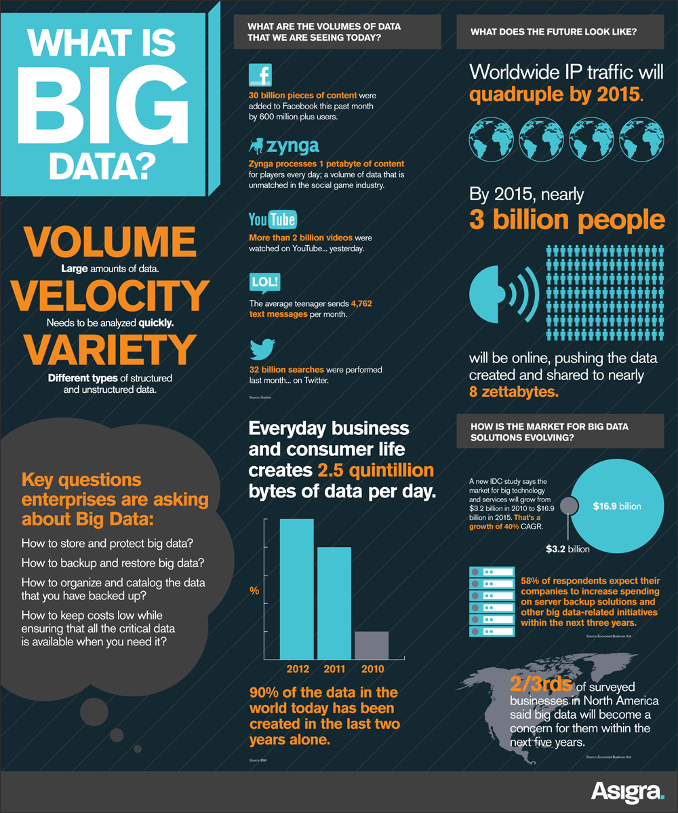
…to the present…

Slide 9

And the future?...Big Data and Privacy
In a report published in May 2014 the Presidents Council of Advisors on Science and Technology (PCAST) identify:
Big data drives big benefits; from innovative businesses to new ways to treat diseases
By data mining and other kinds of analytics, non-obvious and sometimes private information can be derived from data that, at the time of their collection, seemed to raise no, privacy issues
PCAST believes strongly that the positive benefits of big data technology are (or can be) greater than any new harms.

Slide 10

Geospatial information is important to governments and citizens

Slide 11




It underpins transport, utlilities and economic growth

Slide 12




It helps to keep us safe

Slide 13



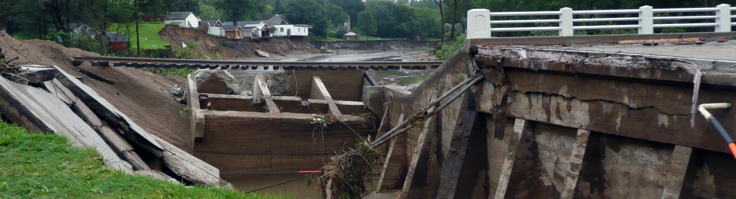

Helps manage and monitor the environment

Slide 14
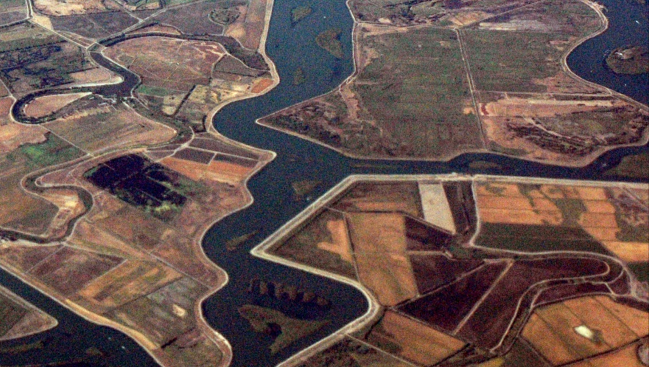


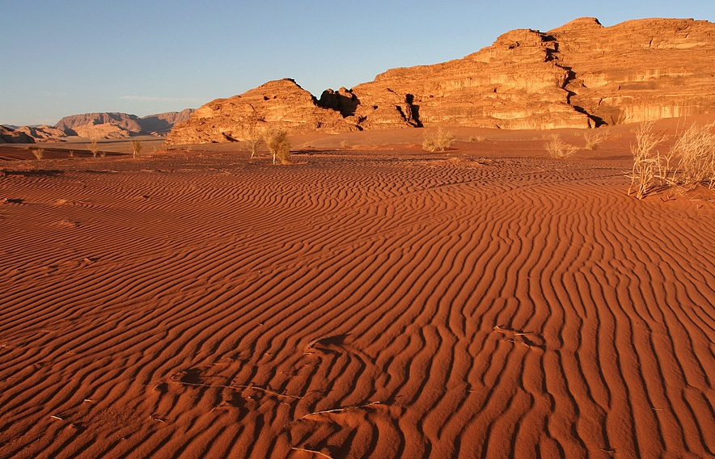
And helps plan for sustainable development

Slide 15



Slide 16
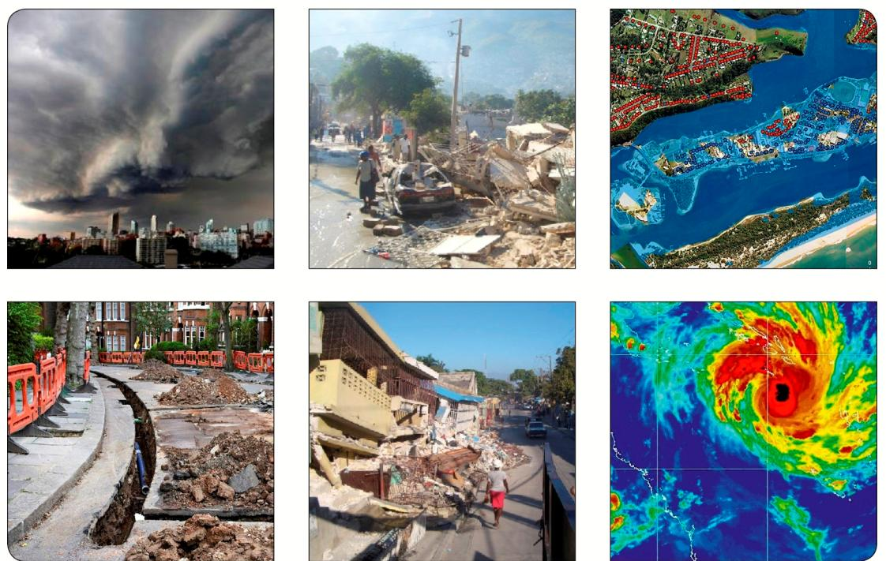
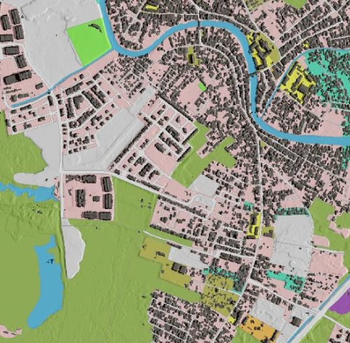
How can you measure and monitor sustainable development…
…without location and geography?

Slide 17

Realizing the Future We Want for All
The first report of the UN System Task Team on the Post-2015 UN Development Agenda to the Secretary-General in May 2012, Realizing the Future We Want for All outlined a vision for the post-2015 development.
Sets out four core dimensions where progress needs to be made:
Inclusive social development: including empowering people through land tenure security
Environmental sustainability: including improved land use planning
Inclusive economic development: including ensuring access to land and natural resources
Peace and Security

Slide 18


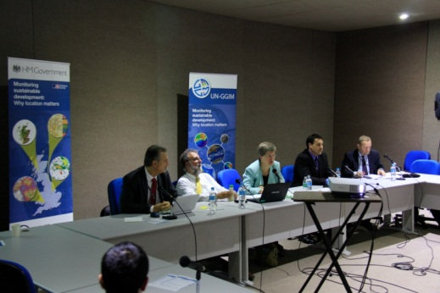

Monitoring sustainable development: why location matters?
Notes:
In terms of the Sustainable Development agenda, UN-GGIM Member States clearly demonstrated the importance of geospatial information at a side event during the UN Conference on Sustainable Development, Rio+20, in June 2012.

Slide 19

Accurate location information assisting better decision-making in:
  Water management
  Food management; food supply and sustainable agriculture
  Sustainable energy

Slide 20
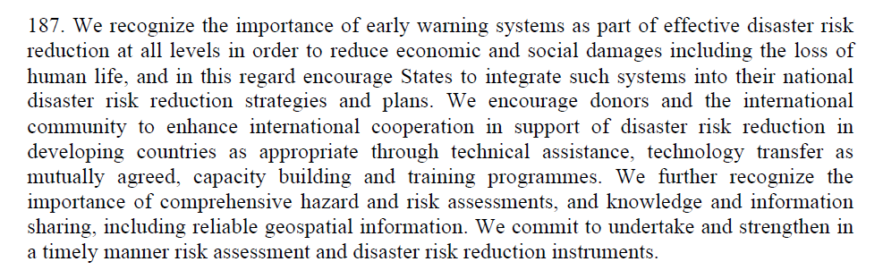
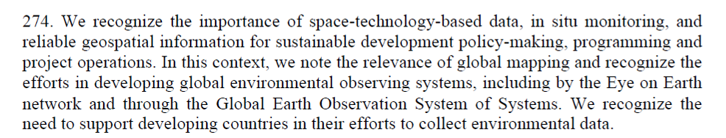
“The Future We Want”: 19 June 2012

Slide 21

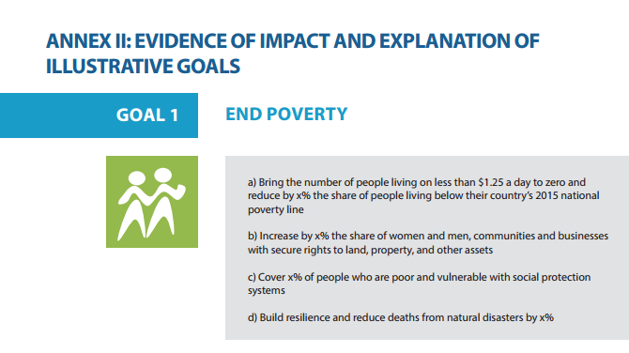
High Level Panel on the Post-2015 Development Agenda
“People are more likely to make long-term investments when they feel secure on their property. But when people or communities lack legal property rights they face the risk that they will be forced to leave their land. Business will also invest less and be less able to contribute to the economy. We know property rights are important, but also realise the challenges of measurement. We urge further work on this issue”.

Slide 22
FIG-World Bank Declaration on
Fit-for-Purpose Land Administration
Flexible in the spatial data capture approaches to provide for varying use and occupation.
Inclusive in scope to cover all tenure and all land.
Participatory in approach to data capture and use to ensure community support.
Affordable for the government to establish and operate, and for society to use.

Slide 23
FIG-World Bank Declaration on
Fit-for-Purpose Land Administration
Reliable in terms of information that is authoritative and up-to-date.
Attainable to establish the system within a short timeframe and within available resources.
Upgradeable with regard to incremental improvement over time in responseto social and legal needs and emerging economic opportunities.

Slide 24
Seventh Session of the Open Working Group on
Sustainable Development Goals (SDGs)
The SDGs will depend on human and physical geography. In order to measure and monitor change and progress you must have access to fundamental and consistent geospatial information – geography.
Not all targets will be equal and will require different means of measure. Indicators will need to be linked to the targets and be well defined, measurable over time, cost effective and clearly and easily communicated.
There will be a need to create a network of consistent global data – reliable geospatial information – to measure and monitor trends, change and progress over time in a standardized manner.

Slide 25
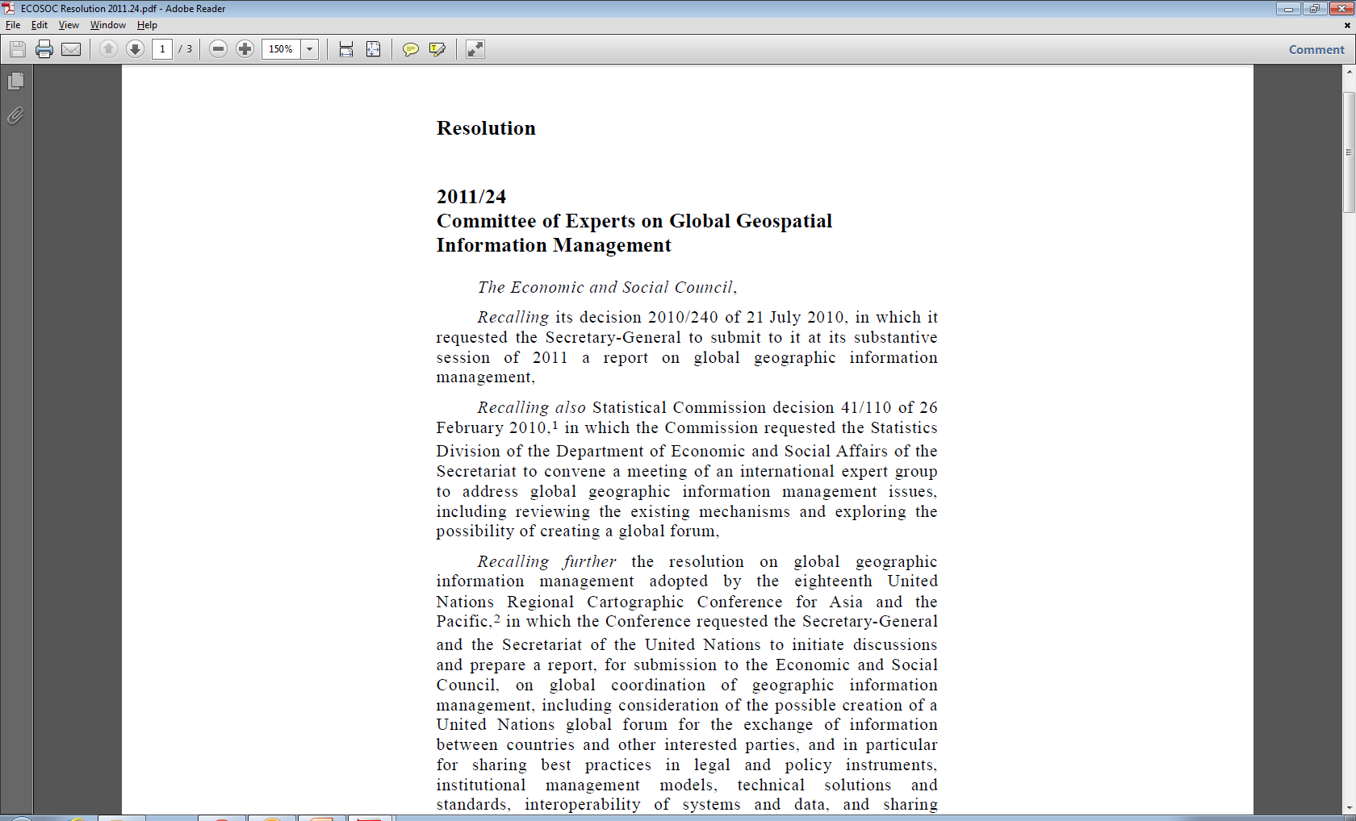
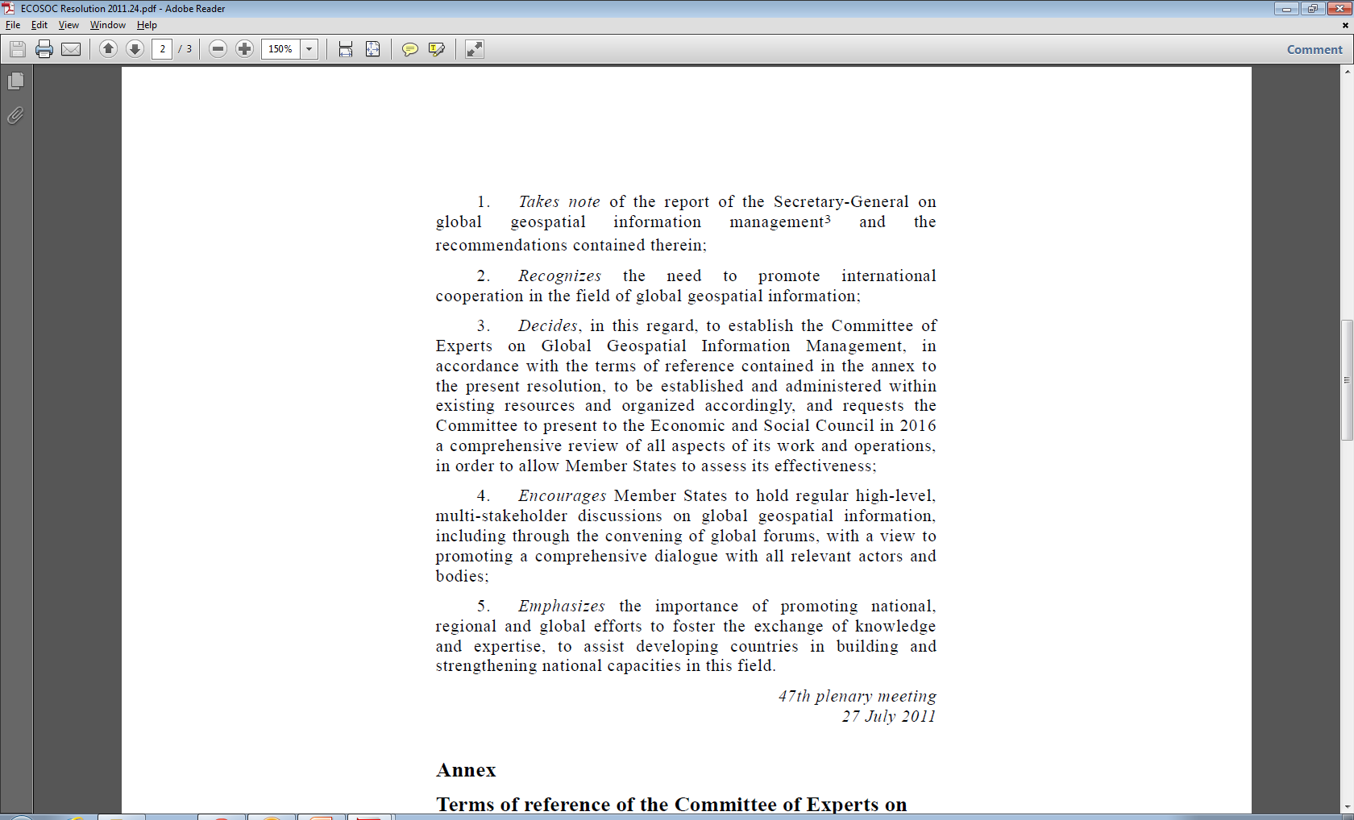
A global geospatial mandate
  At its 47th plenary in July 2011, ECOSOC, recognising the importance of global geospatial information, established the Committee of Experts on Global Geospatial Information Management (UN-GGIM); and
  requested the Committee to present to ECOSOC in 2016 a comprehensive review of all aspects of its work and operations, in order to allow Member States to assess its effectiveness; and
  encouraged Member States to hold regular high-level, multi-stakeholder discussions on global geospatial information, including through the convening of global forums, with a view to promoting a comprehensive dialogue with all relevant actors and bodies.

Slide 26



The United Nations steps forward:
Global Geospatial Information Management
‘There is a significant gap in the management of geospatial information globally’
Paul Cheung, Director, United Nations Statistics Division,
Cambridge Conference, June 2011

Slide 27

UN-GGIM: its role
To make accurate, reliable and authoritative geospatial information readily available to support national, regional and global development

Slide 28




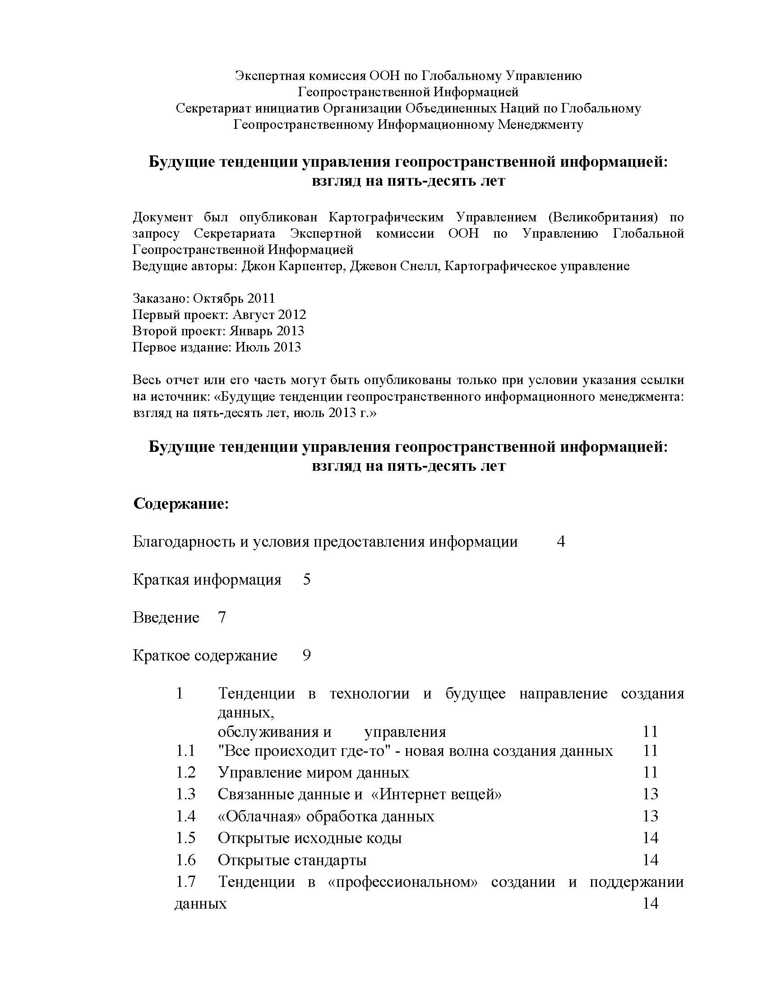
Future trends in geospatial information management: the 5–10 year vision

Slide 29
Five broad themes identified
trends in technology and the future direction of data creation, maintenance and management;
legal and policy developments;
skills requirements and training mechanisms;
the role of the private sector and non-governmental sectors; and
the future role of governments in data provision and management.

Slide 30



Slide 31
Post-2015 Development Agenda
Fit-for-purpose geospatial information
United Nations Committee of Experts on Global Geospatial Information Management
Strong Governance
Standards
Capability and Capacity Building
Spatial Frameworks
High level forum for Member States
Legal and Policy Frameworks
Standards for Geospatial Information Management
Knowledge base for Geospatial Information Management
Forum for exchange of best practice
Global Geodetic Reference Framework
Global Map for Sustainable Development

Slide 32
Post-2015 Development Agenda
Fit-for-purpose geospatial information
United Nations Committee of Experts on Global Geospatial Information Management
Strong Governance
Standards
Capability and Capacity Building
Spatial Frameworks
High level forum for Member States
Legal and Policy Frameworks
Standards for Geospatial Information Management
Knowledge base for Geospatial Information Management
Forum for exchange of best practice
Global Geodetic Reference Framework
Global Map for Sustainable Development

Slide 33
Legal and Policy Frameworks
UN-GGIM has:
  Identified Legal and Policy Issues as one of the main challenges facing the geospatial community in the next ten years
  Engaged with the Centre for Spatial Law and Policy and the International Bar Association to help identify issues
  Conducted a survey of Member States to assess the impact on legal and policy issues on data collection, use and distribution

Slide 34

Legal and Policy Frameworks
UN-GGIM will:
  Write an information paper to be discussed at the Fourth Session of UN-GGIM (GGIM4)
  Host a side event at GGIM4 to discuss Legal and Policy implications with Member States
  Formulate guidance on issues surrounding geospatial law

Slide 35





Cambridge Conference/UN-GGIM – Ministerial Session

Slide 36
Geospatial information: its importance to governments
‘In Namibia a country in which water is a scarce resource…geospatial data is only below water in significance’
Minister Alpheus G. !Naruseb, Minister of Lands and Resettlement, Namibia

Slide 37
High Level Forums

Slide 38
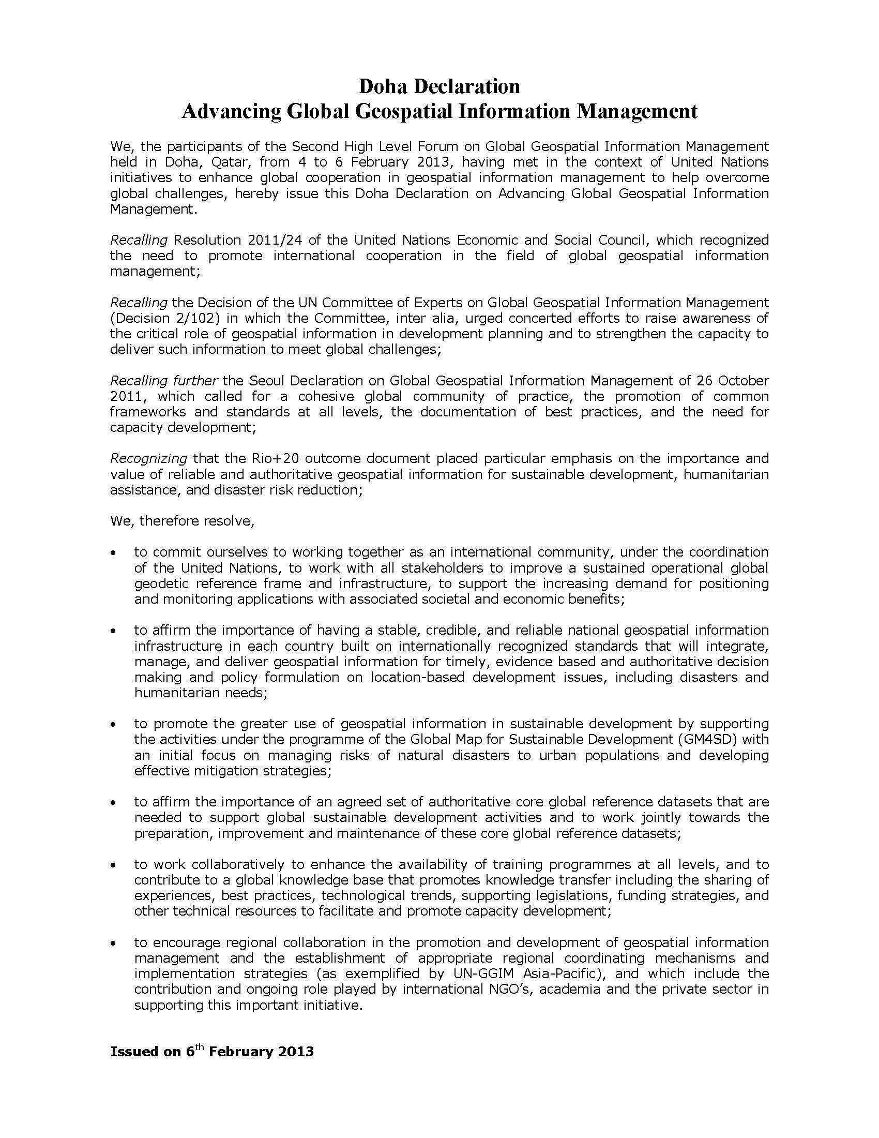
Second High Level Forum
Qatar 4-6th February 2013
350 participants from:
  60 UN Member States,
  international organisations
  private sector
  UN entities
Affirmed the importance of UN-GGIM providing global leadership on geospatial information management, and committed to support the ensuing projects and programmes through the Doha Declaration.

Slide 39
UN-GGIM Committee of Experts
UN-GGIM Asia-Pacific
UN-GGIM Africa
UN-GGIM
Arab States
UN-GGIM Americas
UN-GGIM Europe
China
Rep. of Korea
Japan
South Africa
UN ECA
Member States to be elected
Mexico
Chile
Mexico
Member States to be elected
WG 1
Geodetic Reference Frame for SD
CODIST-Geo
To be determined
Working Groups & Region Vocals
European Commission
+ Eurostat
WG 2
Data Sharing & Integration for Disaster Mmnt.
AFREF
African Reference Frame
UN-GGIM Arab States placed on UN ESCWA Commission Agenda for 2014.
First meeting in Jordan convened February 2014.
PAIGH
Pan Amer. Inst. of Geography and History
Euro
Geographics
WG 3
Place-Based Information for Economic Growth
UN ECA: Geoinfo merged with Statistics. 3/2013 CODIST meeting recommended CODIST-Geo become UN-GGIM Africa. Yet to be ratified.
SIRGAS
Geocentric Reference System for Americas
European Environment Agency
GeoSUR
Geo. Network for Latin America & Caribbean
WG1: France
WG2: Sweden
WG3: Italy
Notes:
39

Slide 40
Post-2015 Development Agenda
Fit-for-purpose geospatial information
United Nations Committee of Experts on Global Geospatial Information Management
Strong Governance
Standards
Capability and Capacity Building
Spatial Frameworks
High level forum for Member States
Legal and Policy Frameworks
Standards for Geospatial Information Management
Knowledge base for Geospatial Information Management
Forum for exchange of best practice
Global Geodetic Reference Framework
Global Map for Sustainable Development

Slide 41

UN-GGIM and International Standards
2/103
Inventory of issues to be addressed by the
UN-GGIM Committee of Experts
Concept proposed
Suggestion by Technical Committee 211
(geomatics and geographic information) of the International Organization for Standardization (ISO/TC211) to put forward, jointly with the Open Geospatial Consortium (OGC) and the International Hydrographic Organization (IHO), a paper related to standard-setting issues in the international community
New York,
13-15 August 2012
Second session of the
UN Committee of Experts on Global Geospatial Information Management

Slide 42


UN-GGIM and International Standards
Draft report submitted
Second High Level Forum on Global Geospatial Information Management
Qatar National Convention Centre, Doha, Qatar, 4-6 February 2013
Full report
Third Session of UN-GGIM
Committee of Experts
Cambridge, UK,
24-27 July 2013

Slide 43
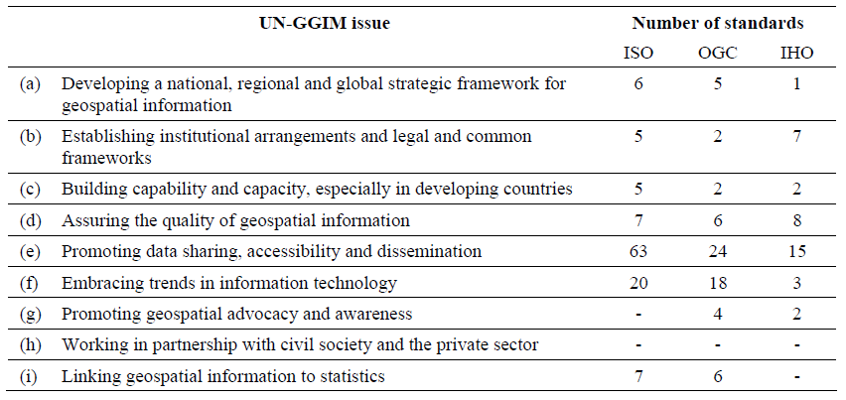
Existing standards and Inventory of Issues

Slide 44
Post-2015 Development Agenda
Fit-for-purpose geospatial information
United Nations Committee of Experts on Global Geospatial Information Management
Strong Governance
Standards
Capability and Capacity Building
Spatial Frameworks
High level forum for Member States
Legal and Policy Frameworks
Standards for Geospatial Information Management
Knowledge base for Geospatial Information Management
Forum for exchange of best practice
Global Geodetic Reference Framework
Global Map for Sustainable Development

Slide 45
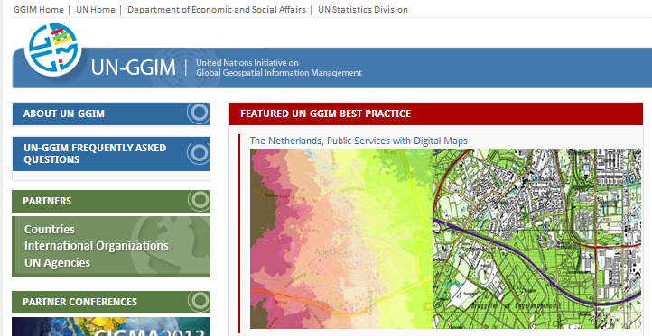
Sharing Best Practice
UN-GGIM website shares best practice models from around the world

Slide 46
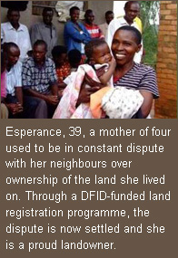
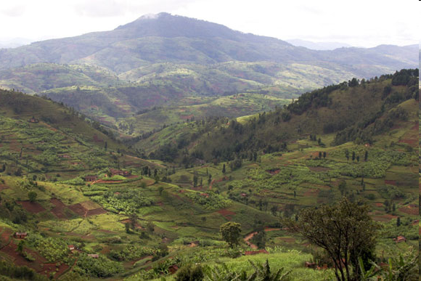
Land tenure regularisation in Rwanda
The UK’s Department for International Development (DfID) have been supporting a major Land Tenure Regularisation programme in Rwanda
Rwanda is one of the most densely populated countries in Africa, with pressure on land likely to increase in the coming years.
Aim to increase number of registered plots
from 40,000 in 2009/10 to 6.9 million
by 2015, helping to reduce conflict
and provide the security needed
by farmers and businesses to invest in
long-term food production.
Location information is a key part
of this process.
Source: UK Gov’t/DfID

Slide 47
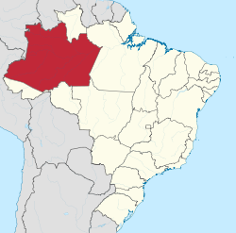
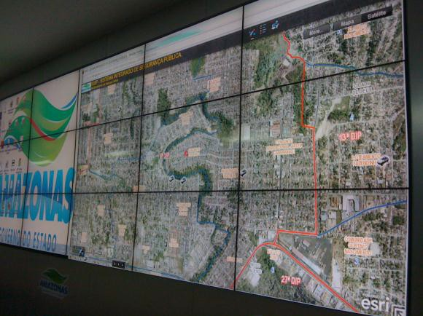
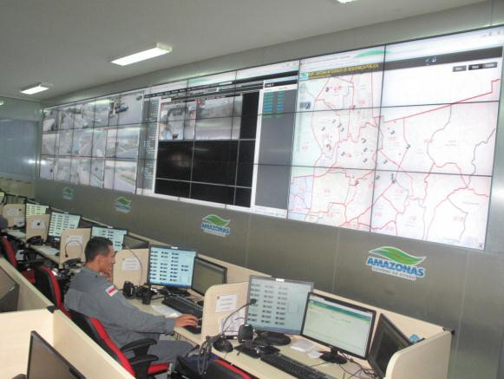
Brazil: use of GIS improves monitoring and reduces crime in the state of Amazonas
With over 1.5 million km² and 3.5 million inhabitants, the
State of Amazonas is the largest of the 27 states in Brazil
and the second most populous in the Northern region.
The challenge: need for faster police response to incidents and to improve the Integrated Public Safety System (SISP).
The solution: investment of US$ 150 million to map major cities, to implement a geographical information system (GIS) and for hardware acquisition (monitoring cameras and GPS navigator).
The benefits: 10% reduction in police incidents and 13% reduction in homicides in May 2012, in comparison with May 2011, due to the benefits of ‘crime map’ in the State.
Data integration between civil and military police.
Source: Imagem / Amazon State Government
9

Slide 48
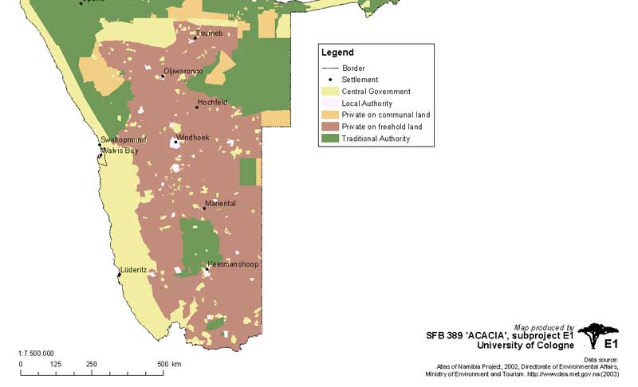
Namibia: Registration of Communal Land Rights Using Aerial Photos
Registration of existing and new customary land rights
  Communal Land reform Act requires that everybody having any right to communal land should apply for recognition of this right by a certain deadline
  There are very few survey control points in the communal areas
  There is an urgent need to find a systematic approach to register communal land rights more efficiently and faster at affordable cost.

Slide 49
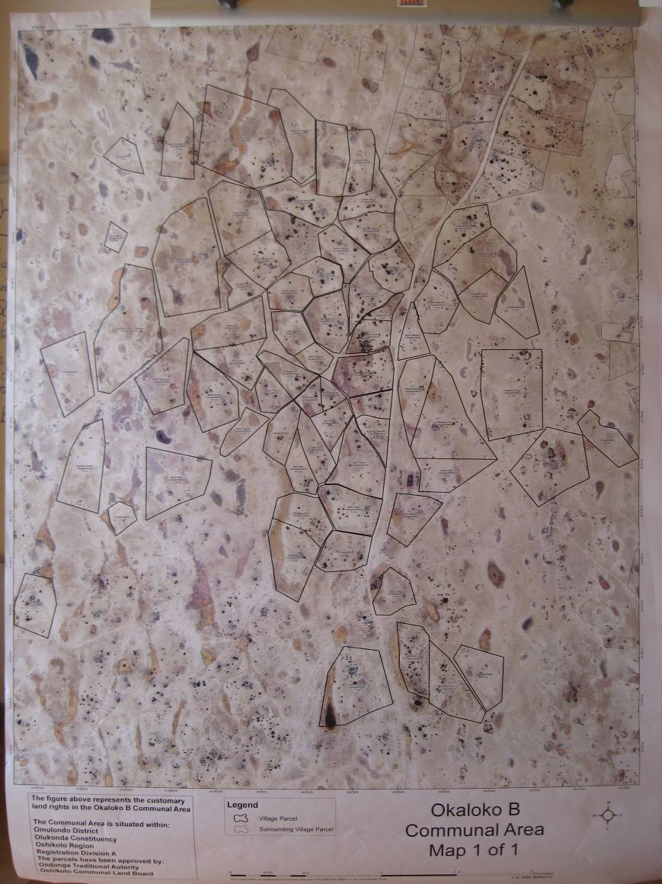
Benefits of using aerial photographs for communal land registration
Use of aerial photos provides a systematic and efficient method of registering the communal land rights in the quickest possible time
Aerial photos are clear, fit for purpose, easy to use and understand, (they are WYSIWYG= what you see is what you get)
Provides additional physical information for adjudication and determination of boundaries
It is cost efficient.
It encourages the involvement of local residents

Slide 50

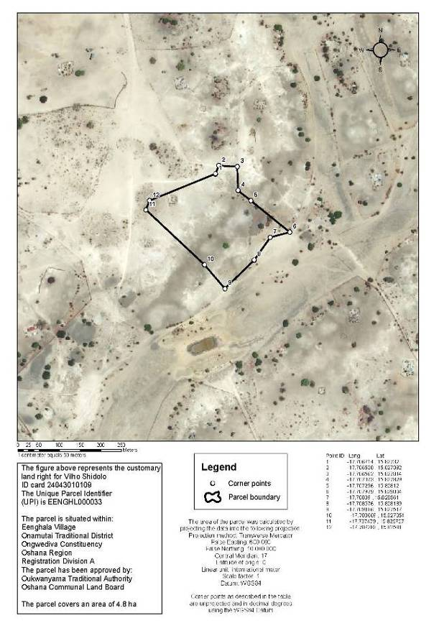
Front & Back of Registration Certificate
FRONT
BACK

Slide 51
Post-2015 Development Agenda
Fit-for-purpose geospatial information
United Nations Committee of Experts on Global Geospatial Information Management
Strong Governance
Standards
Capability and Capacity Building
Spatial Frameworks
High level forum for Member States
Legal and Policy Frameworks
Standards for Geospatial Information Management
Knowledge base for Geospatial Information Management
Forum for exchange of best practice
Global Geodetic Reference Framework
Global Map for Sustainable Development

Slide 52
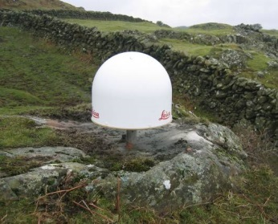
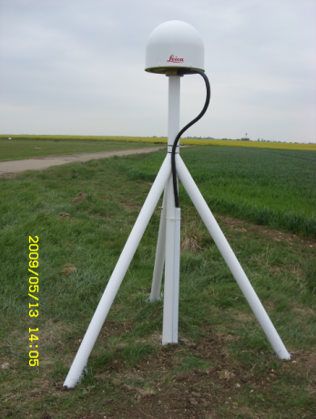

Global Geodetic Reference Frame
Global Geodetic Reference Frame (GGRF) is the global coordinate system - it allows us to know where we and things are on the Earth.
The GGRF is important to society because it underpins all satellite positioning technology including the all societal applications of the Global Navigation Satellite Systems (GNSS), of which GPS is an example.

Slide 53
UN-GGIM: areas of engagement
Future trends in geospatial information management
Development of the global geodetic reference frame
Development of a global map for sustainable development
Establishment and implementation of standards for the global geospatial information community
Development of a knowledge base for geospatial information
Linking of geospatial information to statistics and other data
Significant presence at the United Nations Conference on Sustainable Development
Activities on geospatial information within the United Nations system
Inventory of the status of mapping in the world
Establishment of regional UN-GGIM entities
Legal and policy frameworks, including critical issues related to authoritative data
Development of shared statement of principles on the management of geospatial information
Activities relating to the integration of land and marine geospatial information

Slide 54
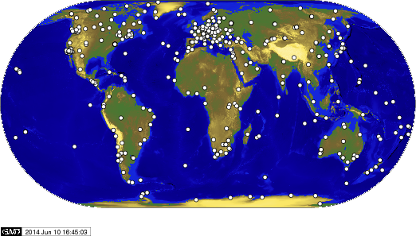
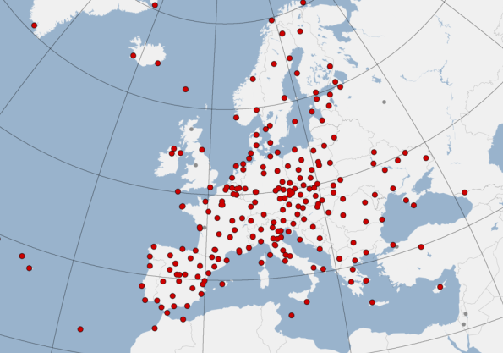
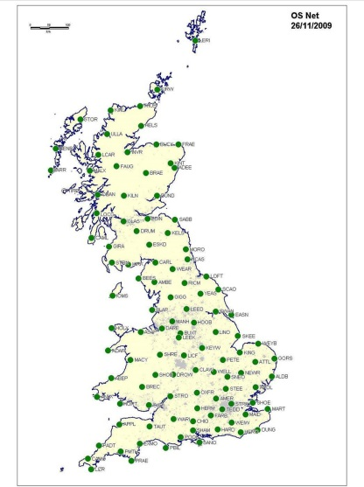
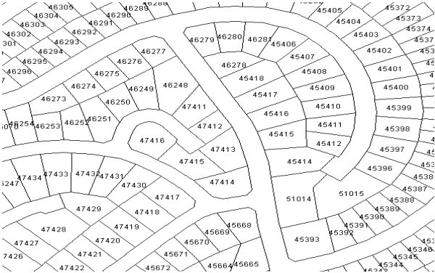
The global geodetic reference frame
Regional Reference System
Global Geodetic Reference System
Local application
National Reference System

Slide 55
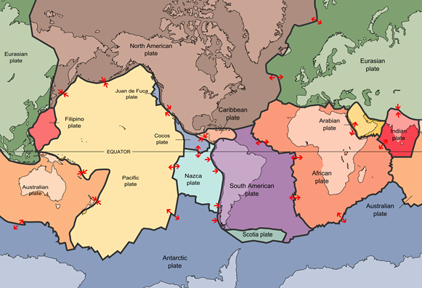
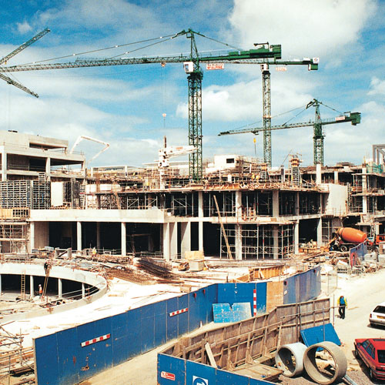



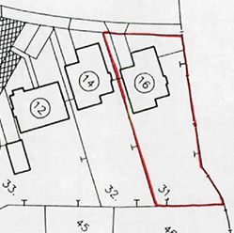
Applications

Slide 56
Genesis of the GGRF evolution
In August 2012, the Committee considered a report by the PCGIAP Working Group on Geodesy that described the growing demand and need for a stable and accurate global geodetic reference frame.
The Committee considered that further global consultation was required on the topic in order to gather consistent tangible evidence from Member States.
Requested the Secretariat to:
  Organize informal consultations with international experts and entities to discuss technical issues on the GGRF;
  Send a questionnaire to Member States and regional organizations on the present status and role of government in adopting and maintaining a globally connected geodetic reference frame;
  Organize a special session on the global geodetic reference system during the 2nd HLF on GGIM in Qatar in February 2013; and
  Consult with global experts and include the topic in the agenda of the 3rd session of the Committee.

Slide 57
Genesis of the GGRF evolution
In July 2013, the Committee considered the global consultations and the responses to the global geodetic questionnaire in which over 100 Member States responded.
A significant number of questionnaire respondents (81%) were from Member State agencies that currently contribute to the global geodetic community, and considered that the geodetic data, products and services of the IAG and the GGOS were of high-critical importance.
Over 50% of agencies indicated that they are potentially able to share the majority of their static GNSS and geodetic levelling data internationally, particularly if a mandate was in place to do so.
The majority of the Member States (75%), recognizing the economic value of a precise positioning capability, indicated that their organization would benefit from having a high level mandate in place that would provide clear responsibilities for national governments and international agencies.

Slide 58
Genesis of the GGRF evolution
It was felt that such a mandate would:
  Provide recognition and raise the profile of those agencies providing geodetic infrastructure to help inform government and decision makers of its importance;
  Encourage additional investment by Member States in geodetic infrastructure;
  Encourage free and open geodetic data access policies and reduce data security concerns;
  Motivate Member States to improve international engagement on geodetic matters;
  Facilitate improved intergovernmental coordination of geodetic activities, standards and infrastructure development; and
  Recognize common-good contributions by Member States to the global geodetic
  infrastructure.
In the outcomes of the 2nd HLF on GGIM, participants agreed that, while the science of establishing a geodetic reference frame is available, it was essential to have governments accept the responsibility of establishing and maintaining a sound national geodetic reference frame which could serve as the foundation for a global system.

Slide 59
Genesis of the GGRF evolution
In July 2013, the Committee of Experts agreed that actions be taken to facilitate the submission of a resolution to be tabled at the 2013-14 Session of the UN General Assembly to seek support and commitment at the highest level.
Requested the Secretariat to establish a Working Group, with equitable regional representation, to develop the conceptual note and draft text of a UN General Assembly resolution through an open and inclusive process.
The Global Geodetic Reference Frame Working Group (GGRF-WG), comprising 21 Member States and the International Association of Geodesy (IAG), has been established, and under the leadership of Australia and Norway as co-chairs, developed Terms of Reference, a draft Concept Note and the draft text of a UN General Assembly resolution.

Slide 60
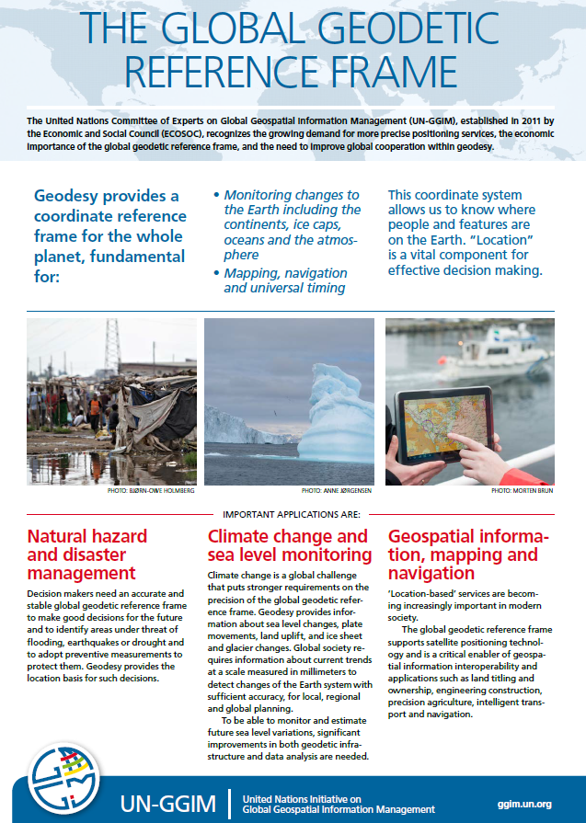

Slide 61

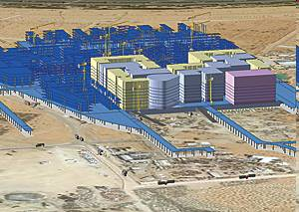
Creating a sustainable city: Masdar City, Abu Dhabi
‘The First Carbon Neutral City’
integrating the use of GIS in every aspect to plan the city
from ensuring the construction process is efficient and produces zero waste
to planning the transport and energy network to meet potential demand
building in monitoring systems into the city infrastructure
monitoring energy reduction, environmental conservation and social development

Slide 62
Location matters
‘We believe a lot of poverty has to do with the poverty of information…if we can democratise our information we can radicalise our democracy. ’ Adviser to the Prime Minister of India
White House memo: ‘Various federal programs can function more effectively if they include well-focused, place-based strategies.’
‘Effective policy depends on good information…it is vital to understand not just what is happening, but also where it is happening.’ President of the European Council

Slide 63
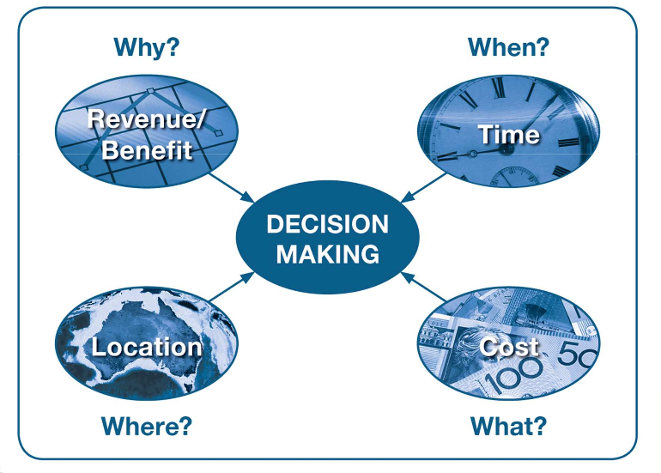
Location is the new dimension to decision making

Slide 64
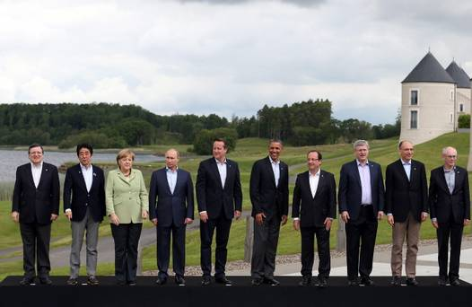
The G8 reaffirmed a global commitment to openness and transparency data
Notes:
The UK currently holds the Presidency of the G8 and as such:
The G8 met in Enniskillen, Northern Ireland on 17 and 18 June 2013.
We probably shouldn’t avoid open data – especially as the industry is split on the issue and many players are not keen on the threat it represents. This slide is just to emphasise that it is on the global agenda and then the UK I leading on this and hence remains highly committed. The current initiative is the National Information Infrastructure which is being developed.
Can we add dates to the notes

Slide 65
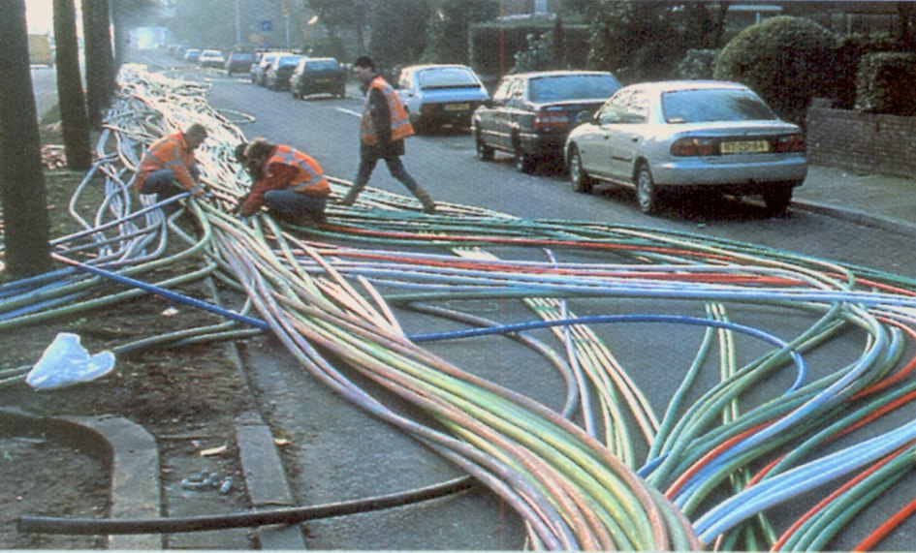
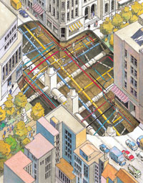
  The global market for Smart Cities is estimated to be $408 billion by 2020

Slide 66

Effective government needs authoritative data…without it how do you know your decisions are based on relevant information?

Slide 67
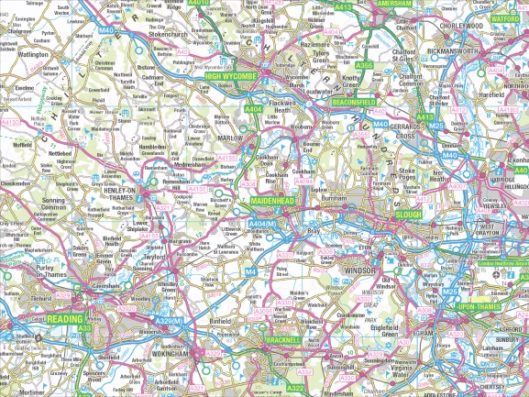
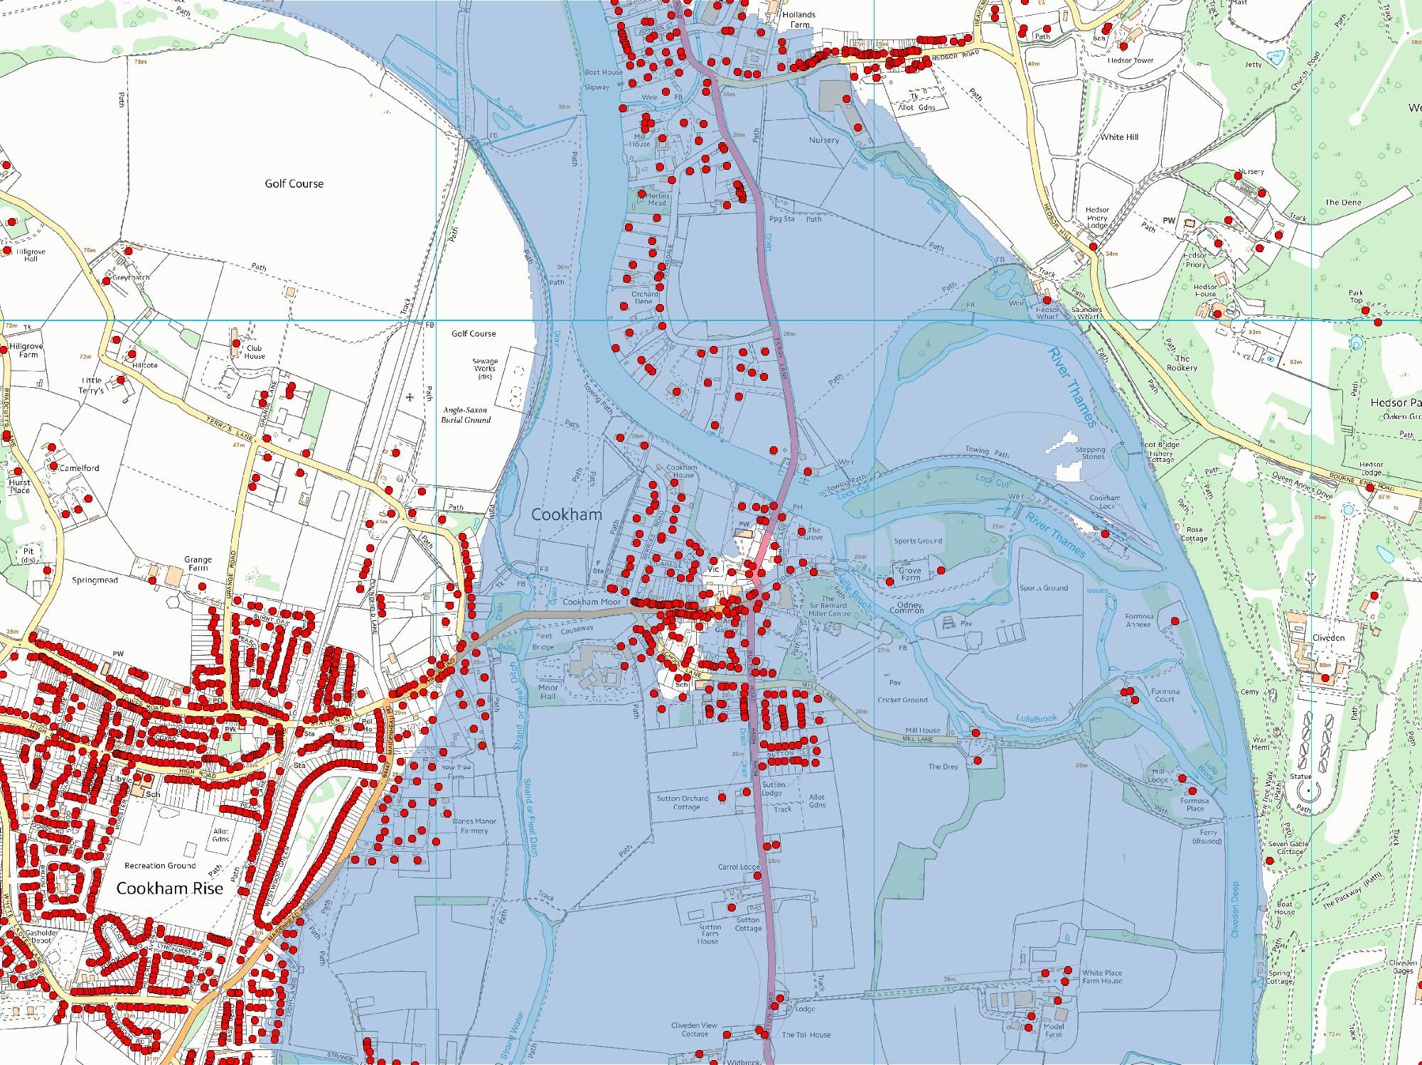



Cookham
OS VectorMap Local with addresses
and predicted 1/1000 yr flood model
Day (Term) population: 298
Day (non-Term) population: 369
Night/Weekend population: 734
Population stats from HSL National population database
Flood model from Environment Agency

Slide 68
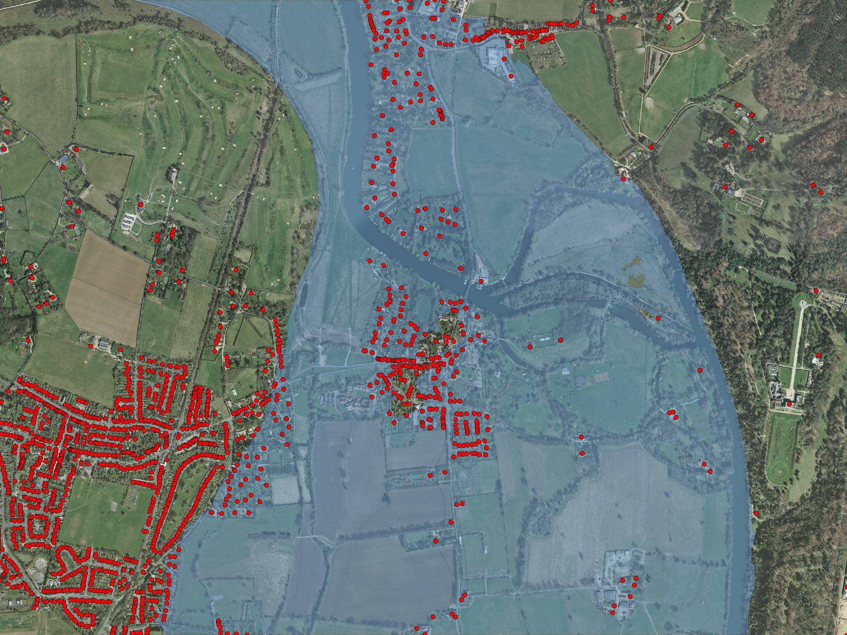
Cookham
OS MasterMap Imagery with addresses
and predicted 1/1000 yr flood model
Day (Term) population: 298
Day (non-Term) population: 369
Night/Weekend population: 734
Population stats from HSL National population database
Flood model from Environment Agency

Slide 69
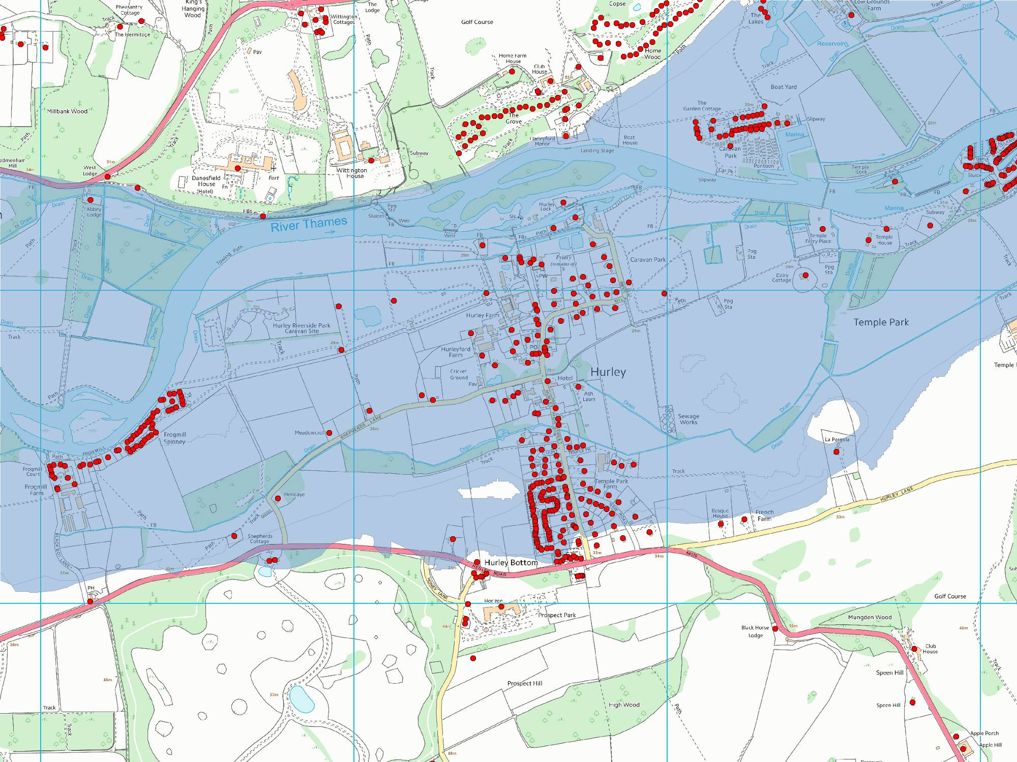
Hurley
OS VectorMap Local with addresses
and predicted 1/1000 yr flood model
Day (Term) population: 406
Day (non-Term) population: 557
Night/Weekend population: 1178
Population stats from HSL National population database
Flood model from Environment Agency

Slide 70
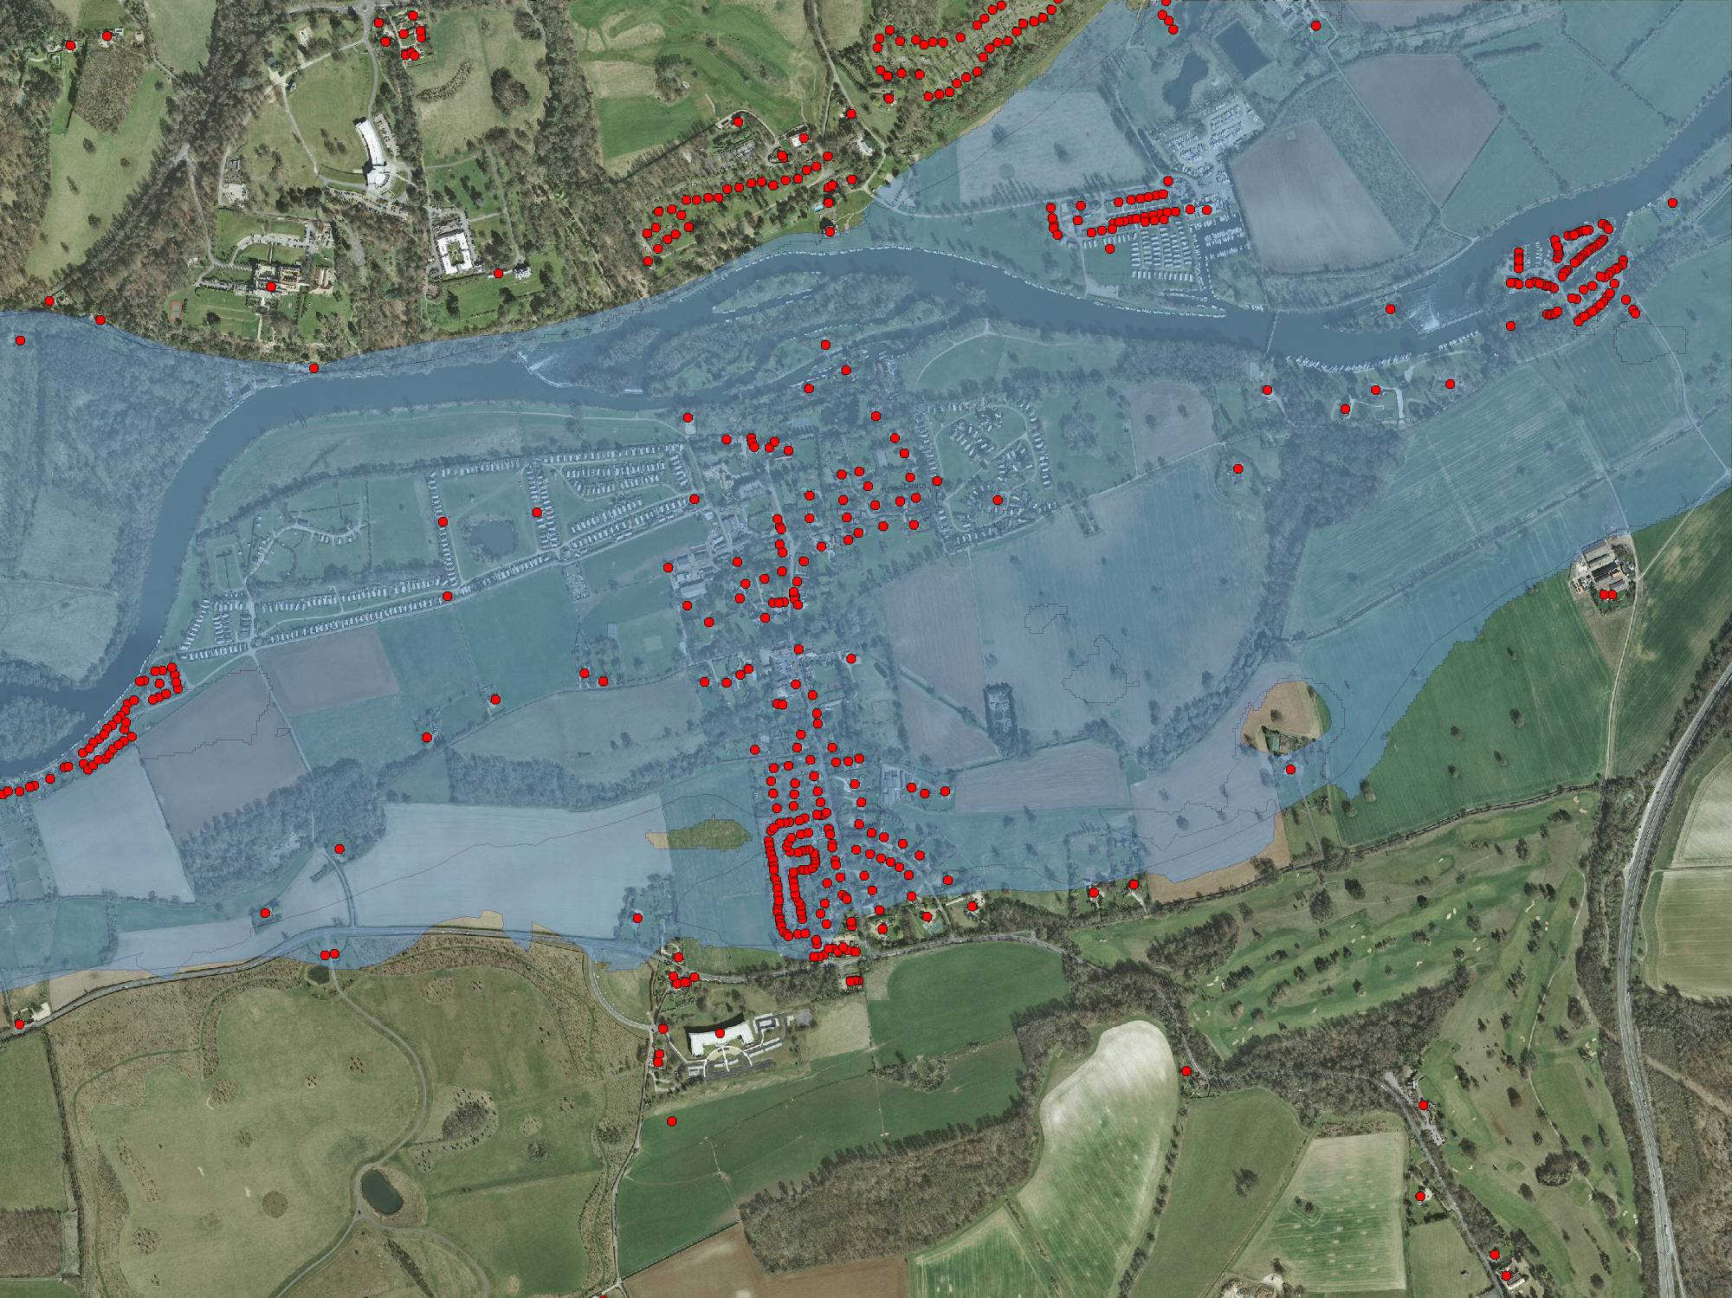
Hurley
OS MasterMap Imagery with addresses
and predicted 1/1000 yr flood model
Day (Term) population: 406
Day (non-Term) population: 557
Night/Weekend population: 1178
Population stats from HSL National population database
Flood model from Environment Agency

Slide 71
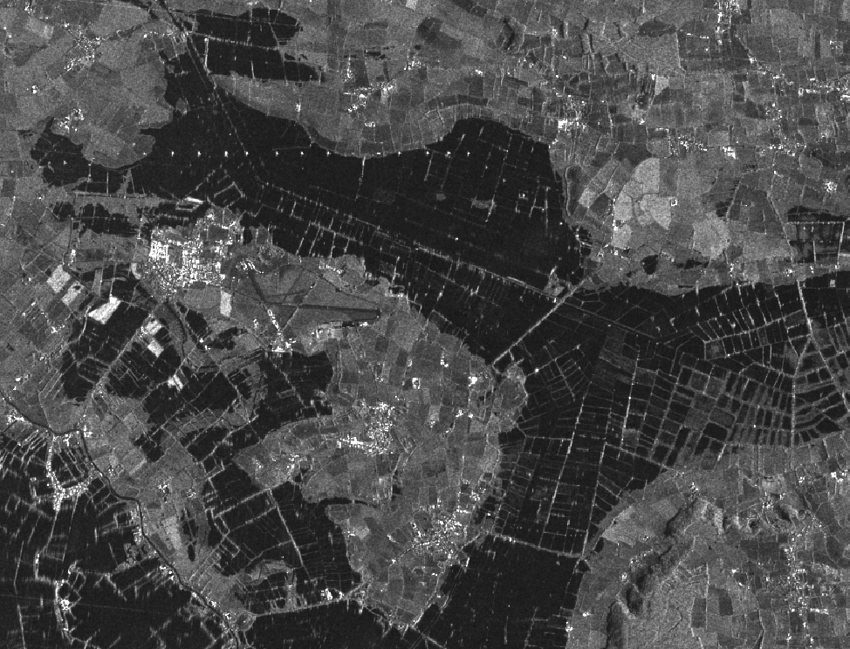
A zoomed in view showing extensive flooding around King’s Sedgemoor Drain. The white area towards the west is Westonzoyland

Slide 72
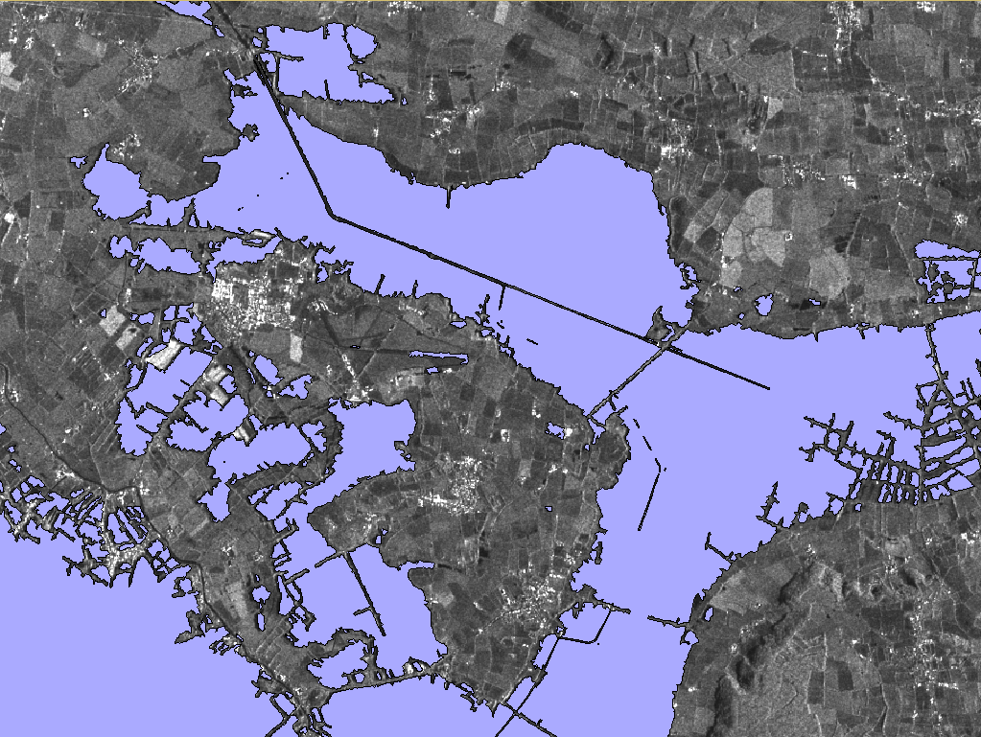
The same area, overlaid with the EA flood polygon, which is a very good fit to the flooded areas indicated by the satellite image

Slide 73
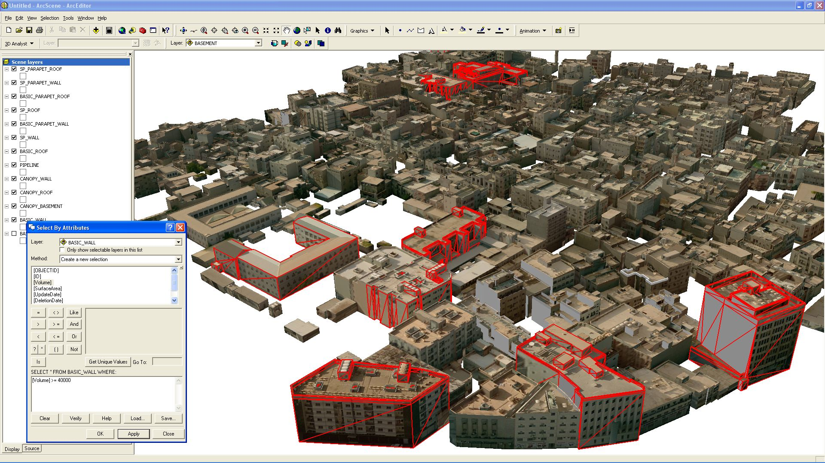
Authoritative Government Information

Slide 74
Detailed maps – a common citizen interface
Surrey Heath Council
Nearest pharmacies and bus stops to the council offices.

Slide 75
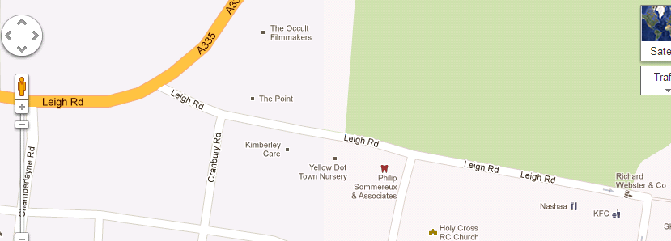
Just good enough…is not authoritative

Slide 76
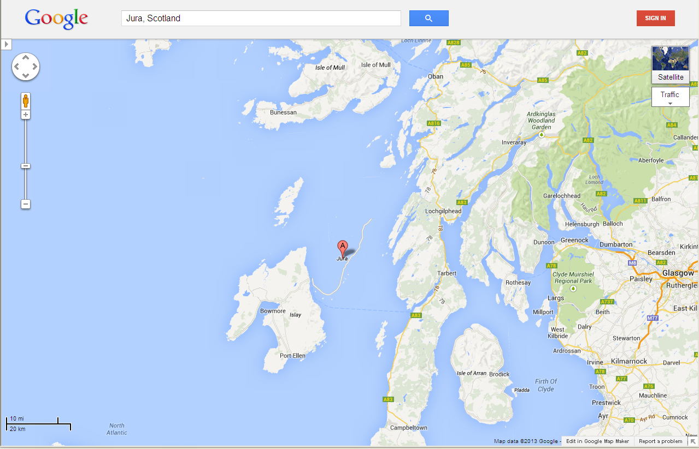
…Because accuracy matters

Slide 77
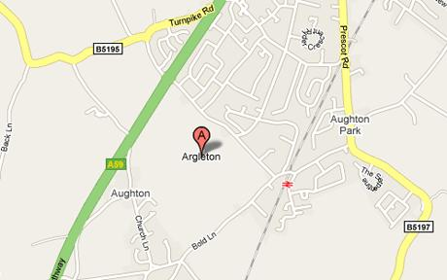

“Argleton” – the town which only appears online

Slide 78



Utility efficiencies by linking customer records to Assets to billing
What the asset department believes it supplies (blue)…
Who the billing department believes they are billing (green)…
Leaving those in red…
24

Slide 79

Northumbrian Water Limited – investing in GI
The return on investment is real and demonstrable and includes:
  • Additional income alone of well over £1m ($1,662,800) through improved management of empty properties.
  • A sustainable cut of at least £60,000 ($99,768) in operating costs through the call centre solve-at-source principle.
  • Significant savings in time and cost in the provision of timely and accurate asset information to field technicians.
Ian Donald, Customer Services Director concludes:
25

Slide 80

Location data underpins all data…
Everything happens somewhere
Bus routes
HVM
Road closures
Bus stops
Hotels
Traffic measures
Shuttle bus routes
Competition venues
Torch Relay route
Fleet depots
Road event routes
Airports
Training venues
UDAC
Venue stations
Cycle parking
Venue overlays
Look and feel
IBC/MPC
PnR
Transport hubs
Taxi stops
Broadcast compounds
Trade restrictions
Media hub
Spectator facilities
Cycle routes
Bus depots
Cultural sites
Last mile routes
Secure perimeters
Venue access points
Tourist information

Slide 81










Slide 82

Global Geospatial Information Management: assisting the vision for The Future we Want for All
Positioning geospatial information to address global challenges
Notes:
82

