Slide 1
CLGE
Working for a Profession
Jean-Yves Pirlot, CLGE President

Slide 2
Sustaining the Profession
Enhancing its
significance and relevance

Slide 3
Reasons to be here
The current FIG President
Presidency of a founding member
Presidency of CLGE
Honour past members and their feats
Prepare the professional future and have faith in the youth
Answer a challenging question asked by the organiser

Slide 4
Overview
Answer a challenging question asked by the organiser
Presidency of CLGE
Presidency of a founding member
Honour past members and their feats
Prepare the professional future and have faith in the youth
The current FIG President

Slide 5
FIG quote
“The Profession has key roles towards the betterment of society, environment and economy and must continue its march to the top, towards professional significance and relevance”

Slide 6
Other Professions
1.

Slide 7
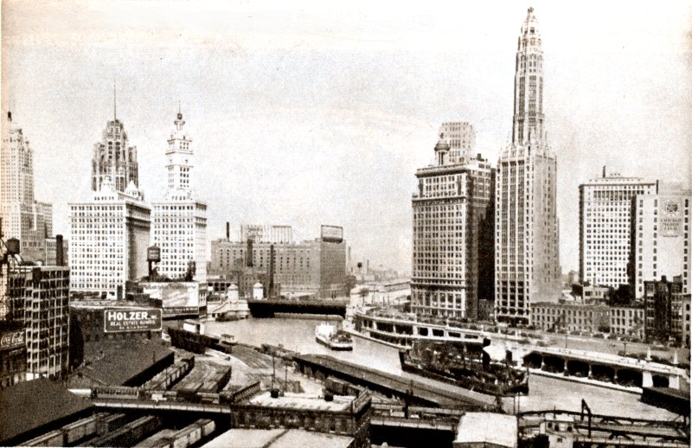


Slide 8

FIG

Slide 9
Other Professions
2.

Slide 10

Mars convention 5352

Slide 11

FID

Slide 12
Other Professions
3.

Slide 13
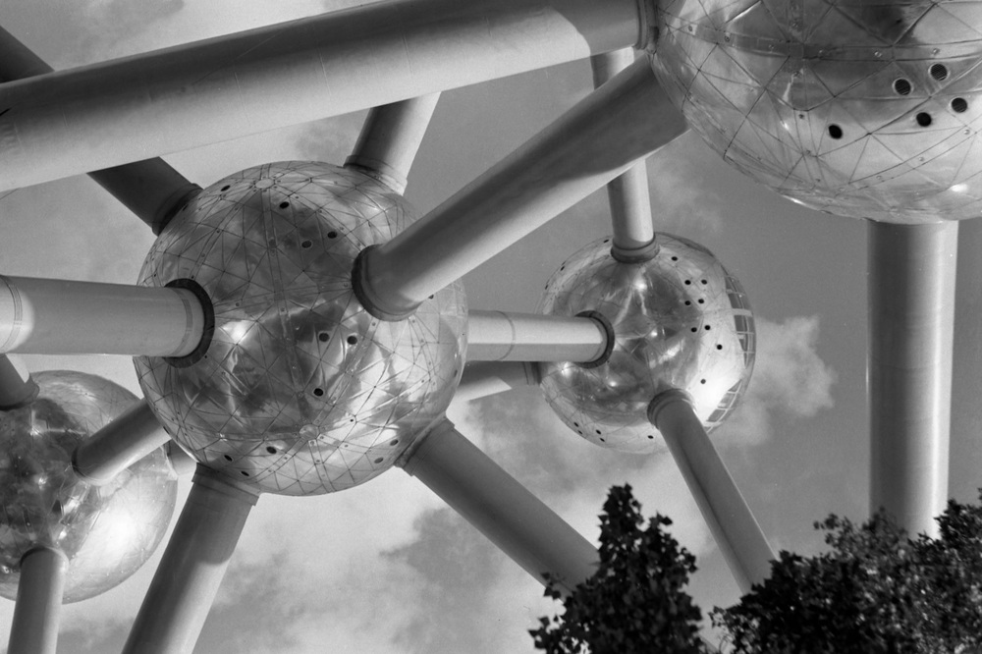

Slide 14
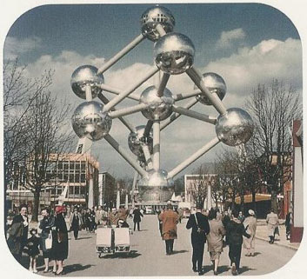
1958

Slide 15

FID

Slide 16
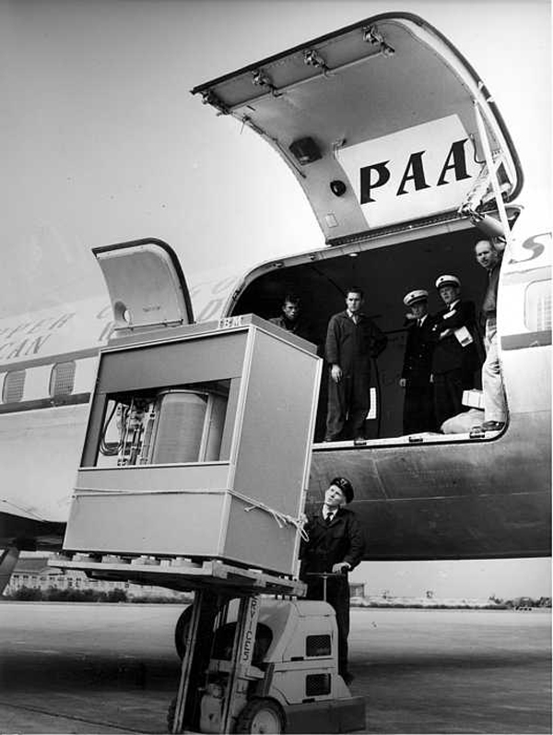
Evolution of Computers

Slide 17




Slide 18
Overview
Answer a challenging question asked by the organiser
Presidency of CLGE
Presidency of a founding member
Honour past members and their feats
Prepare the professional future and have faith in the youth
The current FIG President

Slide 19
Presentation of CLGE
Introduction
Our Strategy
Our Actions

Slide 20
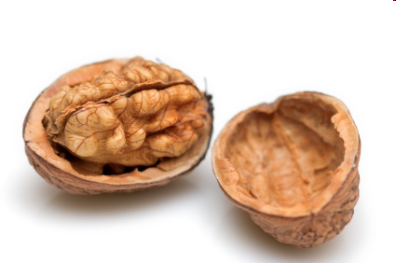


Slide 21
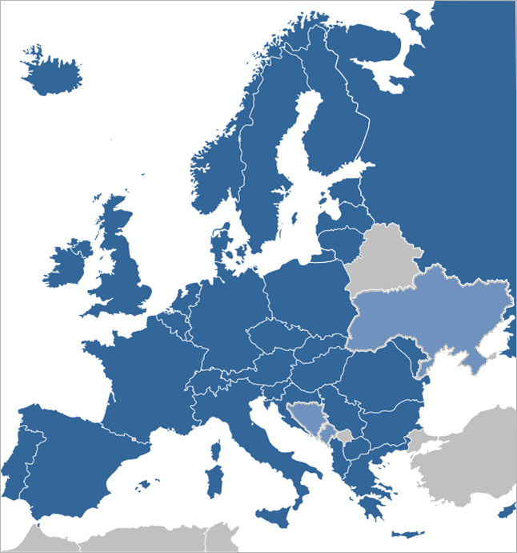
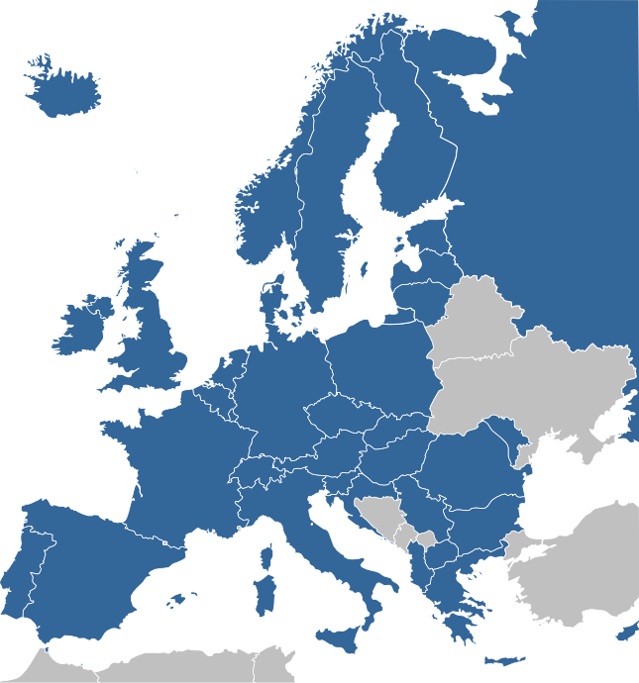
Leading Surveyors Association
36 Member countries
+ 3 Observing members
28 EU Members States
>> 100.000 Surveyors
Requires close cooperation
  FIG, YSEN, …
  PCC, EG, EuroGI, EGoS, …
  European Bodies
  National Associations
Notes:
Fees were related to number of surveyors.
Then we had about 30 000 surveyors.
Spain had 2000 surveyors more than probably not correct
Belgium had 800 surveyors probably not correct
In reality we know that Germany has about 20 000 surveyors
Italy has more than 100 000 members, of course not all active in the Surveying sector.
However 100 000 must be a good estimate.
Therefore we make a Dynamic Professional Knowledge Base.

Slide 22
One Profession
Regulated
Profession
Free Market
Civil
Servants
Publicly
Appointed

Slide 23
CLGE: a definition
CLGE is the leading representational body for the Surveying Profession in Europe.
- Promotes the Profession in the EU
- Fosters its development in the Council of Europe
Surveying includes Cadastral Surveying which provides security to land and property title and thus underlies the economic base of western society.
Geospatial Information is now ubiquitous in our lives and the Surveyor plays a fundamental role in this field.

Slide 24
CLGE: a definition
CLGE is the leading representational body for the Surveying Profession in Europe.
- Promotes the Profession in the EU
- Fosters its development in the Council of Europe
Surveying includes Cadastral Surveying which provides security to land and property title and thus underlies the economic base of western society.
Geospatial Information is now ubiquitous in our lives and the Surveyor plays a fundamental role in this field.

Slide 25
CLGE: a definition
The individual Surveyors spread over now 36 member states are the final and most important beneficiaries of our activities.
CLGE also pursues more general aims such as:
- the sustainable development;
- public and individual interests European Citizens.

Slide 26
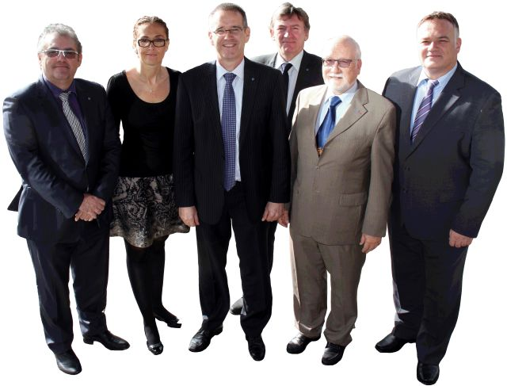
The Executive Board 2012 - 2014

Slide 27
Strategic Goals of CLGE
Take part in the legislative process governing the exercise of the Surveying Profession at the European and national levels;
Build a Professional image of the European of Surveyor, recognized by the national governments as well as the EU;
Motivate young surveyors to become active within their national associations and hence within CLGE;
Make sure that the CLGE members are satisfied with the performance of CLGE.
Notes:
Examples
We have answered the Green Paper on the revision of the Mutual Recognition of Professional Qualifications
We are launching a tender for the constitution of a Dynamic Professional Knowledge Base
We are involved in a students contest, promote students and trainees placements (Firs STEP), organize a Students Meeting in Hanover (invite Serbia to InterGEO)
We are working in a much more dynamic way than in the past with Workshops during our GA’s.

Slide 28
Strategic Goals of CLGE
Influence;
Visibility;
Renewal;
Members Satisfaction.

Slide 29
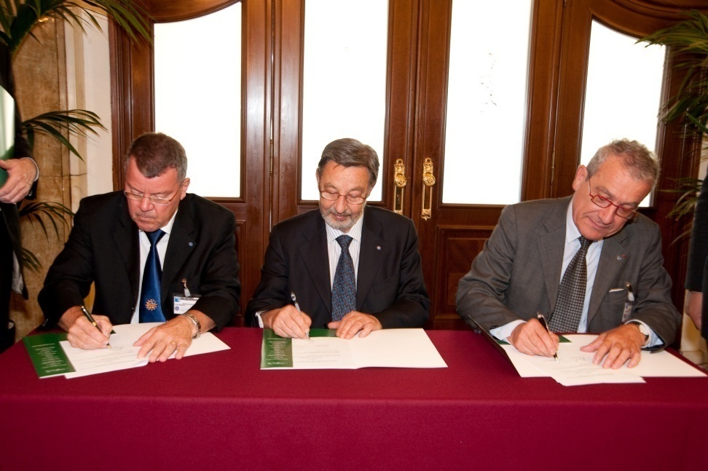
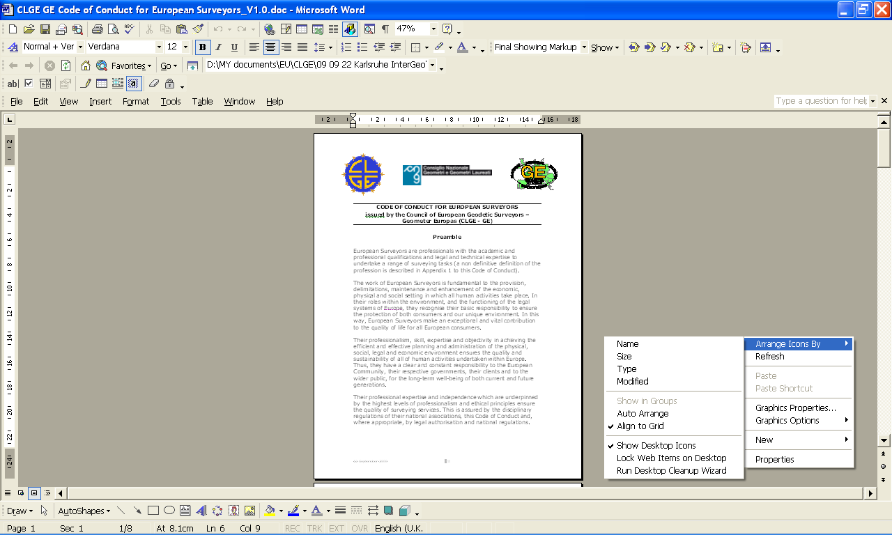
European Code of Conduct

Slide 30
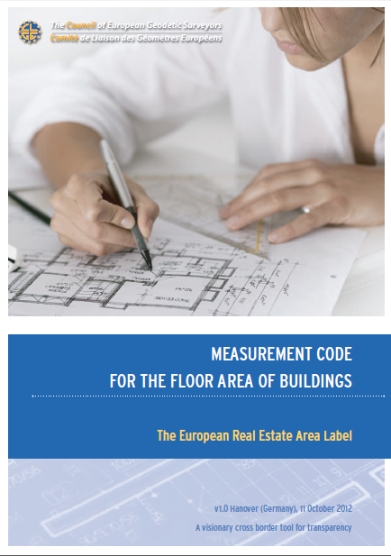
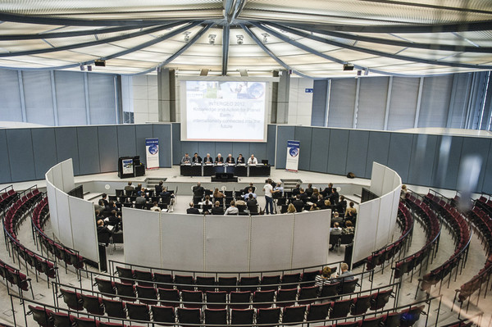
www.eureal.eu

Slide 31
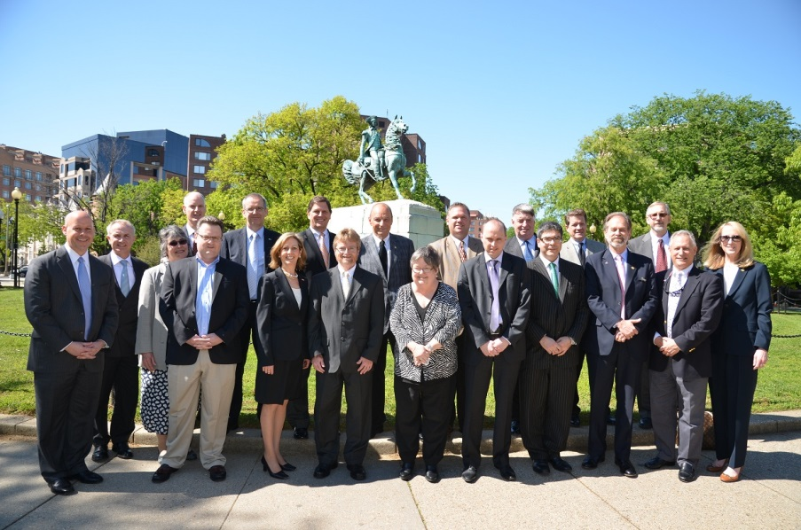
Global IPMS Coalition

Slide 32






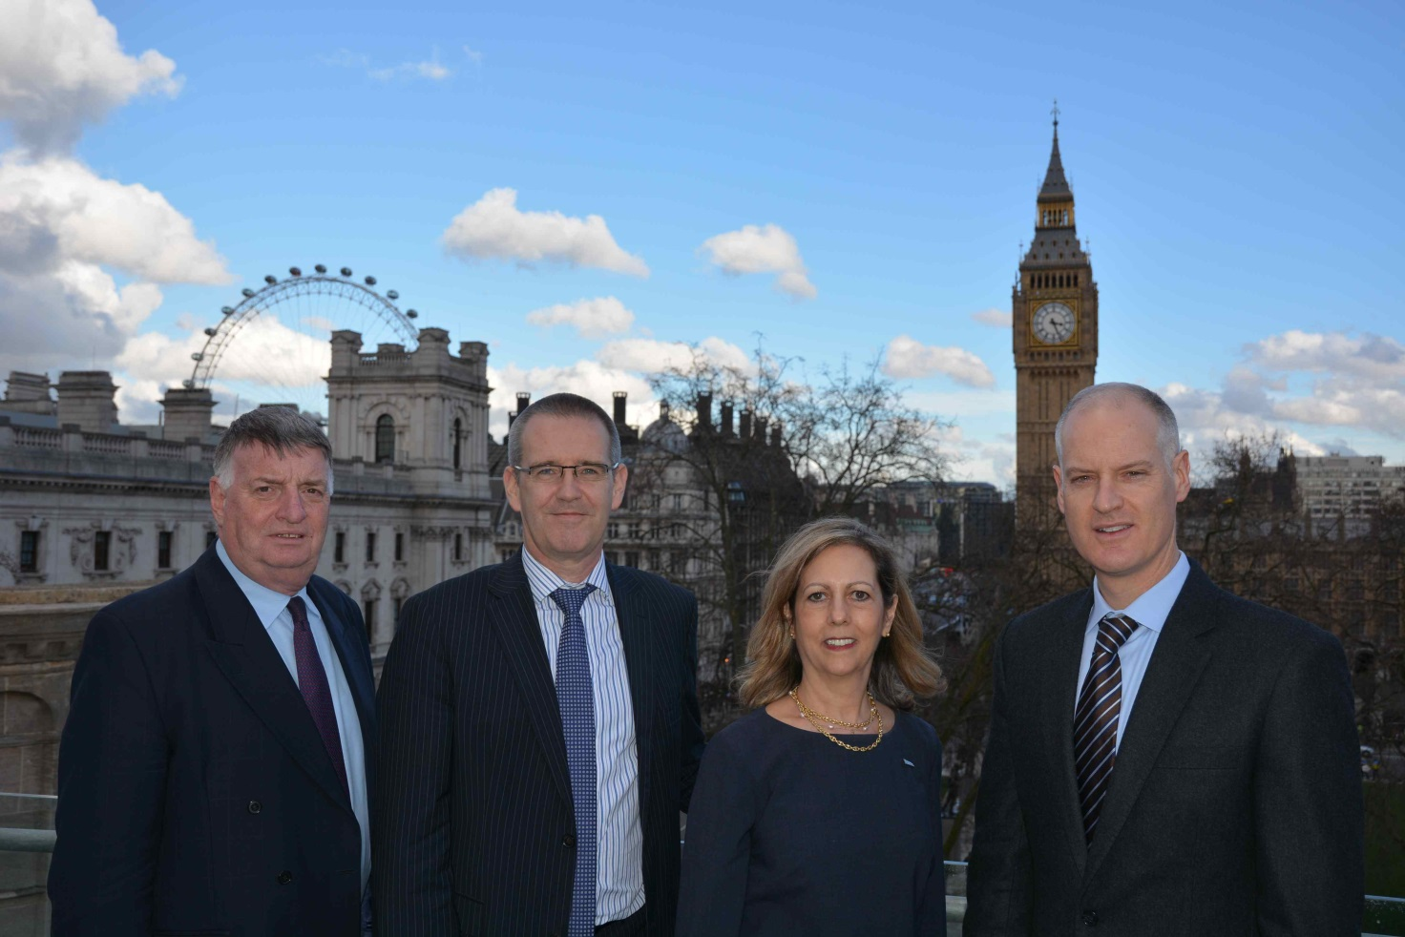


























Slide 33
Strategic Goals of CLGE
Influence;
Visibility;
Renewal;
Members Satisfaction.

Slide 34
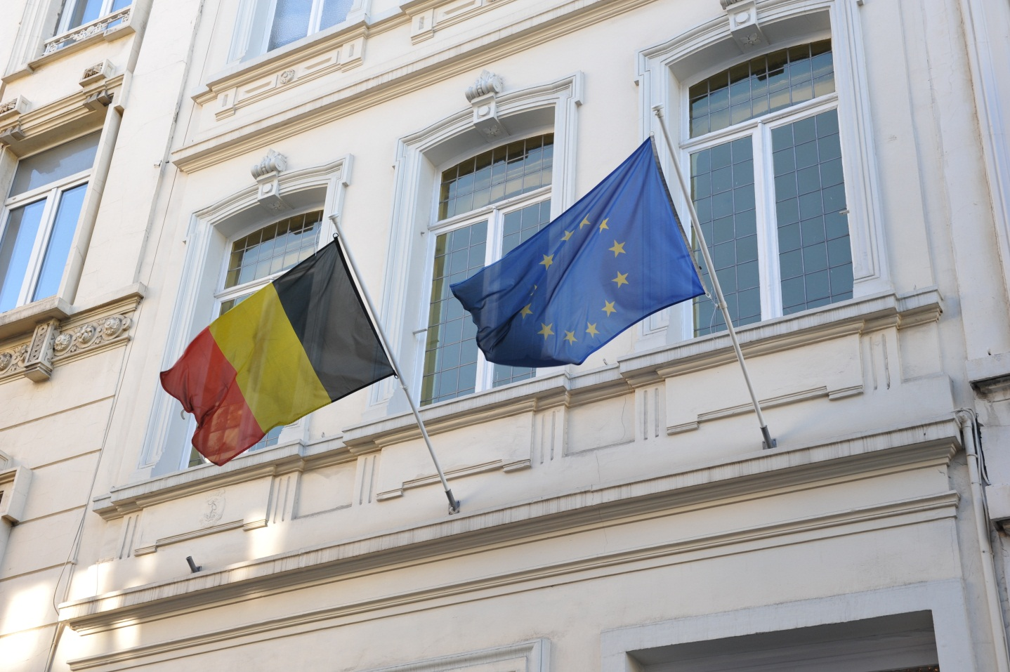






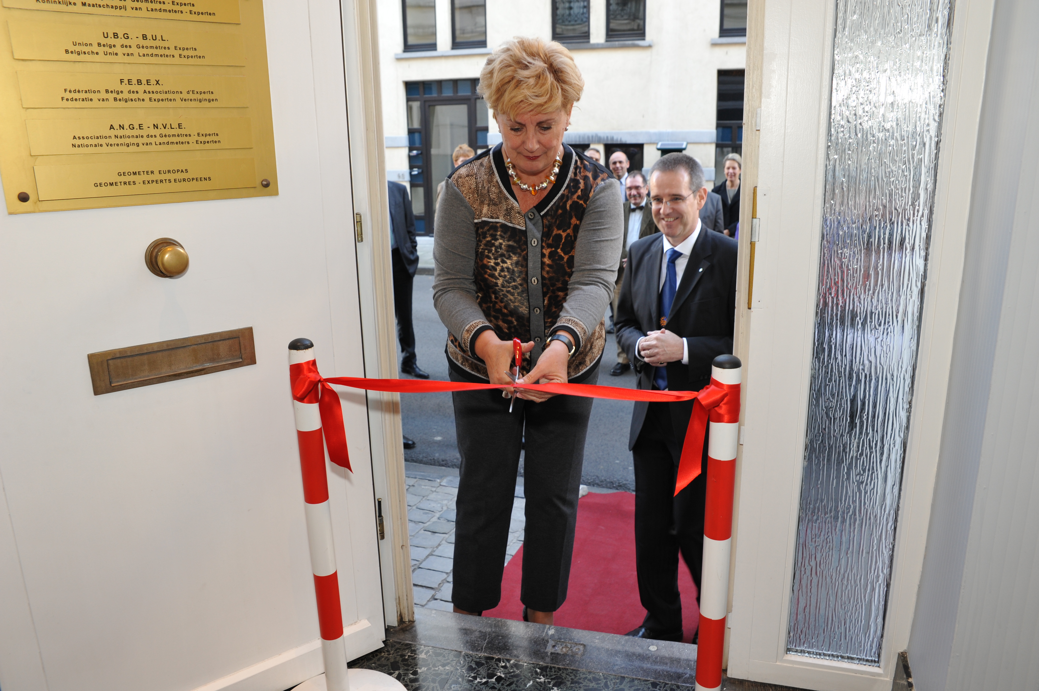
House of the European Surveyor and GeoInformation in Brussels

Slide 35
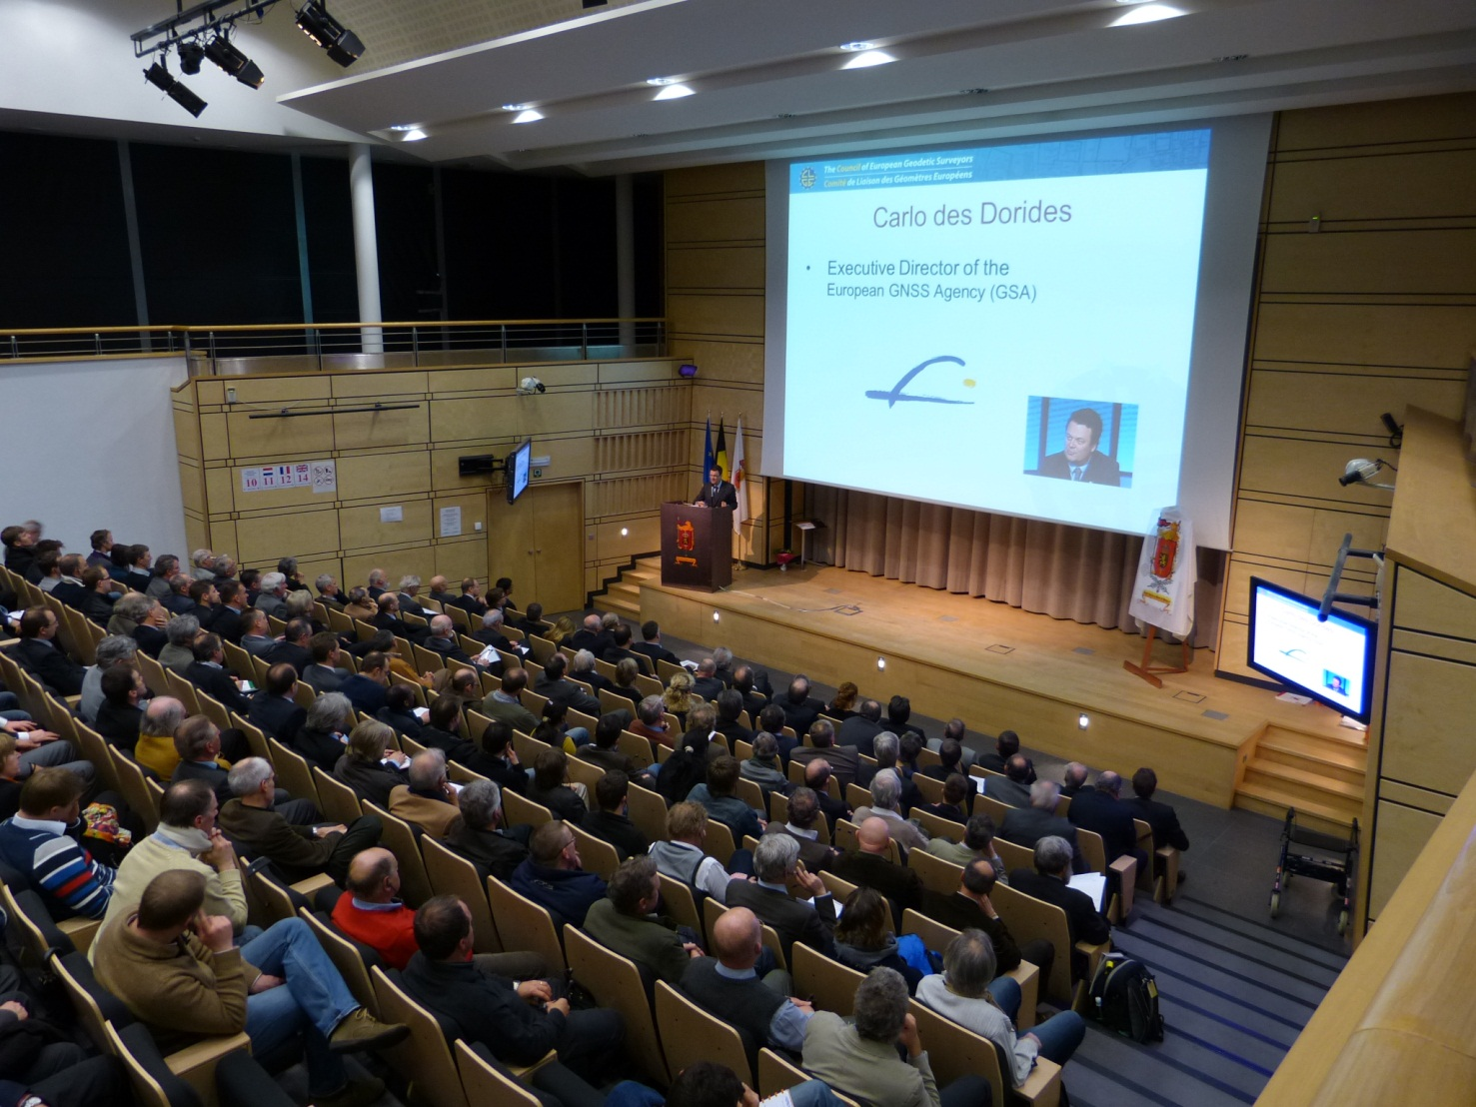
GSA & CLGE hand in hand

Slide 36
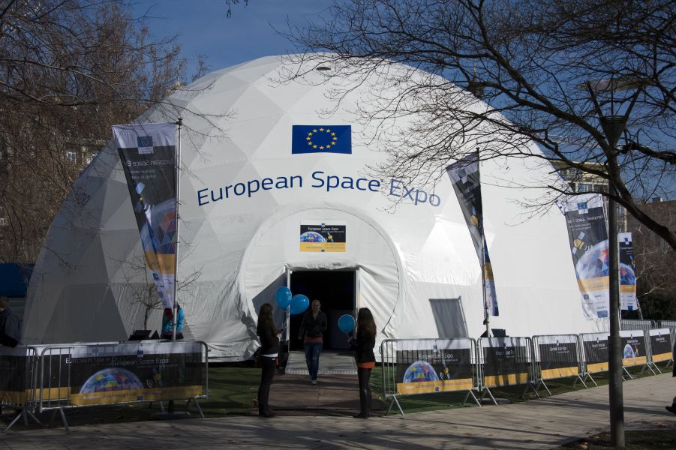

The European Space Expo moves to Budapest

Slide 37

www.BlueParking.eu
(GNSS surveys to map P for disabled people)

Slide 38



Slide 39

Exclusive Sponsor
European Surveyor of the Year
Day of the European Surveyor and GI

Slide 41

Of
Day
the
European
Galileo
Galilee
&GI
Surveyor
Day

Slide 42
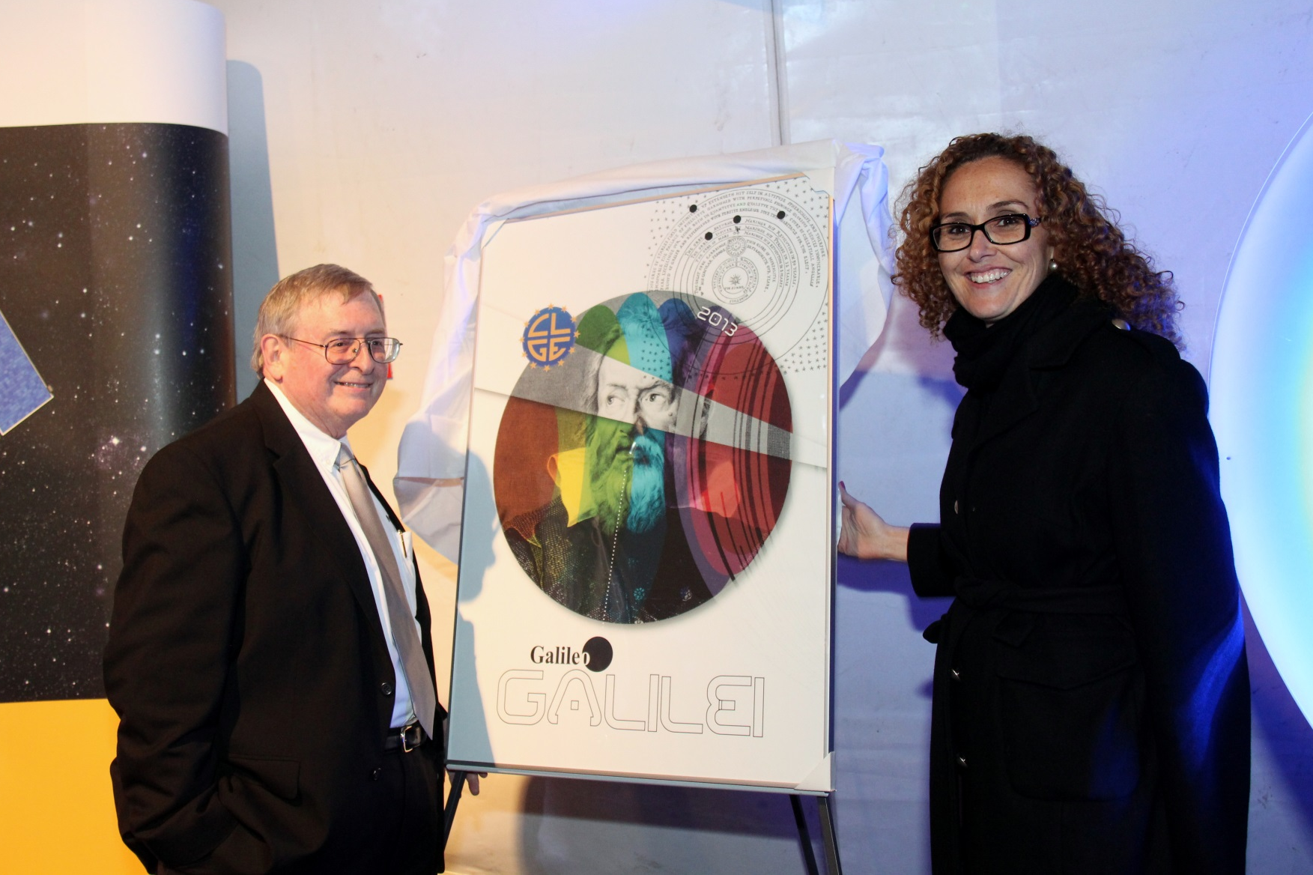

Slide 43
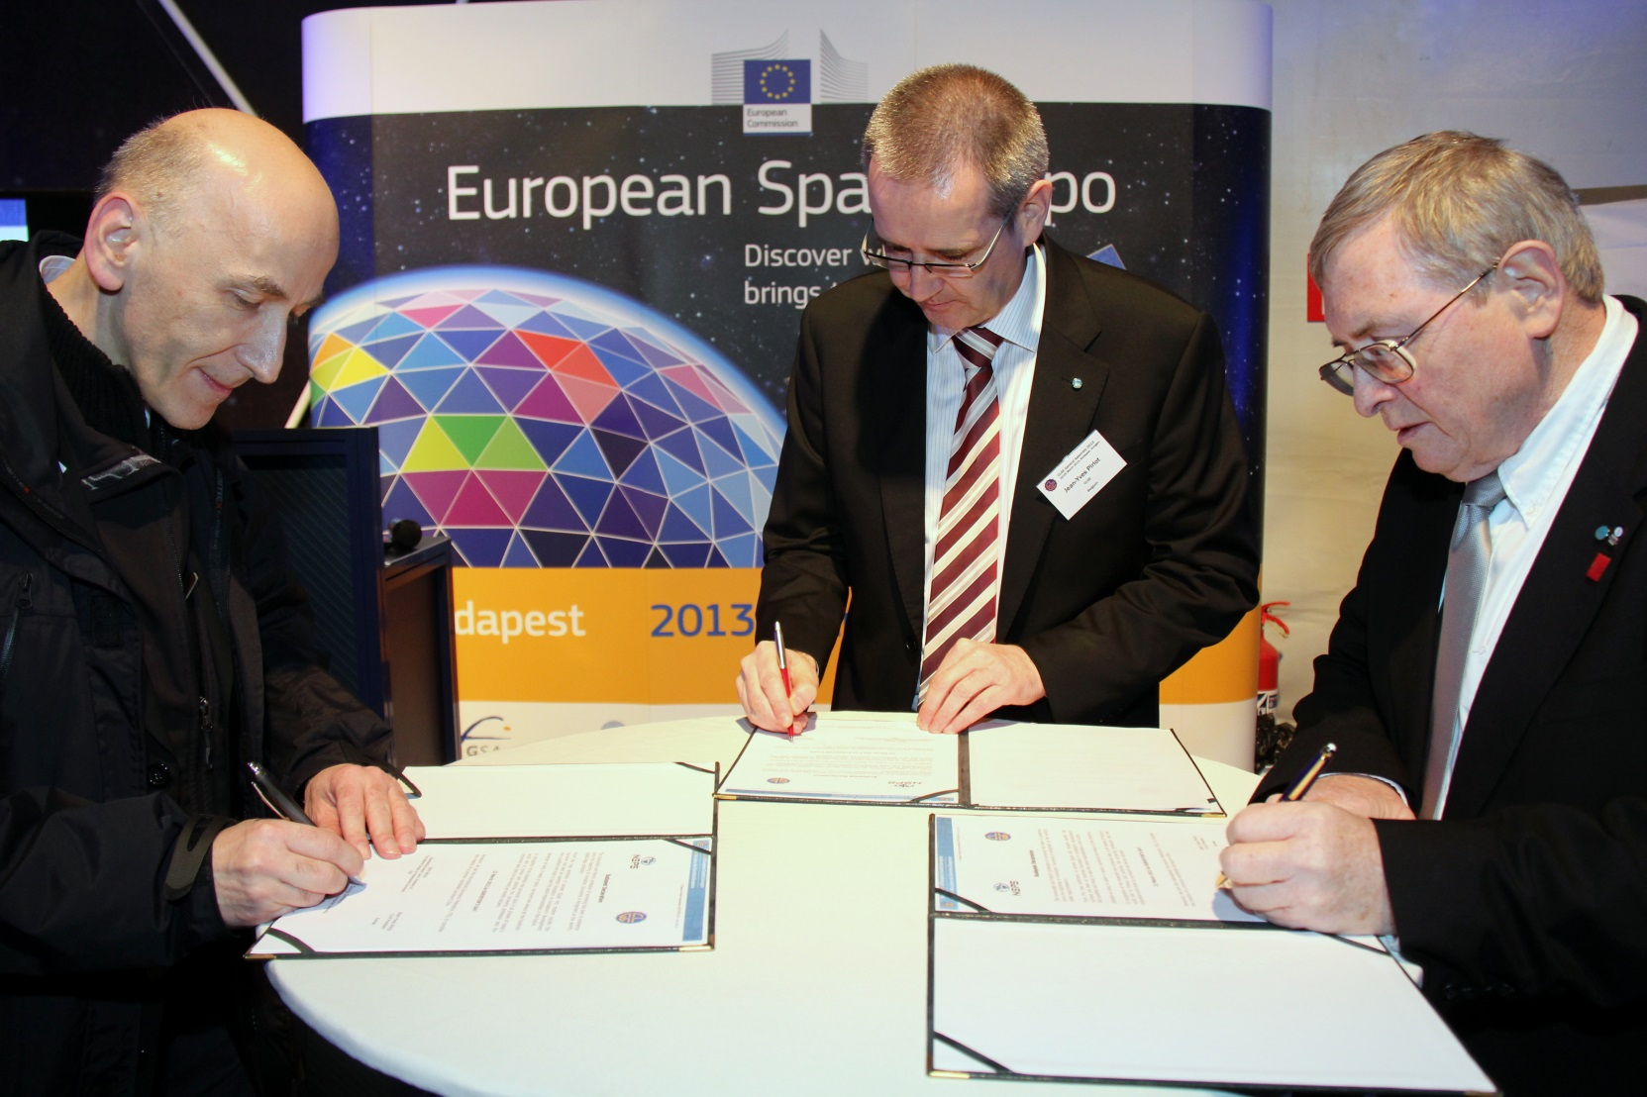
Budapest Declaration

Slide 44
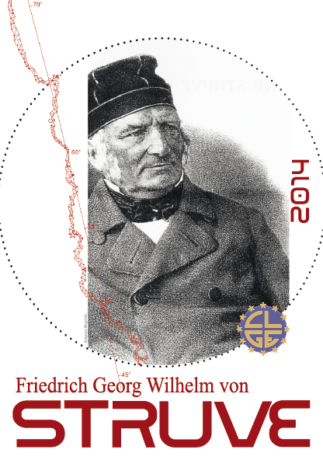
Of
Day
the
European
von
Struve
&GI
Surveyor
Year

Slide 45

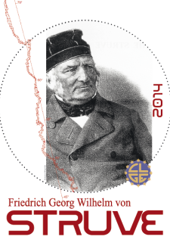

Slide 46
Strategic Goals: Renewal
Motivate young surveyors to become active within their national associations and hence within CLGE

Slide 47
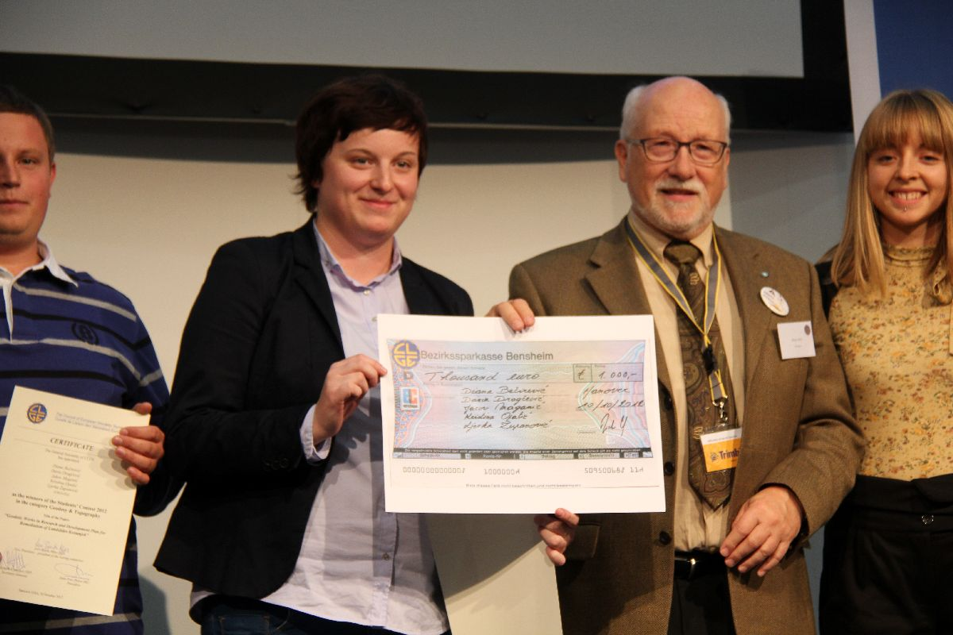
CLGE Students’ Contest & Meeting
Notes:
Constantin Gisca

Slide 48


Slide 49
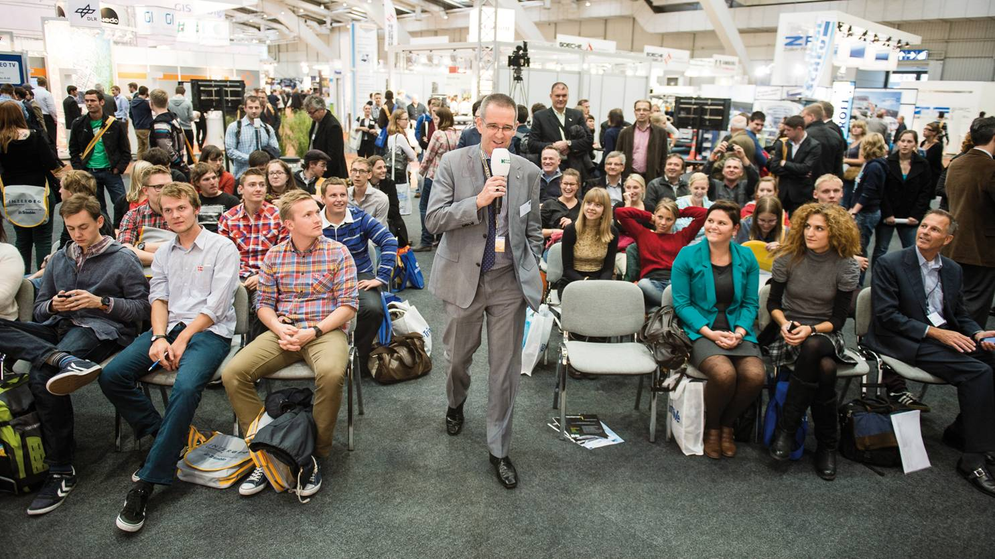
CLGE Students’ Contest & Meeting
YSEN Meeting
INTERGEO 2014!
07 - 09 October

Slide 50
Strategic Goals: Satisfaction
Make sure that the CLGE members are satisfied with our performance
Notes:
Examples
We have answered the Green Paper on the revision of the Mutual Recognition of Professional Qualifications
We are launching a tender for the constitution of a Dynamic Professional Knowledge Base
We are involved in a students contest, promote students and trainees placements (Firs STEP), organize a Students Meeting in Hanover (invite Serbia to InterGEO)
We are working in a much more dynamic way than in the past with Workshops during our GA’s.

Slide 51
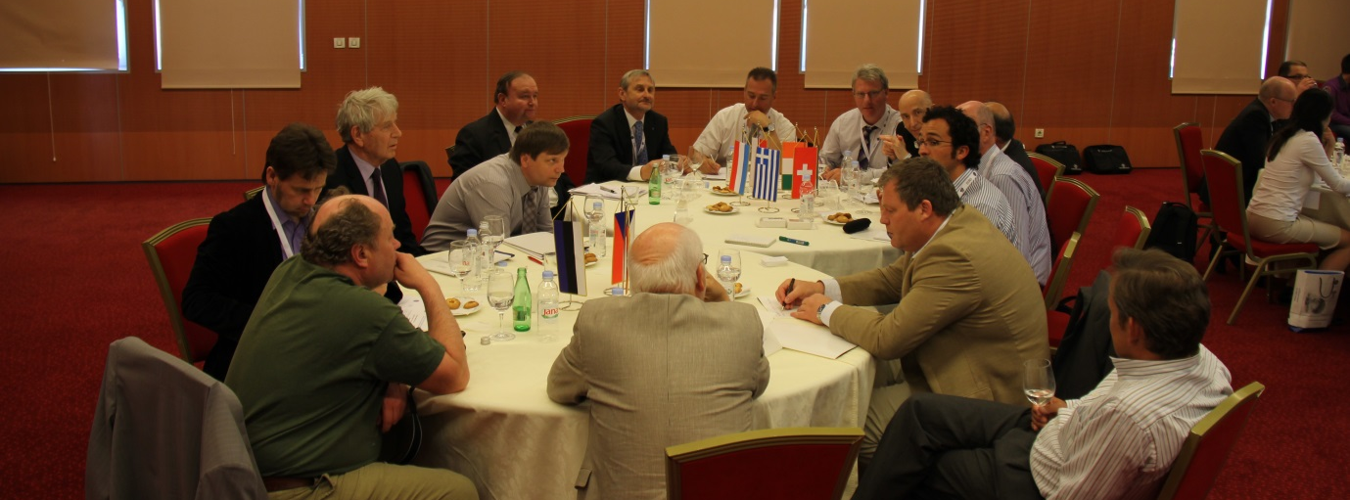
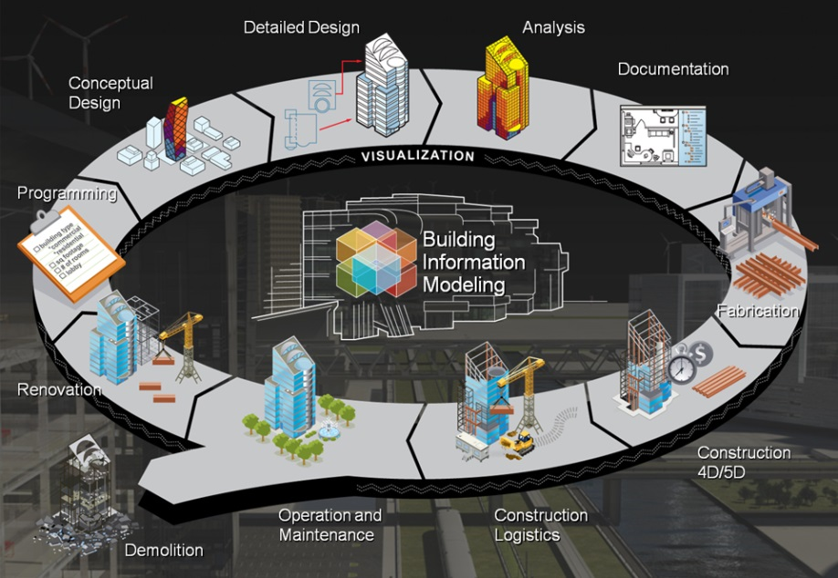
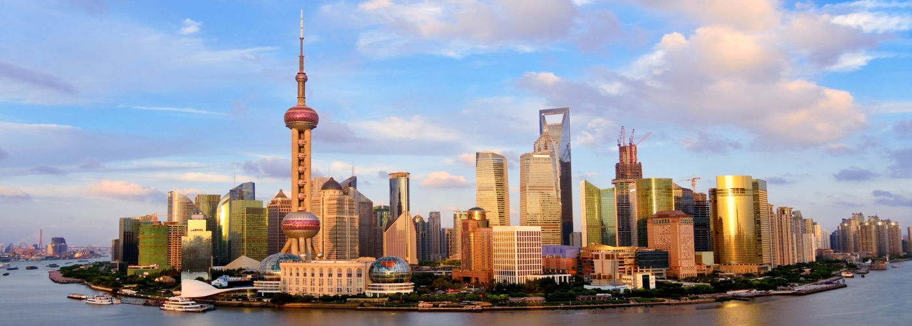
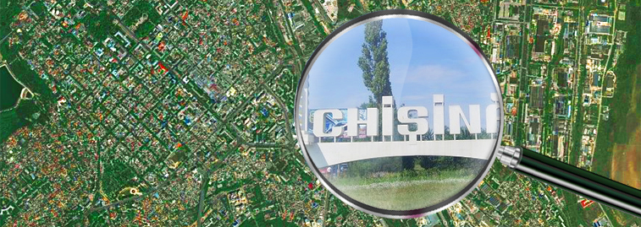
Introduction of WorkShops

Slide 52
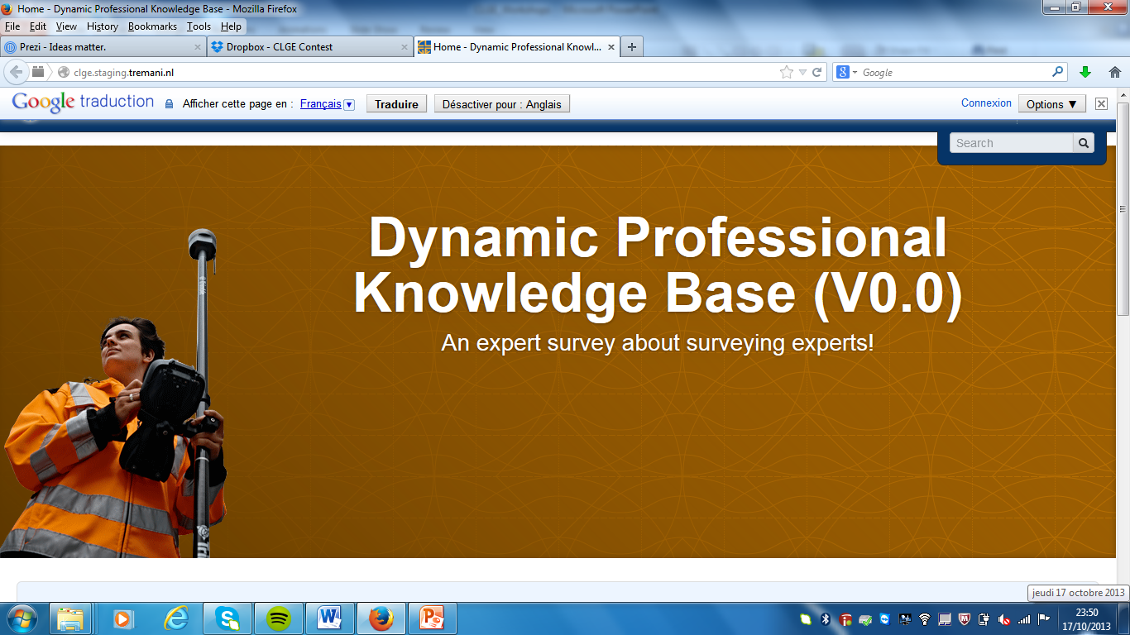
DPKB

Slide 53
Aims of the DPKB
Explain and promote our profession to the European Bodies
Guide the individual Surveyors
Information source and decision tool for our Stakeholders and Partners
  European institutions
  National Organisations (best practices)
  PCC, EuroGeographics, …

Slide 54
Structure
Comprehensive collection of relevant information about the profession in all CLGE member countries
Incorporates existing information after validity check
Regularly updated, with permanent quality assessment

Slide 55
Key Elements
National legal framework
Fields of activity
Professional recognition
Public appointment
Education programmes
Statistical data / economical data
Other relevant information

Slide 56
GeoInformatics

Slide 57
www.geoinformatics.com/CLGE
Twitter: CLGEPresident and _CLGE

Slide 58
Overview
Answer a challenging question asked by the organiser
Presidency of CLGE
Presidency of a founding member
Honour past members and their feats
Prepare the professional future and have faith in the youth
The current FIG President

Slide 59
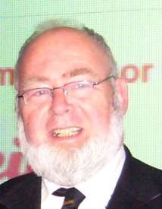
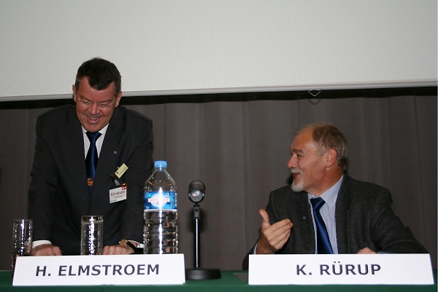
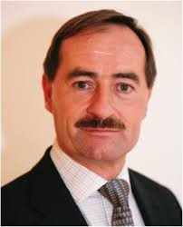
Past – CLGE Presidents
Only some of them
Steel, Riemersma, Van der Linden…

Slide 60
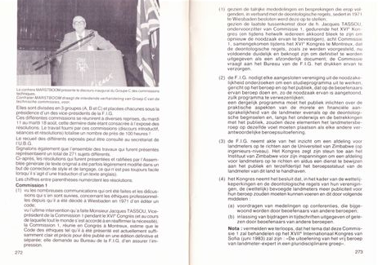

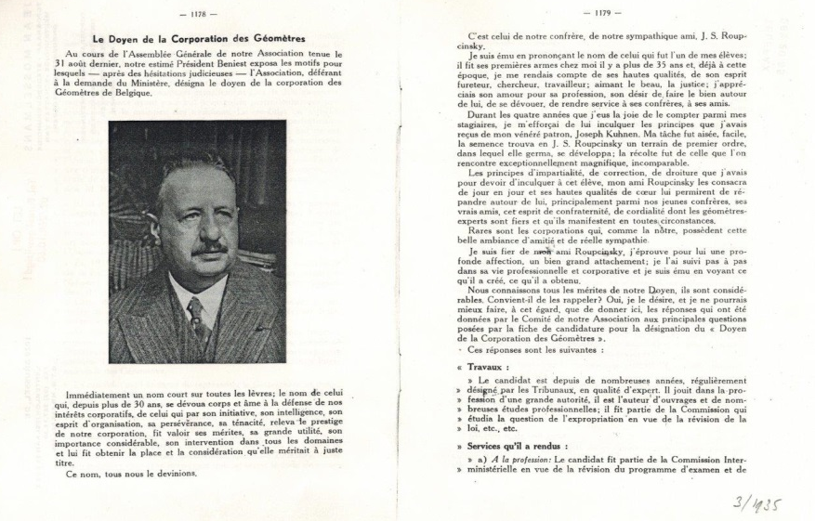
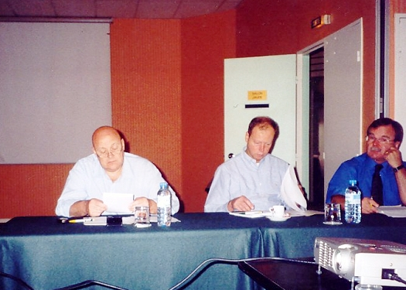
Belgians who’ve shaped FIG

Slide 61
Overview
Answer a challenging question asked by the organiser
Presidency of CLGE
Presidency of a founding member
Honour past members and their feats
Prepare the professional future and have faith in the youth
The current FIG President

Slide 62
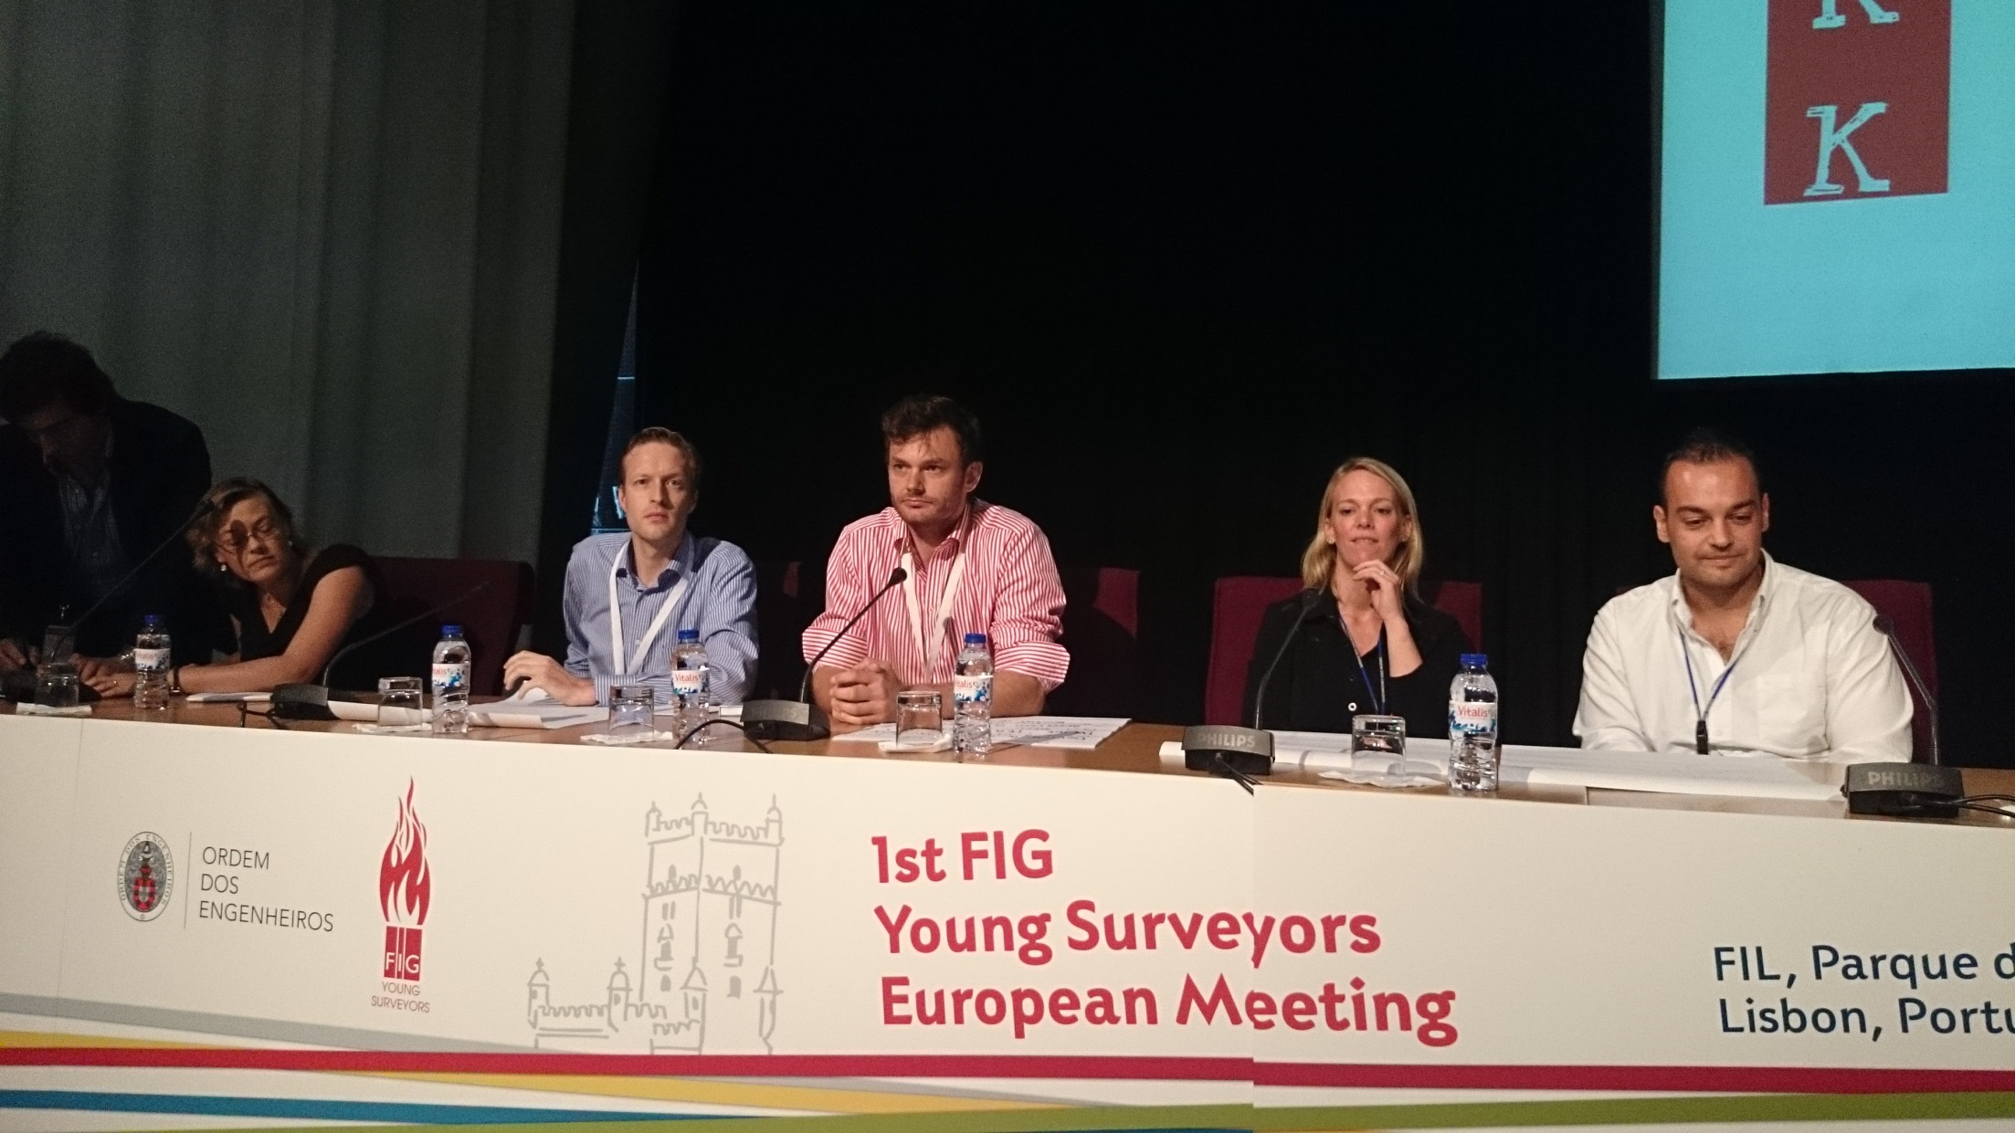
Developing a YSEN (FIG YSN)
Notes:
Constantin Gisca

Slide 63
Sustaining the Profession
With the risk of Carrying Coals to Newcastle …

Slide 65
Of course, we’re no gangsters…
Be Honest
Seem Honest
Code of Conduct

Slide 66
What dentists teach us …
Have a strong initial Education
Training (crucial tasks)
High level CPD

Slide 67
Let’s avoid the Typewriters Trap
Surveyor Data Capturer
Surveyor Data Manager
Surveyor Data Guarantor

Slide 68
Overview
Answer a challenging question asked by the organiser
Presidency of CLGE
Presidency of a founding member
Honour past members and their feats
Prepare the professional future and have faith in the youth
The current FIG President

Slide 69
Strategic Goals of CLGE
Influence;
Visibility;
Renewal;
Members Satisfaction.

Slide 70
Cooperation FIG & CLGE
Influence;
Visibility;
Renewal;
Members Satisfaction.

Slide 71
Cooperation FIG & CLGE
Influence
  Strong cooperation for these stepping stones (ethics, education, evolution)
  Think Globally, Act Locally
    Bilateral MoU’s
    Council of Regional Bodies

Slide 72
Cooperation FIG & CLGE
Visibility
  National Surveyors Week USA
  Day of the European Surveyor
  FIG Surveyors Day!

Slide 73
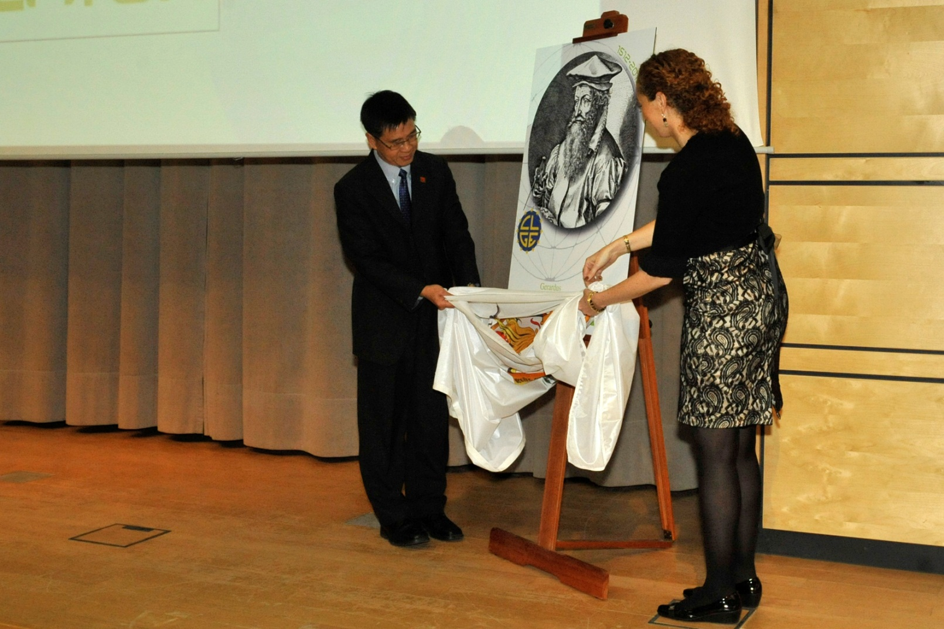
CheeHai TEO, FIG President

Slide 74
Cooperation FIG & CLGE
Renewal
  Continued support to the FIG YSN
  Continued support to the FIG YSEN

Slide 75
Cooperation FIG & CLGE
Influence;
Visibility;
Renewal;
Members Satisfaction.

Slide 76
We have to remember…
… that we are active in a profession that allows people to realize one of their dearest dreams:
Surveying is a DREAM SECTOR
… to become and stay
and happy Real Estate Owner

Slide 77
Terima kasih untuk penjagaan anda.
Apa-apa Soalan?
Thank you for your Attention.
Any Questions?

