Slide 1
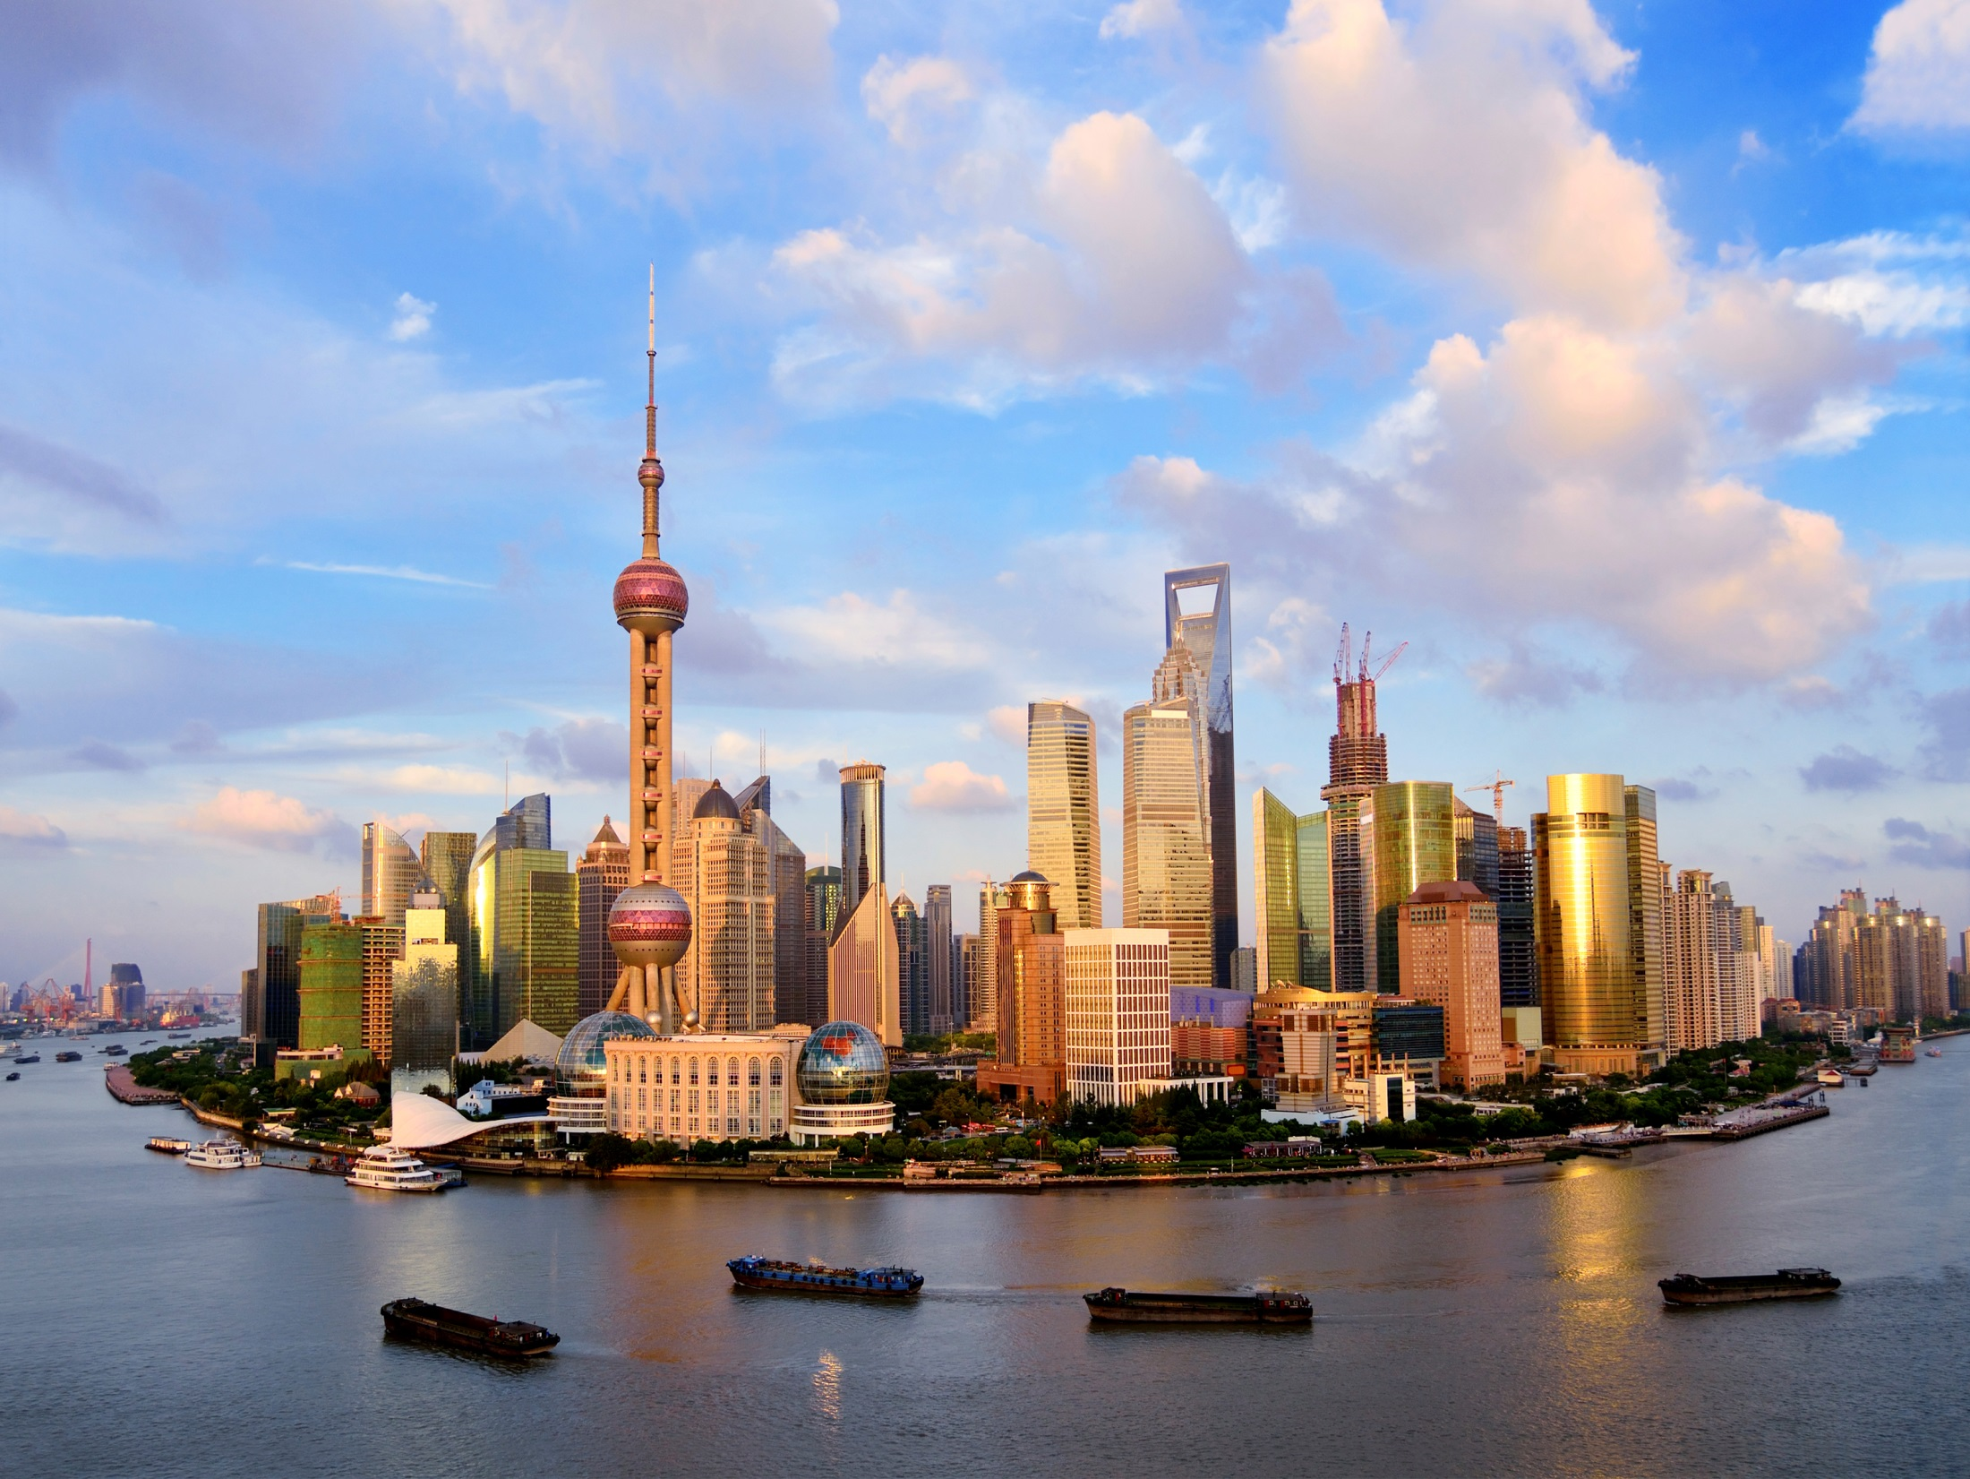
International Property Measurement Standards (IPMS)
Ben Elder
RICS Global Director of Valuation & EQS
FIG June 2014 KL Malaysia

Slide 2
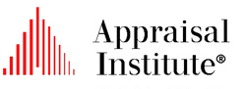














International Property Measurement Standards Coalition (IPMSC):
By the profession; for the profession
Professional members in more than 150 countries
Public interest mandate
Nominated Standards Setting Committee
Guardians of IPMS
Notes:
In Washington, the IPMSC was established by 13 organisations.
They agreed to develop and implement a common international standard for measuring property, starting with offices.
2

Slide 3
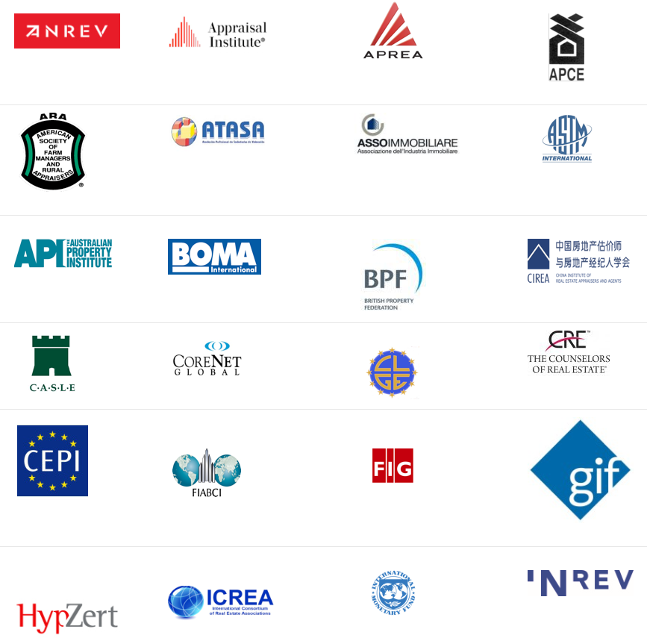

Notes:
Since the Washington meeting the Coalition has grown to 36 organisations (at April 2014)
More are joining all the time and all have committed to implement IPMS within their organisation when it launches in June 2014

Slide 4
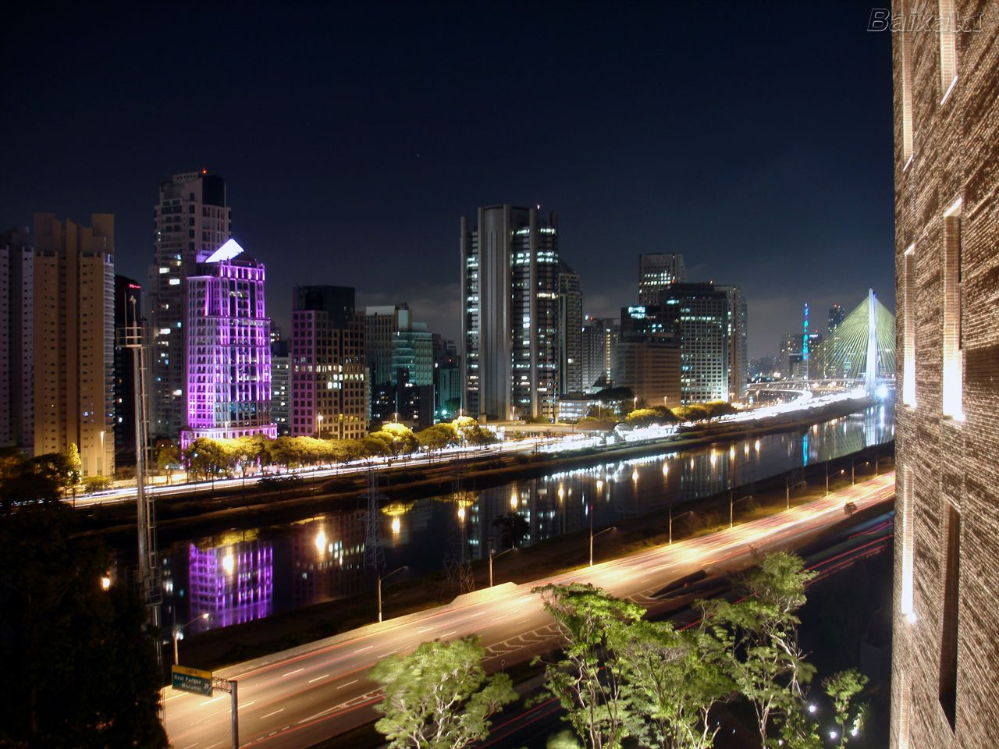
Why is a vibrant property profession important to society?
60% of a nations wealth
60% of all utilised materials used in Construction
60% of energy used on heating and servicing buildings
40% of carbon emissions emitted from Buildings
10% of workforce employed in the sector

Slide 5
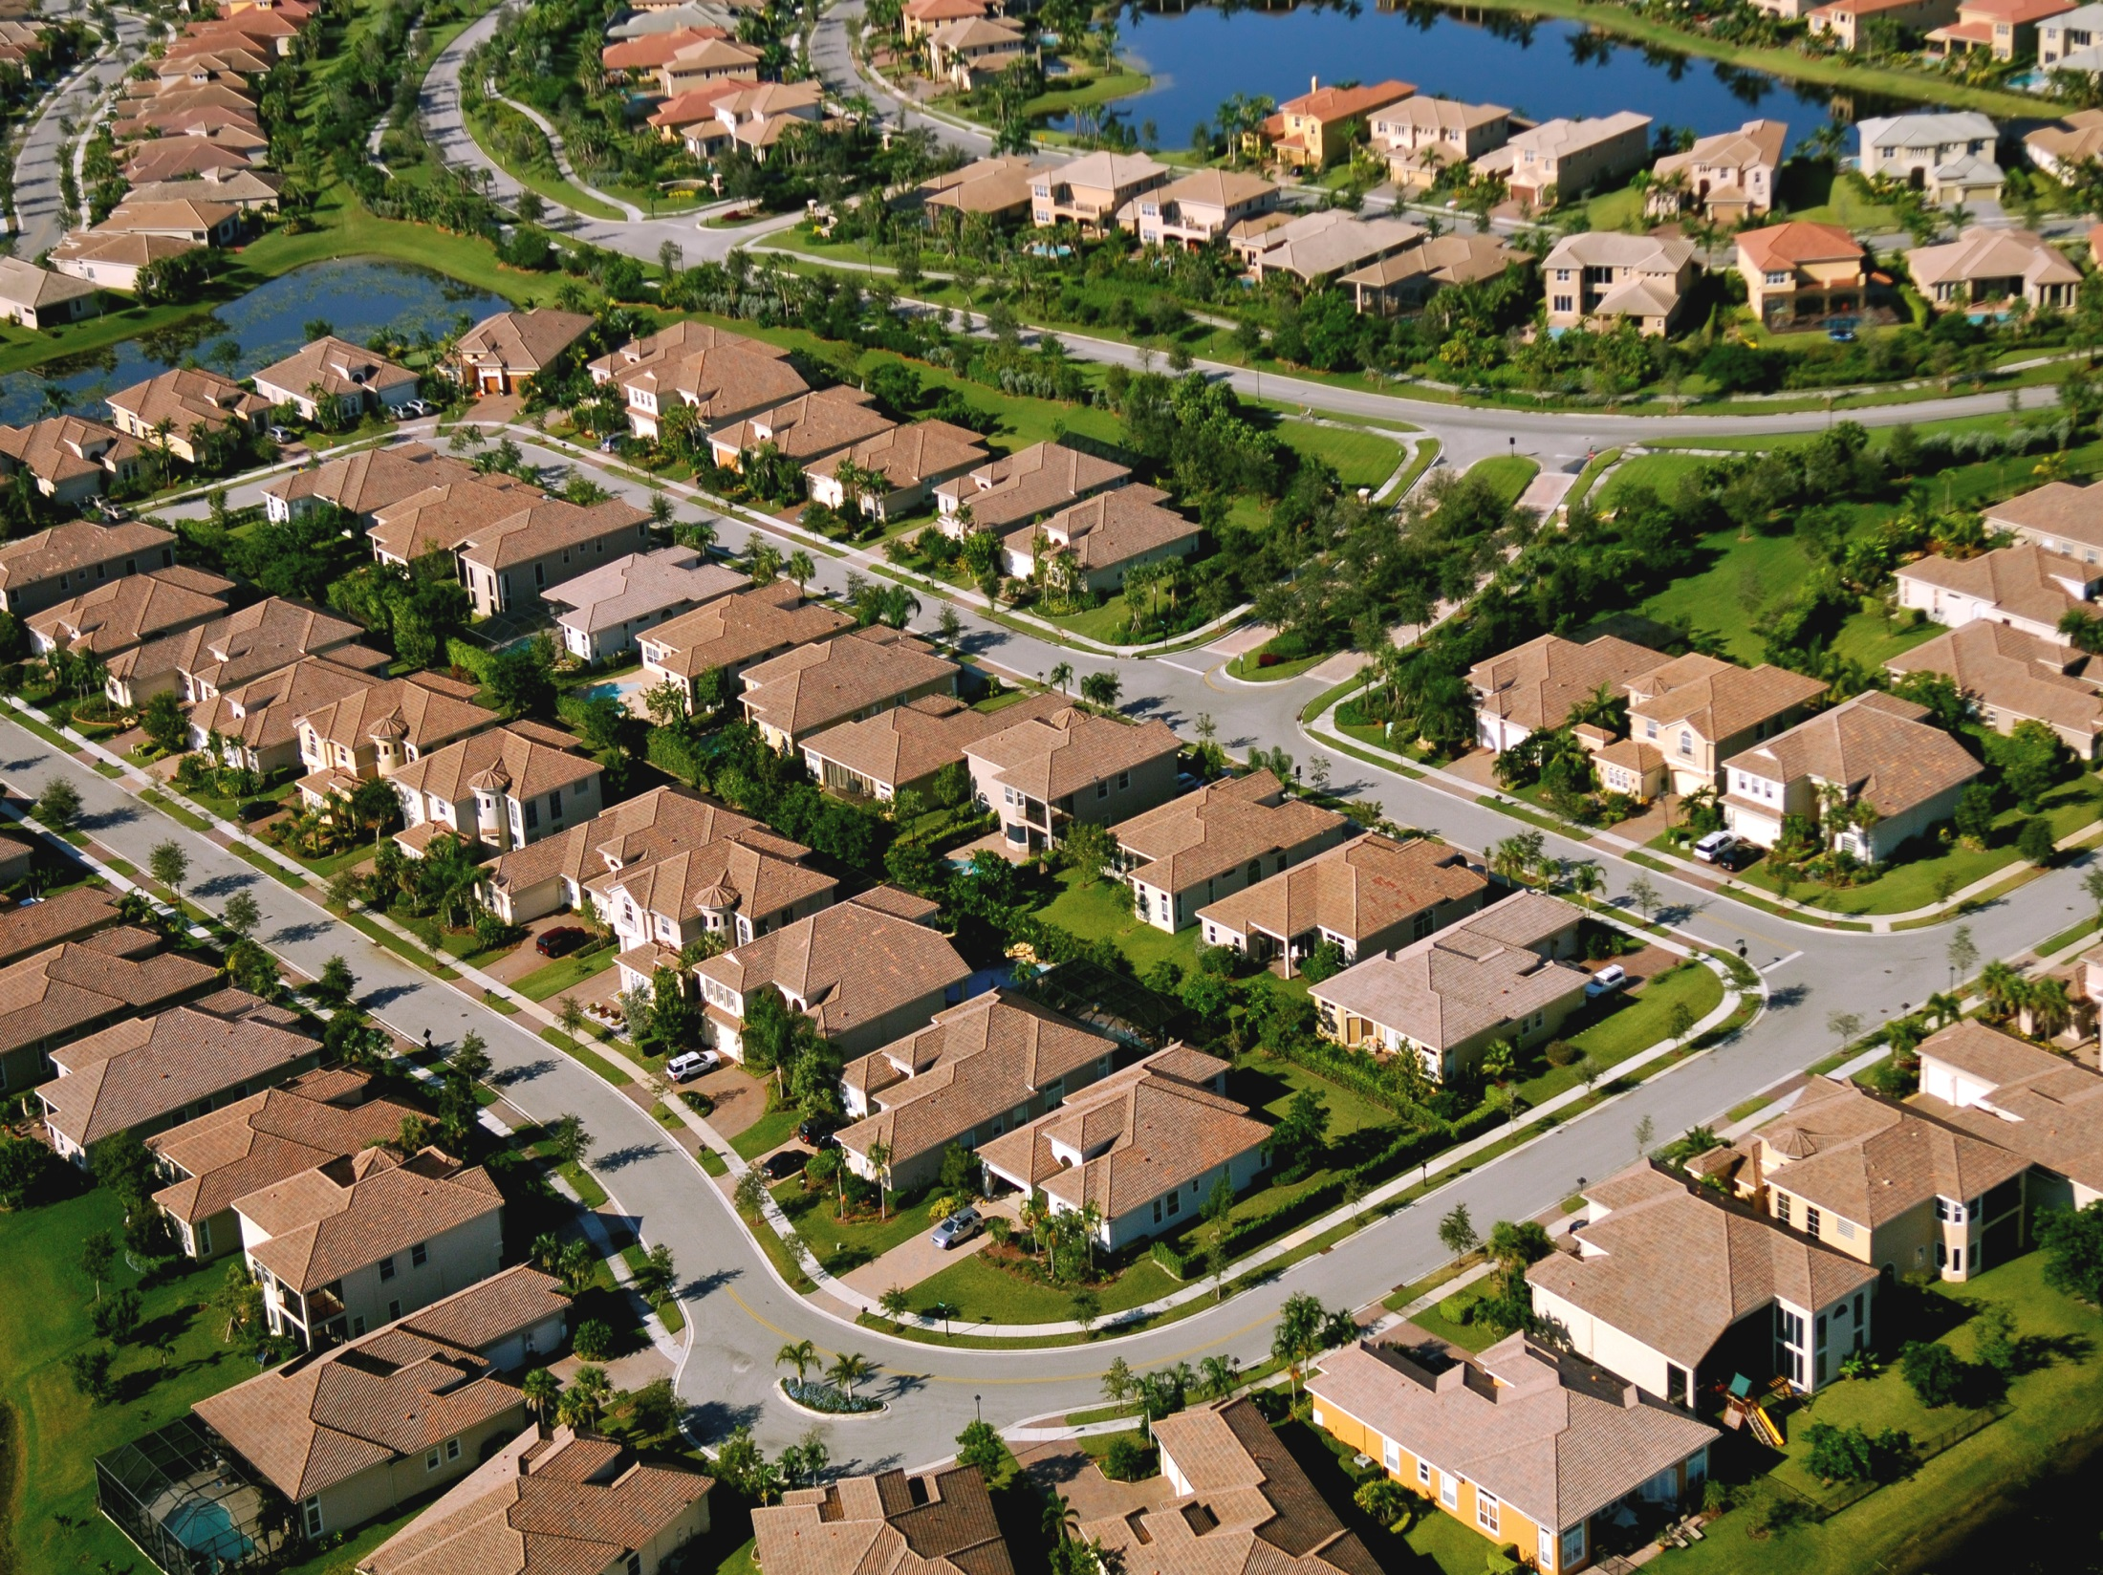
Why is property measurement so important?
Sound measurement is fundamental to property markets
It underpins decisions made by all property users
It provides a tool for comparison
Notes:
The importance of measurement:
Space measurement is vital. It acts as a basis for:
- Valuation
- Occupation / building use
- Investment
- Financial reporting
- Public confidence
Not referring to units of measurement (feet/meters) but to the standard or methodology used to conduct a space measurement. What is included in a measurement.
Measurements of space provides a use with a tool for comparison and enabled us to use space (as an occupier or an investor, for example) appropriately.

Slide 6

Markets
Allocate scare resources
  Highest and best use
Markets operate on information
  Information is imperfect
  Information v knowledge
  Knowledge reduces risk and increases productivity
Balance between ‘market’ and ‘regulation’
belder@rics.org
www.rics.org

Slide 7
Hernando De Soto –
“The mystery of capital”
Capital Creation–
“Capital is not created by money; it is created by people whose property systems help them to cooperate and think about how they can get assets they accumulate to deploy additional production”
belder@rics.org
www.rics.org

Slide 8
Hernando De Soto –
“The mystery of capital”
Fungiability
“If standard descriptions of assets were not readily available, anyone who wanted to buy, rent or give credit against an asset would have to expend enormous resources comparing and evaluating it against other assets- which would also lack standard descriptions.”
belder@rics.org
www.rics.org

Slide 9
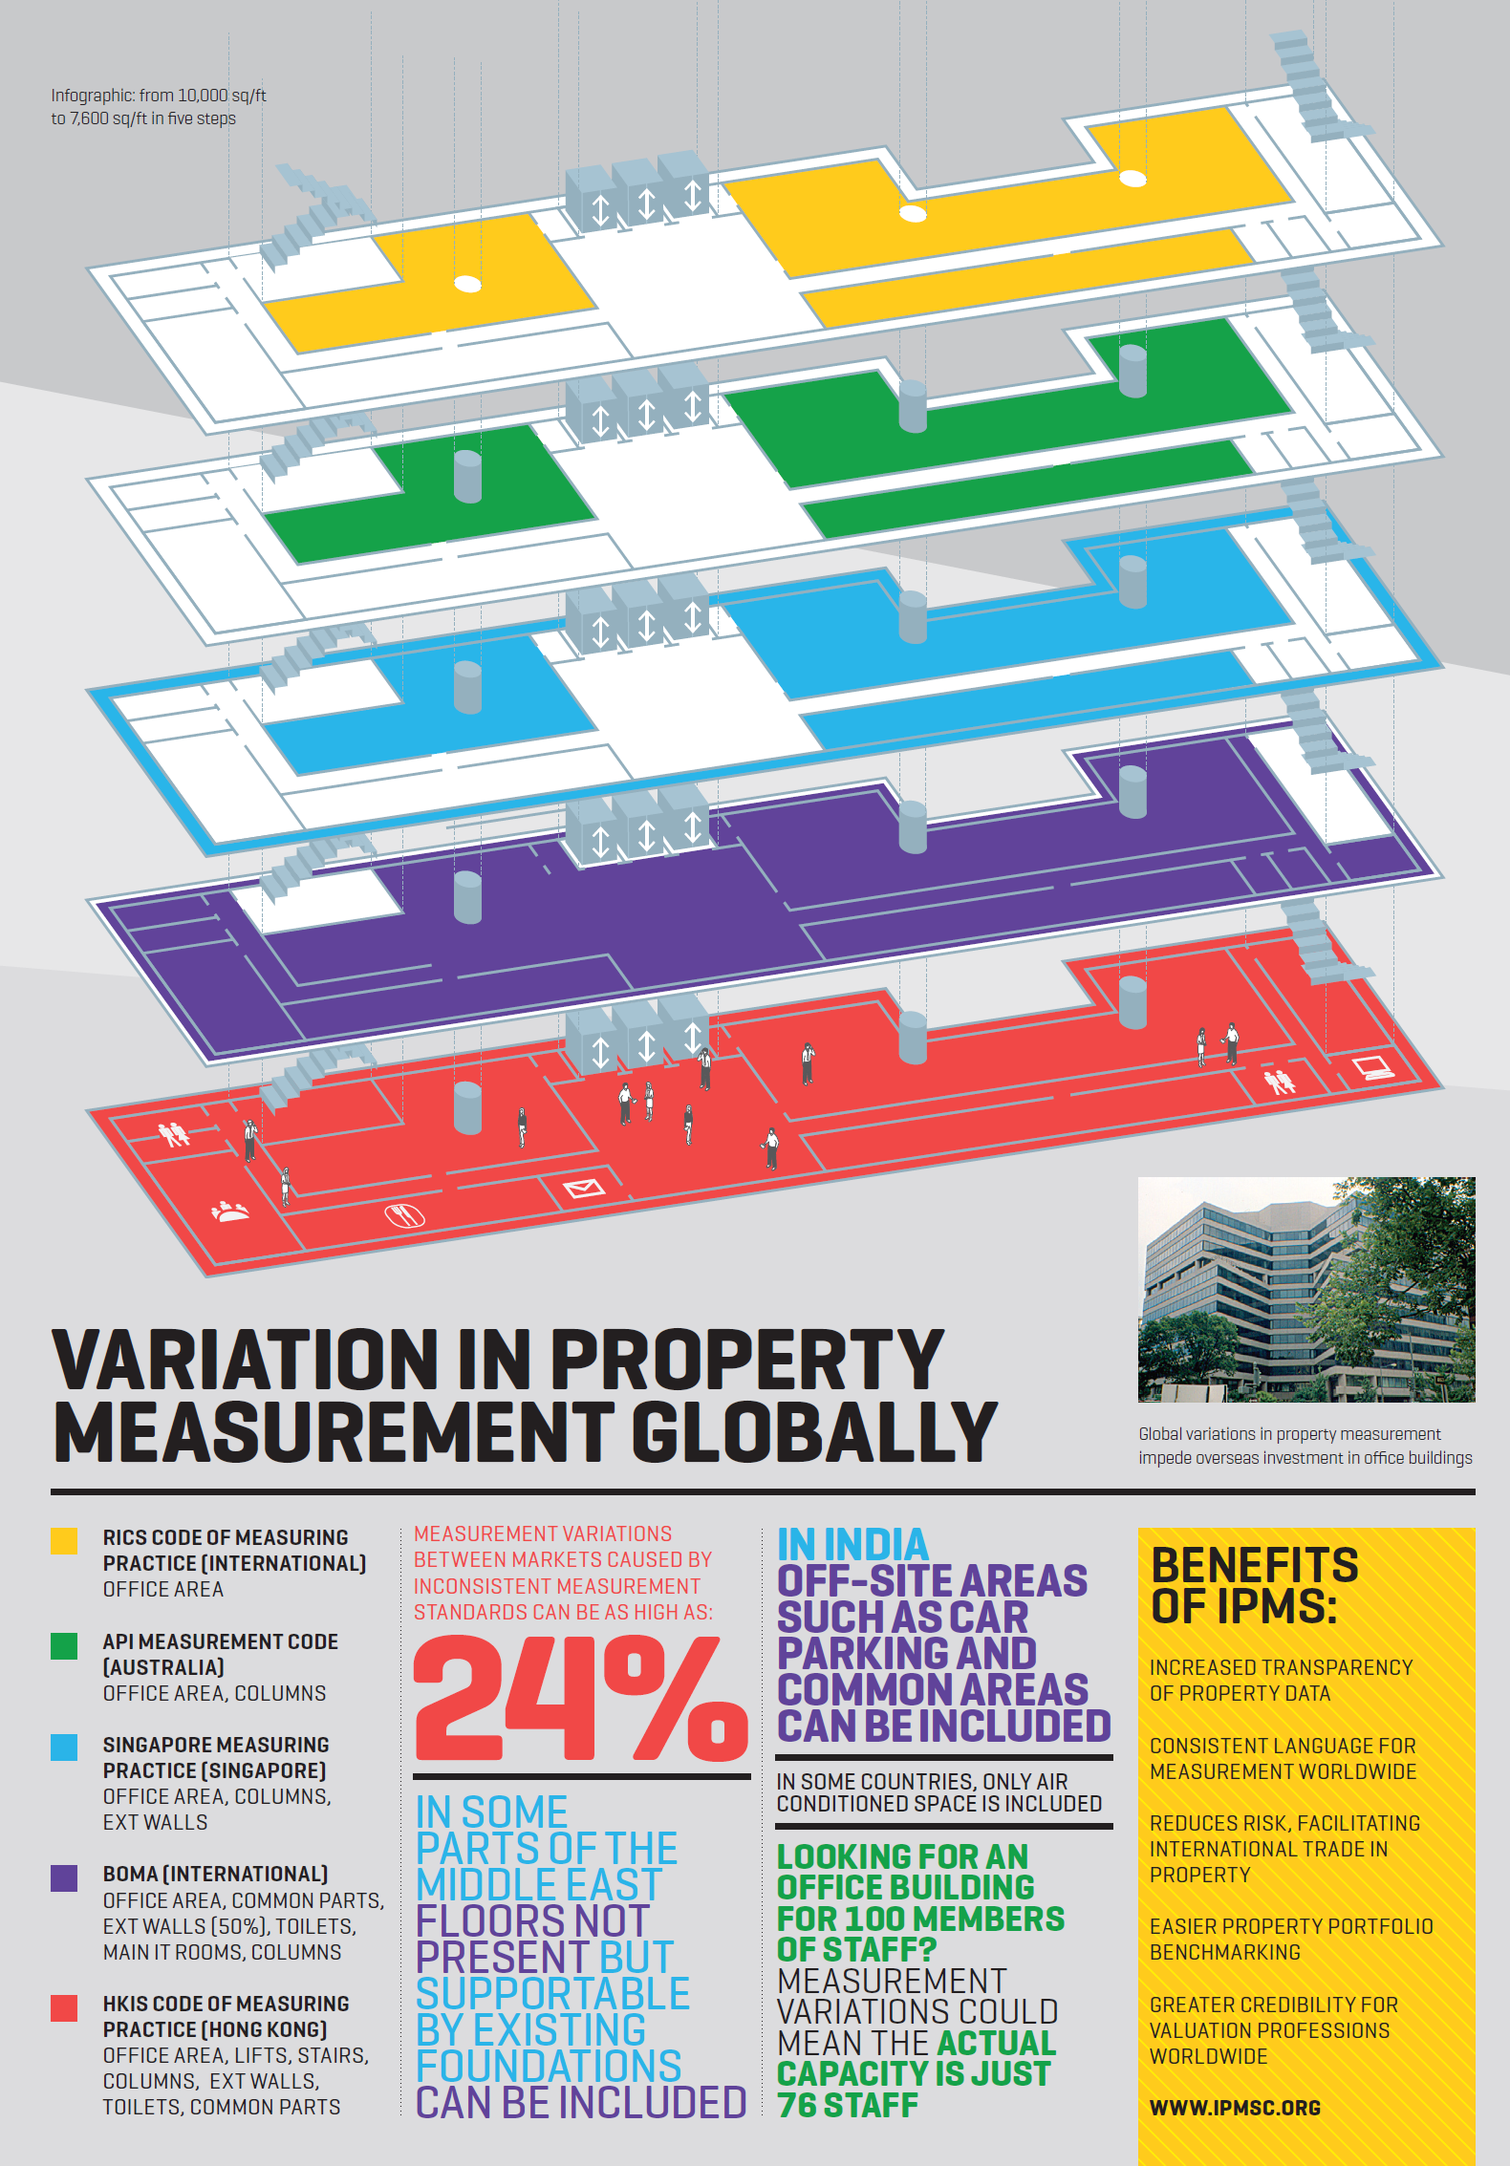
Notes:
This infographic shows how different measurement methodologies can lead to very different floor area measurements of the same space.

Slide 10
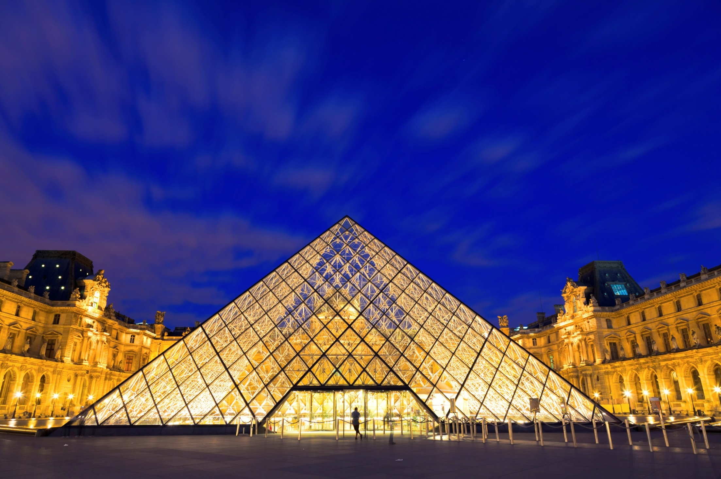
International Property Measurement Standards are the missing link
IFRS
IVS
IPMS
Notes:
IFRS is used and required by governments and companies around the world.
IVS provides for a common approach to valuing assets around the world. This information feeds into IFRS.
However, the measurement data that feeds into valuations is currently not standardised. As a result it undermines IVS and IFRS.
An International Property Measurement Standard (IPMS) is the fundamental component that is currently missing.

Slide 11
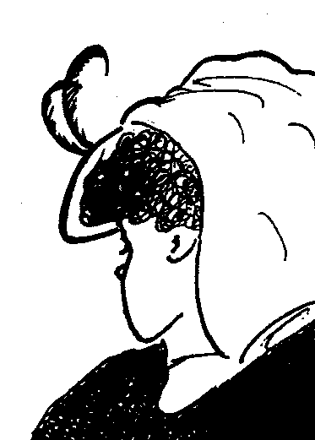
What do you see?
belder@rics.org
www.rics.org

Slide 12
Thank you for listening
Ben Elder
RICS Global Director of Valuation & EQS
belder@rics.org
www.rics.org

