Slide 1
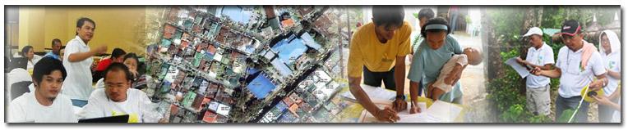

The Post-2015 Global Development Agenda: World Bank Support for Land Governance and Fit-for-Purpose Land Administration
Keith Clifford Bell & Klaus Deininger, World Bank,
FIG 2014, Kuala Lumpur, June 18, 2014

Slide 2

FIG 2014 Conference Theme:
“Engaging the Challenges, Enhancing the Relevance”
Plenary #2 General Focus:
“The profession has key roles towards the betterment of society, environment and economy and needs to attend to emerging issues and trends.”

Slide 3
Message from the Prime Minister of Malaysia to FIG 2014
“The pressure on the land and resources - and therefore the environment - will increase. Sustainable growth therefore will determine strategies of politics, but also for surveyors. Spatial information is vital because it shapes policy-making, surveyors are responsible for translating raw data into pieces of information useful for policy-makers. Spatial information needs to be reliable and reusable, there lies a challenge for the surveyor of the future, according to the Prime Minister.”
Source: GIM, Jun 17, 2014

Slide 4
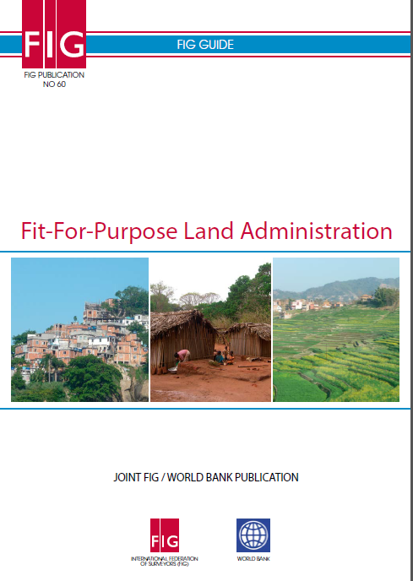
Key Roles of Surveyors
(and the other Land professions) is to Deliver
Fit-for-Purpose Solutions & Services

Slide 5

A Reality Check for Land Professionals - “The Tyranny of Experts”
“The technocratic illusion is that poverty results from a shortage of expertise, whereas poverty is really about a shortage of rights. The emphasis on the problem of expertise makes the problem of rights worse. The technical problems of the poor (and the absence of technical solutions for those problems) are a symptom of poverty, not a cause of poverty. This book argues that the cause of poverty is the absence of political and economic rights, the absence of a free political and economic system that would find the technical solutions to the poor’s problems. The dictator whom the experts expect will accomplish the technical fixes to technical problems is not the solution; he is the problem.”
The Tyranny of Experts: Economists, Dictators,
and the Forgotten Rights of the Poor,
William Easterly, (2014), Chap 1, p. 7

Slide 6
(Donors &) Land Professionals Must Respect Rights and Not Impose Top-down Solutions
“The title of Bill Easterly’s new book pretty much conveys the message: The Tyranny of Experts: Economists, Dictators, and the Forgotten Rights of the Poor. Out of arrogance and political convenience, Western donors are designing and financing destructive top-down development ‘solutions’ to be imposed on the poor. The donors are playing into the hands of dictators, even becoming mini-dictators themselves. The just and surer path to economic development lies in respecting the rights of poor people and empowering them to solve their own problems in ways no expert could plan.”
David Roodman (2014), formerly Center for Global Development; Worldwatch Institute; & Gates Foundation.
*****Surely this is why Fit-for-Purpose Land Administration and Management is so important! *****

Slide 7
Millennium Development Goals – Target 2015 A Silence of the Lands!!
Goal 1: Eradicate extreme poverty and hunger
Goal 2: Achieve universal primary education
Goal 3: Promote gender equality and empower women
Goal 4: Reduce child mortality
Goal 5: Improve maternal health
Goal 6: Combat HIV/AIDS, malaria, and other diseases
Goal 7: Ensure environmental sustainability
Goal 8: Develop a global partnership for development

Slide 8
Post-2015 Development Agenda –
Defining Goals
An Open Working Group (OWG) was established to define agreed goals for the post-2015 Agenda.
On Jun 2, 2014, the Zero Draft of the proposed goals was released. Proposed Goal #1.5:
“by 2030, ensure development opportunities for all men & women, including secure rights to own land, property & other productive resources, & access to financial services, with particular focus on the poor, the most marginalized & people in vulnerable situations”
So, how will that be monitored?

Slide 9
Realities of Our Two Speed World
Developed & developing nations are moving at different speeds in land administration & management – a Two (or multi) Speed World.
Low-Income, Middle-Income & High-Income countries, each with different access to resources, capacity & priorities for land administration & spatial enablement.
80% of humanity live below US$10.00 a day and around 75% of humanity lack land or property rights
“Technology is not a limitation” - BUT funding it is in many cases
An understanding of the political economy of the land-based sectors of any country provides clear insights into why there is weak governance, lack of political will for reform & governance which favors the status quo in support of elites.
(Source: World Bank-FIG Spatial Innovations Forum, March 28, 2014).

Slide 10
Increasing Pressures on the Land-based Sectors
Increasing competition for land in the 21st century, driven by
    Population increase, urbanization, change in diets, biofuels, climate change.
    Global “land rush” – large-scale land acquisitions by foreign & domestic investors.
Concerns
  Protecting the land rights of smallholder farmers, including women & local communities for food security & poverty reduction.
  Ensuring an equitable, environmentally sustainable & economically efficient use of land resources.
  Increasing urbanization and loss of productive rural lands.
  Hottest Underpinning Issue
  Good Land Governance which is dependent on many factors including the rule of law, civil service, etc etc….. & reliable spatial data - “AAA” – accurate, authoritative, assured. (AAA – Williamson, 2011)

Slide 11



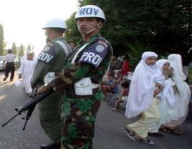
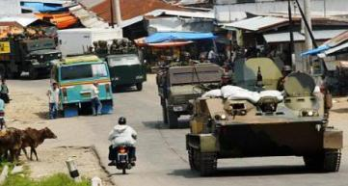
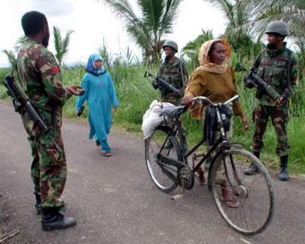
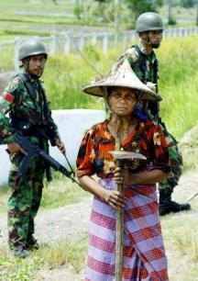

Land Issues - Conflict & Post-Conflict

Slide 12
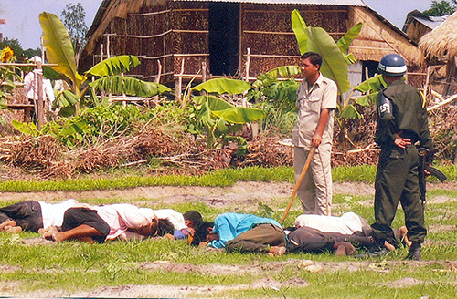
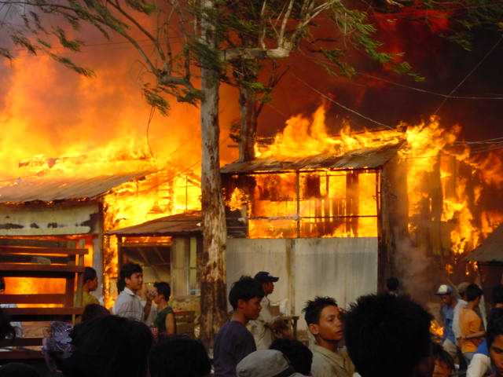
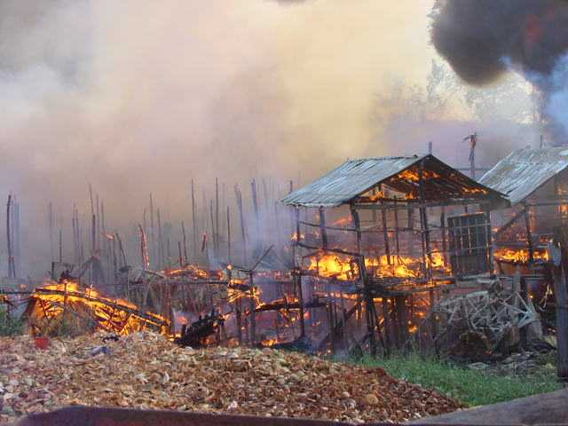
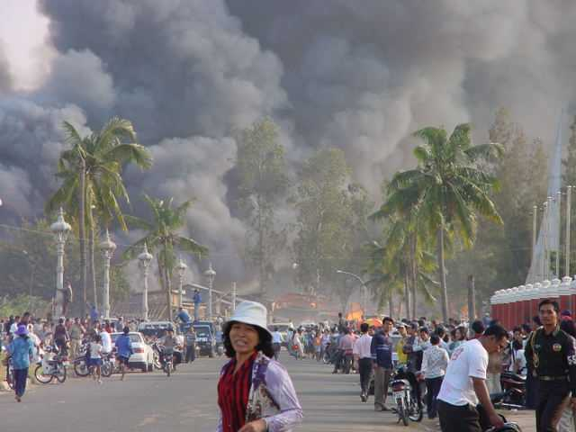
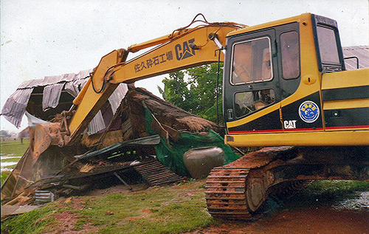
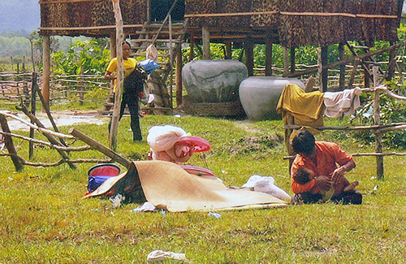
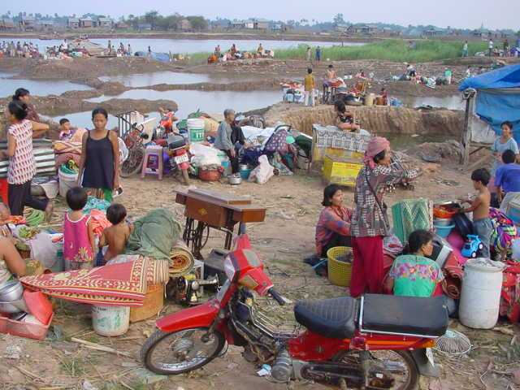
Tenure Security & Land Evictions

Slide 13
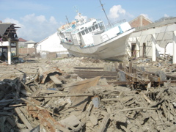
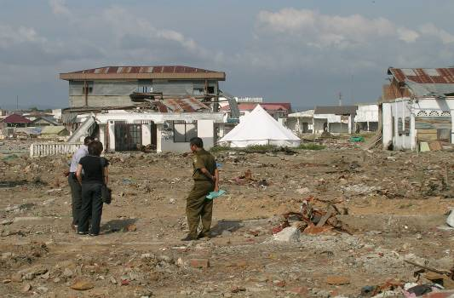
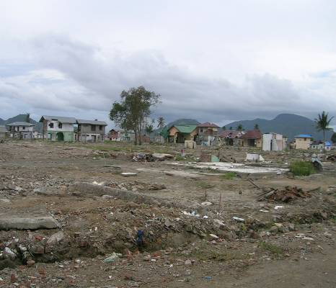
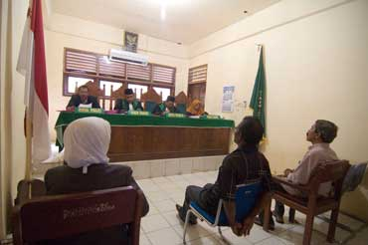
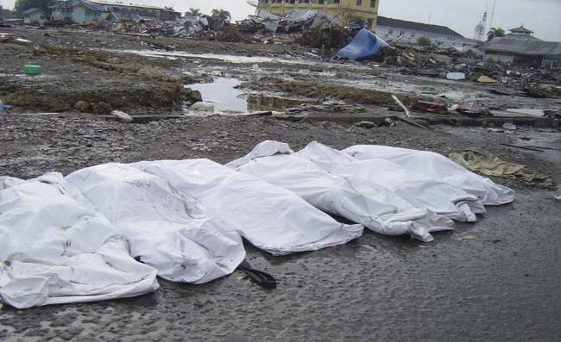
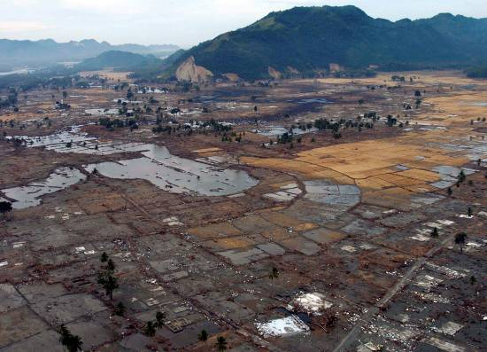
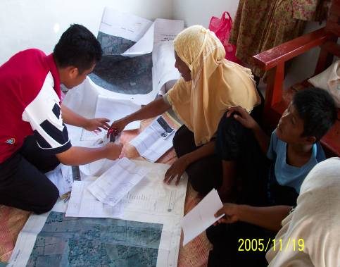
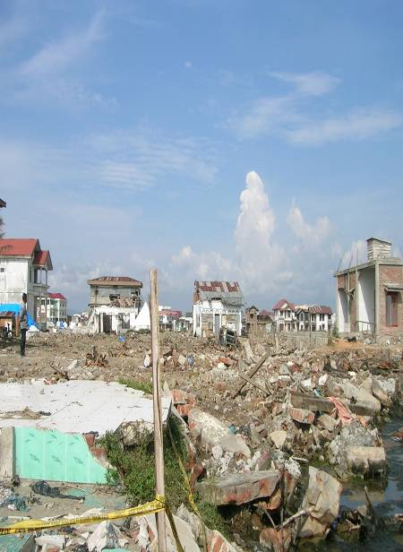
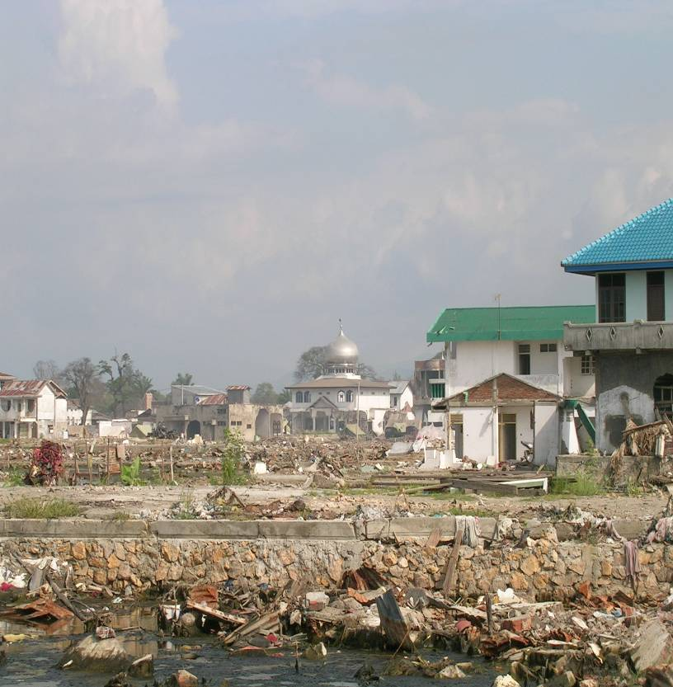
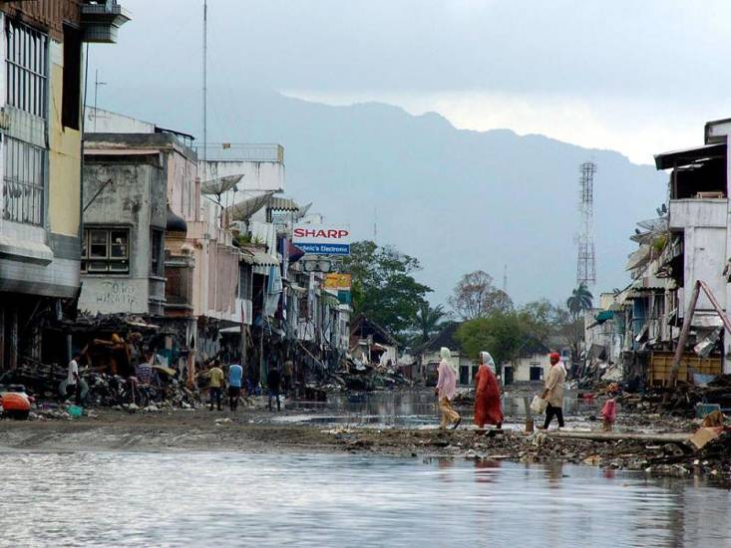
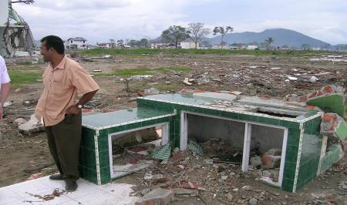
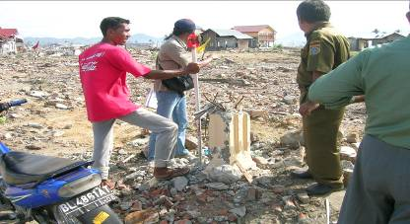
Disasters
i

Slide 14
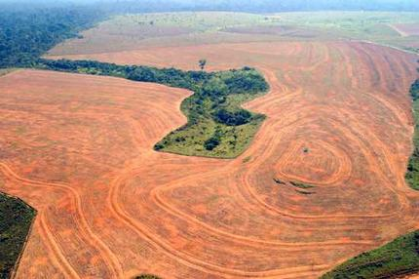
Deforestation

Slide 15
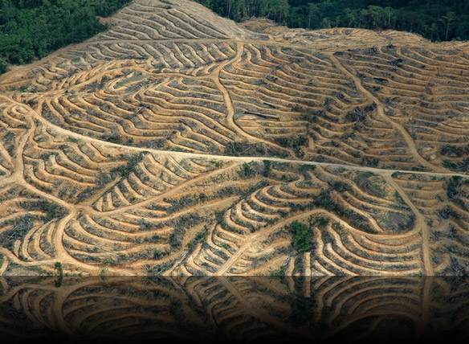

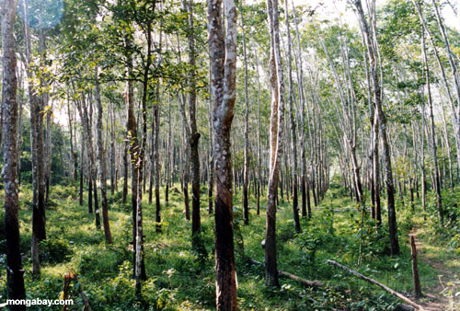

FDI

Slide 16

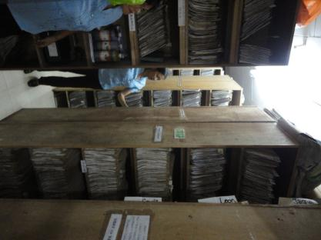
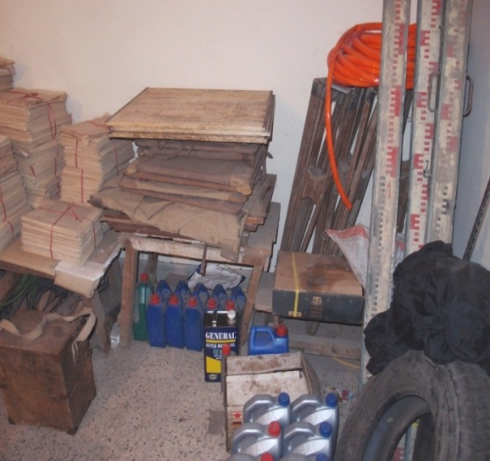
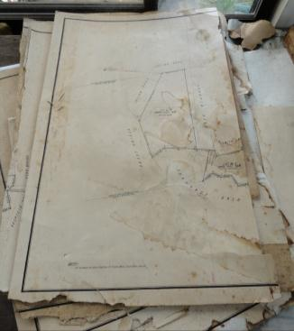
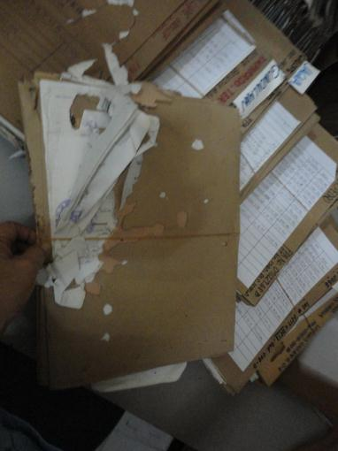
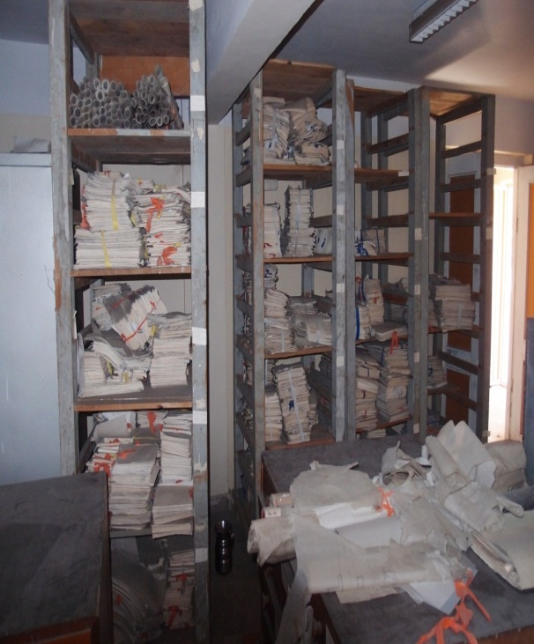
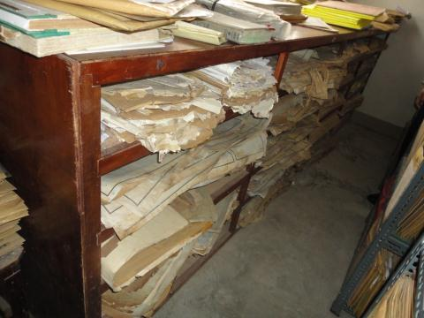
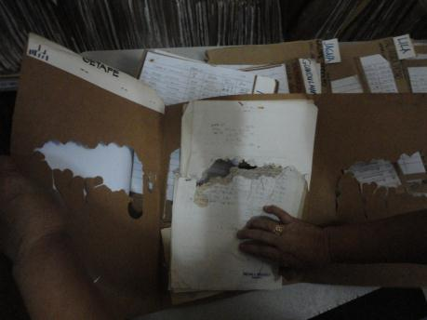
Best Practice Land Administration?
Pics: WB May 2012, (Left and center) and USAID, 2012 (Right)

Slide 17
Land governance challenges
A broader view of land governance is needed at the country level – too many silos – NLA and NMOs
Urban land tenure essential for low-cost housing and livable cities
Tenure security key constraint for farmers, especially for women
Land grabbing and FDI
Land fiscal issues
Tenure security / demarcation & registration of Common lands/ forest lands/ ancestral lands
REDD+
Climate Change
Institutional & political economy issues often neglected
NSDI - consistent, reliable, authoritative data
Fit-for-purpose land administration systems
Disasters
Conflict

Slide 18
Land Governance must not become rhetoric
Good governance is increasingly recognized as critical to effective development & sustainability – it is key for FFP
Specifically for land governance, a fully functioning land & property system is composed of 4 key building blocks:
(a) a system of rules that defines the bundle of rights & obligations between people & assets;
(b) a system for the rule of law;
(c) a functioning market for the registration, exchange of assets; &
(d) an instrument of social policy.

Slide 19
G8 – 2013 Gave Recognition to Land
“43. Weak land governance and property rights systems can lead to opaque land deals, which facilitate corruption and undercut responsible actors seeking access to land for productive investment. Weak governance in many developing countries allows unproductive land speculation and undermines agricultural productivity. Increasing security of land rights and transparency of land governance fosters participation of citizens, contributes to government accountability, reduces costs for businesses, and strengthens the climate for responsible investment. …..
44. We will support greater transparency in land transactions including at early stages, and increased capacity to develop good land governance systems in developing countries. Last year, the G8 welcomed the UN Committee on World Food Security’s Voluntary Guidelines on the Responsible Governance of Tenure of Land, Fisheries and Forests in the Context of National Food Security (VGGT). “
United Kingdom Government, 2013, “2013 Lough Erne”, G8 Leaders' Communiqué, Prime Minister’s Office, June 18, 2013, London., paras 43-45

Slide 20
G8 – 2013 Endorsed the Open Data - core to Good Governance
“46. Open government data are an essential resource of the information age. Moving data into the public sphere can improve the lives of citizens, and increasing access to these data can drive innovation, economic growth and the creation of good jobs. Making government data publicly available by default and reusable free of charge in machine-readable, readily-accessible, open formats, and describing these data clearly so that the public can readily understand their contents and meanings, generates new fuel for innovation by private sector innovators, entrepreneurs, and non-governmental organizations. Open data also increase awareness about how countries’ natural resources are used, how extractives revenues are spent, and how land is transacted and managed.
47. We have today agreed and published an Open Data Charter (annexed) with the following
principles:
Open Data by Default – foster expectations that government data be published openly while continuing to safeguard privacy;
Quality and Quantity – release quality, timely and well described open data;
Useable by All – release as much data in as many open formats as possible;
Releasing Data for Improved Governance – share expertise and be transparent about data collection, standards and publishing processes;
Releasing Data for Innovation – consult with users and empower future generations of innovators.”
United Kingdom Government, 2013, “2013 Lough Erne”, G8 Leaders' Communiqué, Prime Minister’s Office, June 18, 2013, London, paras 46-49

Slide 21
Two Approaches are Required
1. LGAF - Land Governance Assessment Framework (Operational – 38+ countries completed, many more starting)
Detailed in-country assessment of governance – national and subnational
A comprehensive diagnostic of around 100 elements of governance of the land-based sectors.
2. Land Monitoring Indicators (Under Development – in 9 country pilots)
For post-2015 development agenda, a simplistic system of a few key indicators for country-comparative monitoring - global scale, as we are dealing with a global agenda - is required.
Can draw upon LGAF as well as administrative and core foundation spatial data

Slide 22
Why the LGAF was created
Thinking started around 2006/7 when discussions for regional/global initiatives (incl. VGGT) took off
Clear that upon endorsement need for
  comprehensive assessment of land sector
  priority setting
  benchmark /baseline to track progress both for in-country policy reform
  facilitation- stakeholder dialogue & engagement
Many experts & organizations involved (FAO, IFAD, UN-Habitat, GLTN, IFPRI, bilateral etc.)
Coordinated by WB

Slide 23
LGAF:
Country-driven & Evidence-based
Land sector reforms are decided at the country level by local actors; both political economy / and “change”
Should be based on broad, participatory policy dialogue between/ within government and other stakeholders
guided by evidence-based assessment
Comprehensive assessment – across silos

Slide 24
LGAF - 9 Panels
Panel 1 Land Tenure Recognition
Panel 2 Rights to Forest & Common Lands; Rural Land Use Regs
Panel 3 Urban Land Use, Planning & Development
Panel 4 Public Land Management
Panel 5 Process for transfer of Public Land to Private Use
Panel 6 Public Provision of Land Information: Registry & Cadastre
Panel 7 Fiscal - Land Valuation & Taxation
Panel 8 Dispute Resolution
Panel 9 Review of Institutional Arrangements and Policies

Slide 25
Process and Steps: 4-6 months
Inception Phase
Background Report based on existing information
9 Panels of Experts
Draft Report
Technical Validation Workshop & Policy Dialogue
Follow Up
actions
Final report & Score card
1
2
3
4
5
6
Platform/
observatory
Dialogue
monitoring

Slide 26
Structure of the assessment framework
Area
Indicators
Dimensions
Score
Recognition of a continuum of rights
A
B
C
D
Land tenure rights recognition (rural)
Enforcement of rights
Land tenure rights recognition (urban)
Legal and Institutional Framework
Mechanisms for recognition of rights
Rural group rights recognition
Restrictions on rights
Clarity of institutional mandates
Urban group rights recognition in informal areas
Equity and nondiscrimination in the decision-making process
Opportunities for tenure individualization

Slide 27
Voluntary Guidelines (VG) Topics Covered by the LGAF
VG Topics | # of Corresponding LGAF Dimensions
Tenure Rights and Responsibilities | 16
Policy, Legal and Organizational Frameworks | 17
Delivery of Services | 15
Safeguards | 8
Public Land, Fisheries and Forests | 12
Indigenous Peoples, Communities with Customary Tenure Systems | 3
Informal Tenure | 6
Markets | 6
Investments | 13
Redistributive Reforms | 5
Expropriation and Compensation | 5
Records of Tenure Rights | 16
Cont’d. | #
Valuation | 2
Taxation | 5
Regulated Spatial Planning | 12
Resolution of Disputes Over Tenure Rights | 4
Land Consolidation and Other Readjustment Approaches | 1
Restitution | 0
Transboundary Matters | 0
Climate Change | 1
Natural Disasters | 1
Conflicts in Respect to Tenure of Land, Fisheries and Forests | 19

Slide 28
Land monitoring indicator/s
Why a global indicator is important
  Focus the debate on a key issue that was missing - LAND
  Foster change at policy and operational level
  Allow users to hold institutions to account
  Guide private decision-making (investors’ choices) & reward good behavior
  Build analytical & policy analysis capacity at country level
Lessons from MDG s/poverty
  Very little analytical work on poverty issues before the 80s
  Stepwise progress: Data issues, methodology, and policy went hand in hand
  Narrow scope: Excluded many things (assets/gender)
  Top level indicator linked to country strategies
Advantages in the case of land
  Information is a key output of the land admin. system
  Developments in spatial & information technology
  Can draw on wide range of data providers (incl. communities – crowd sourcing/VGI)
… but need to have criteria to assess instruments

Slide 29
Criteria for LMI/s
Frequency of updates
Country coverage
Scope for disaggregation (gender/space)
Cost-effectiveness
Objectivity/replicability

Slide 30
Options for Land Monitoring Indicators?
 | Freq | Ctry cvg | Disagg. | Cost | Replic.
Expert opinion | H | H | VL | L | L
Partic. M’toring | H | M | L | L | M
Opinion surveys | M | H | M | M | H
Census data | L | M | VH | M | VH
Hhld surveys | M | L | H | H | H
Admin. data | VH | ?? | VH | M | VH

Slide 31
Collection of key admin. data feasible?
 | Area mapped | Women reg. | Transact | Tax revenue | Exprop. | Disputes
UGA | Y* | Y | Y | N | Y*** | N
RWA | Y | Y | Y | Y | Y** | Y
CMB | Y* | Y*** | Y | N | Y** | Y
PHL | Y** | Y** | N | N | Y** | N
VNM | Y | Y | Y | Y | Y | Y
GEO | Y* | Y** | N | N | Y | N
UKR | Y* | Y** | N | N | Y** | N
PER | Y** | Y(urban) | Y/N | N | Y** | N
BRA | Y** | Y | Y | Y *** | Y** | Y**
* for mapped & recorded land ** data are scattered/not available *** paper based.

Slide 32
Recommended Approach to LMI/s
Recommended that LMI/s would draw upon LGAF and Administrative Data
LMI needs to be done spatially, drawing upon the core foundation data of NLAs and NMOs

Slide 33
NLAs and NMOs are custodians of key data for land sector monitoring
Mandates of institutions
  Reliable, authoritative information is a core mandate
  Custodian - information made available
  Direct link to institutions’ performance reporting
Spatially explicit
  Core or Foundation data
  Expose inconsistencies Map once – use often (not only registry; tax maps plans)
  Spatial disaggregation (poverty maps, poor areas)
  Link tenure to land use (& change) maps (urban & rural)
  Climate change and REDD+

Slide 34
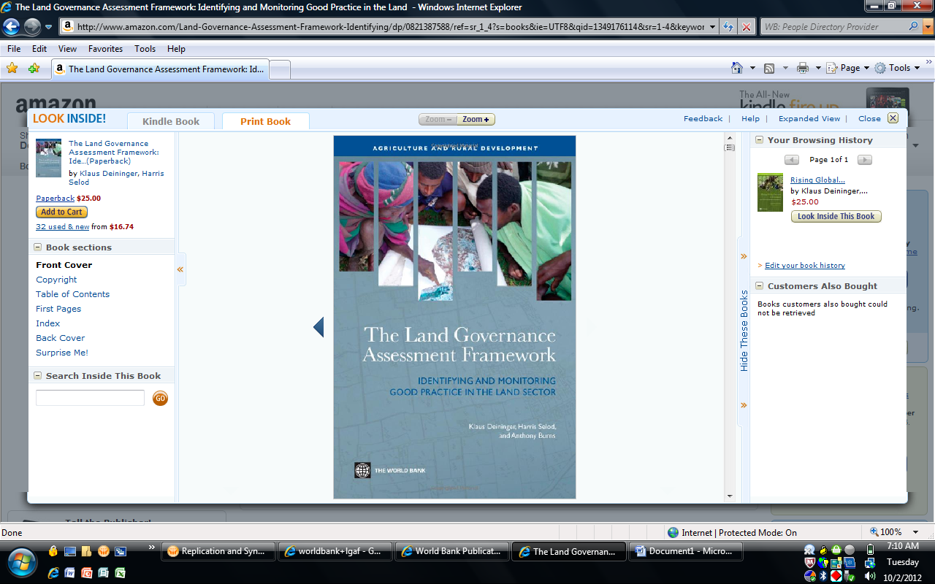
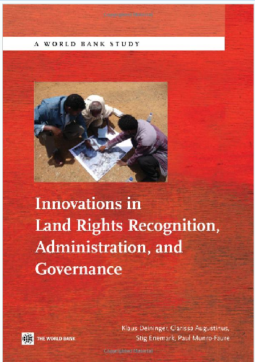

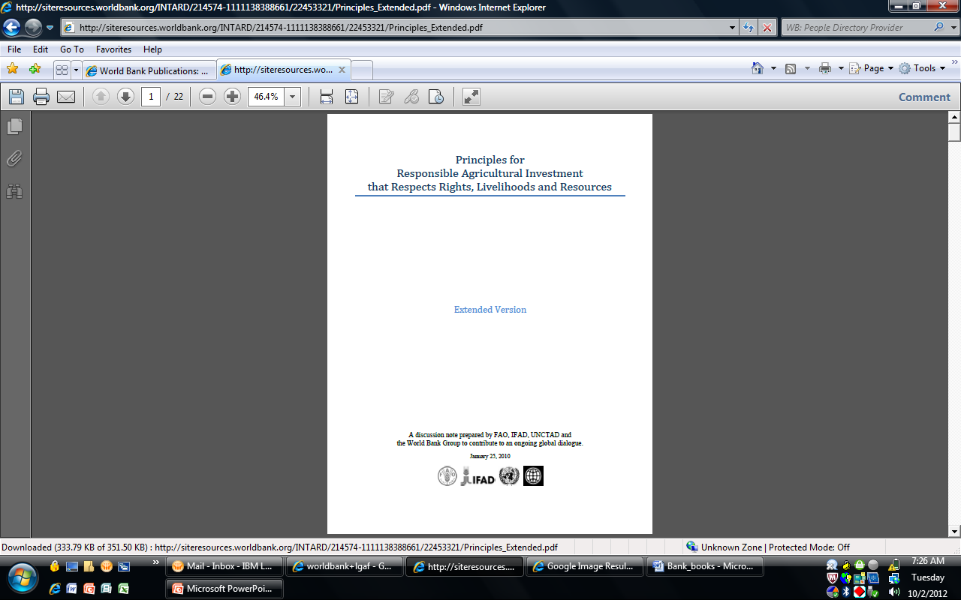
Key Publications and more on LGAF http://econ.worldbank.org/lgaf

Slide 35
Recommended Next steps
Demonstrate the viability of collecting a global indicator
  Interest is there – but people disagree about viability
  Data availability not a primary concern (but sampling)
  Cost estimate: 3 years to cover 2/3 of countries for $ 10m
  Need standards & reputable institution to take the lead
Document benefits for national stakeholder platforms
  Define disaggregated reporting formats
  Link with other types of data collection and local processes
    Land use monitoring - revenue potential
    Gender dynamics of land rights
  Feed into updating of land governance assessments (strong demand)
  Share global best practice and build capacity
Use this to influence the post-2015 agenda
  Unique opportunity to quickly jump-start SDG process
  In parallel to interpretation/use of data
  Get countries to express their preferences in the process

Slide 36
Take Home Messages
Good land governance is fundamental to the land-based sectors and reform – it is the overarching issue.
Land professions must be leaders in the reform process - must be part of the solution and not the problem -
NLA s and NMOs are custodians of the BIG DATA - core administrative data and foundation spatial data sets - for governance monitoring
LGAF used to diagnose & benchmark land governance, to prioritize land sector reforms & monitor progress over time in the land-based sectors consistent with VGGT - evidence-based land reforms
SDGs and Global Land Monitoring Indicator/s must be spatially monitored

Slide 37
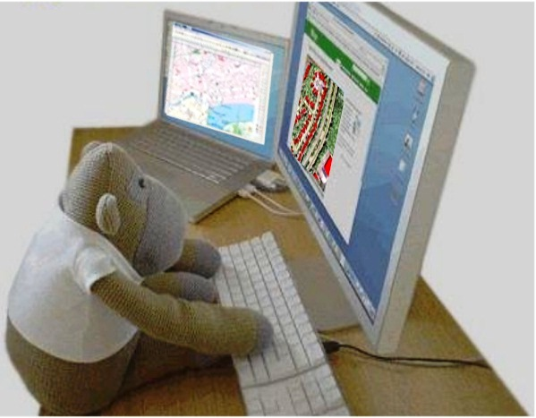
So for Surveyors and Land Professionals
Embrace the challenges of the Post-2015 Development agenda
Let’s be professional surveyors, land administrators and geospatial scientists - NOT JUST USERS OF APPS!
Trish Nicholson,( 2013),
"From Apes to Apps: How Humans Evolved as Storytellers and Why it Matters“.
“It matters because adaptations that enabled us to thrive in prehistoric times leave us
vulnerable in the changed environment of our global digital age.”
Pic: “Ning”
adapted from http://farisyakob.typepad.com/blog/2007/04/monkey_we_need_.html
THANK YOU! terima kasih

