Slide 1





“SURVEYORS HELPING
SMALL BUSINESSES”
James Raven - 15-years experience
BSc(Hons) Property Management
Current Overview of Tax on Commercial Property
Ideas to Share & Develop

Slide 2

BRITAIN
Known as: Non-Domestic Rates
Non-Domestic Rates are related to
the rent of the property / land
“tax rate” is set across
WHOLE COUNTRY
Rate is annually reviewed

Slide 3
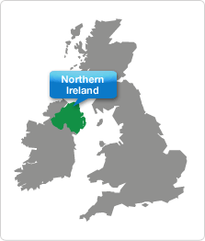
NORTHERN IRELAND
Known as: Non-Domestic Rates
Non-Domestic Rates are related
to rent of the property / land
Current “tax rate” is set
individually by
EACH DISTRICT

Slide 4
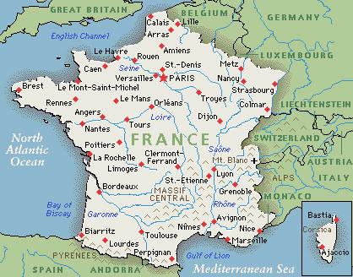
FRANCE
Known as: Business Tax
Business tax is related to the rent of the
property / land AND plant & machinery
Current “tax rate” is set individually by each
LOCAL AUTHORITY

Slide 5
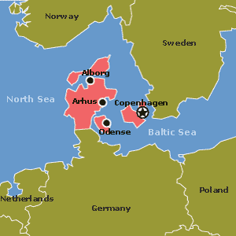
DENMARK
Known as: SERVICE TAX
Service Tax is related to the CAPITAL VALUE of the
property / land
Current “tax rate” is set individually by each
LOCAL AUTHORITY

Slide 6

CANADA
Known as: PROPERTY TAX
Property Tax is related to the CAPITAL VALUE of the
property / land
Current “tax rate” is set at MUNICIPAL LEVEL

Slide 7


Slide 8
BRITAIN
Rateable Value | Amount to pay
< £6,000 | 0%
£6,001 - £12,000 | 0% > > > 100%
> £12,000 | 100%

Slide 9
BRITAIN
Rateable Value | Amount to pay
< £6,000 | 0%
£6,001 - £12,000 | 0% > > > 100%
> £12,000 | 100%
BUT
Offer only renewed annually by the government, so how can a business plan??

Slide 10
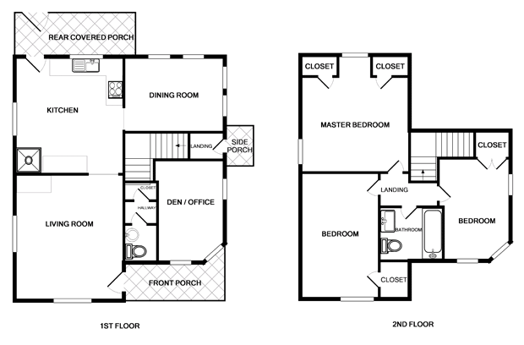

BRITAIN
25% discount or 0% discount?

Slide 11
BRITAIN
70 sq m
BECOMES
140 sq m
Property TAX from
£10,000pa to £15,000pa

Slide 12
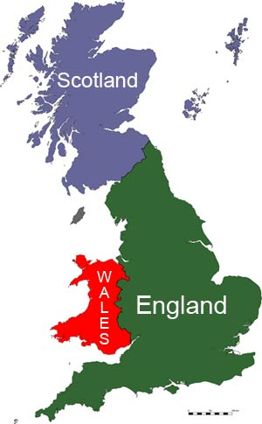
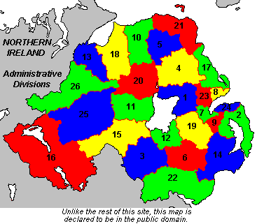
BRITAIN v NORTHERN IRELAND
1 26

Slide 13
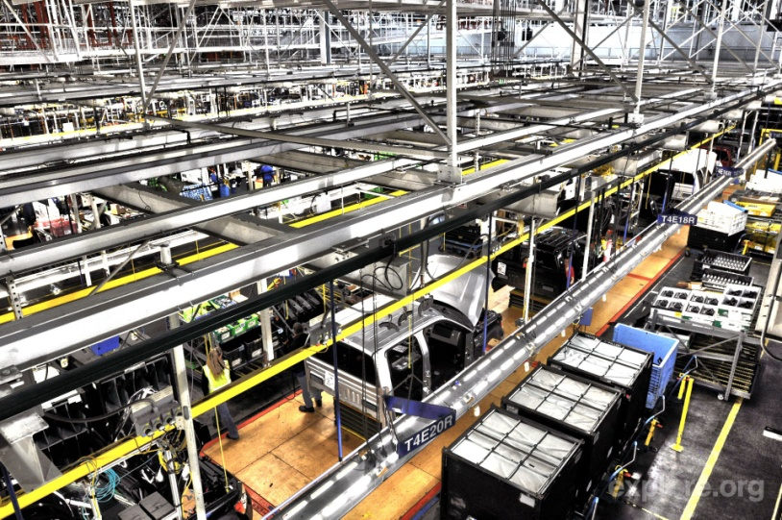
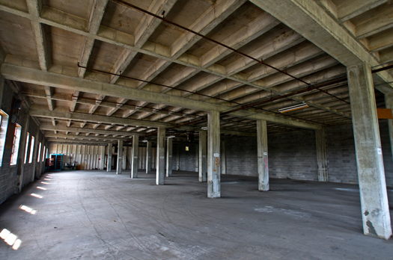
FRANCE
OR…

Slide 14
SOUTH AFRICA
Set locally
Relief granted at local
Payable by property owners
Reviewed 4-yearly
Based on Market Value NOT rental value

Slide 15


ONLINE or ON-LAND?

Slide 16

TURNOVER
PROFITS

Slide 17
How can Surveyors
HELP??

Slide 18
TIPS & IDEAS
TO SHARE & DEVELOP
Can turnover be moved / shared to a company elsewhere?
Can part of the property become ‘unused’ / derelict?
Can NATIONAL be changed to LOCAL to help cater for geographical trends?

Slide 19
TIPS & IDEAS
TO SHARE & DEVELOP
Can we help in other ways:
Part-subletting?
Change of use? Then assign?
Taking on the national cause?

Slide 20


20, 19, 18, 17, 16, 15, 14, 13, 12, 11, 10, 9, 8, 7, 6, 5, 4, 3, 2, 1

