Slide 1

Low-Cost Integrated GNSS/INS for
Surface Variation Monitoring
Miguel Cordeiro
João Apolinário

Slide 2
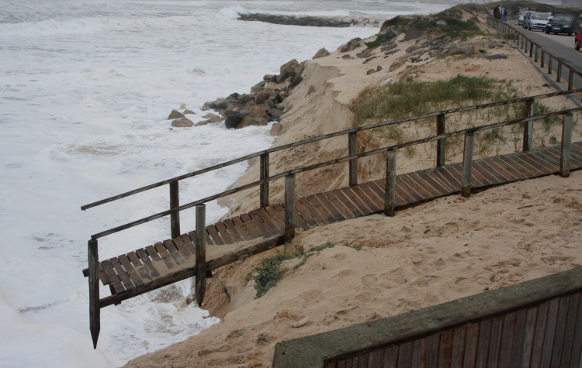
Coastal Erosion Monitoring (1/3)
High rates of coastal line retreat.

Slide 3
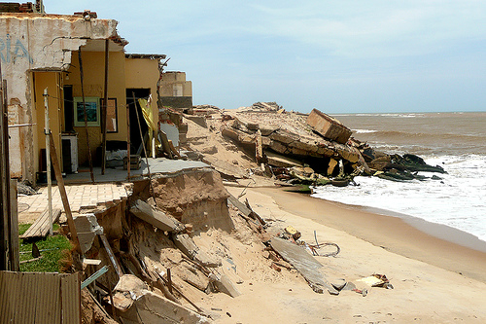
Coastal Erosion Monitoring (2/3)
Effective human occupation in stretches of coastline
with great vulnerability to erosive phenomena.

Slide 4
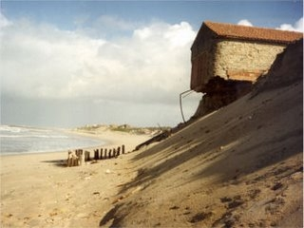
Coastal Erosion Monitoring (3/3)
Such phenomena originates potential risk situations;
That is why it is extremely important to accurately monitor beach volumetric variations and assess coastal erosion.

Slide 5
Classical Methods to Address the Problem…

Slide 6
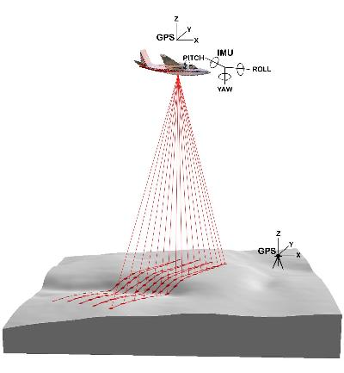
Terrestrial and Airborne LiDAR
Very Expensive;
Governmental requirements, such as licenses, environmental and safety issues.

Slide 7
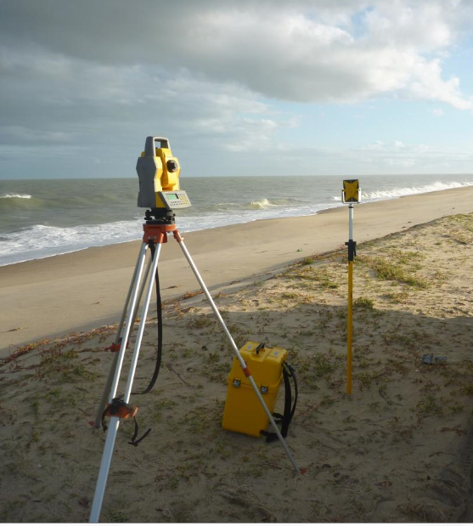
Total Stations
Highly Time-Consuming

Slide 8
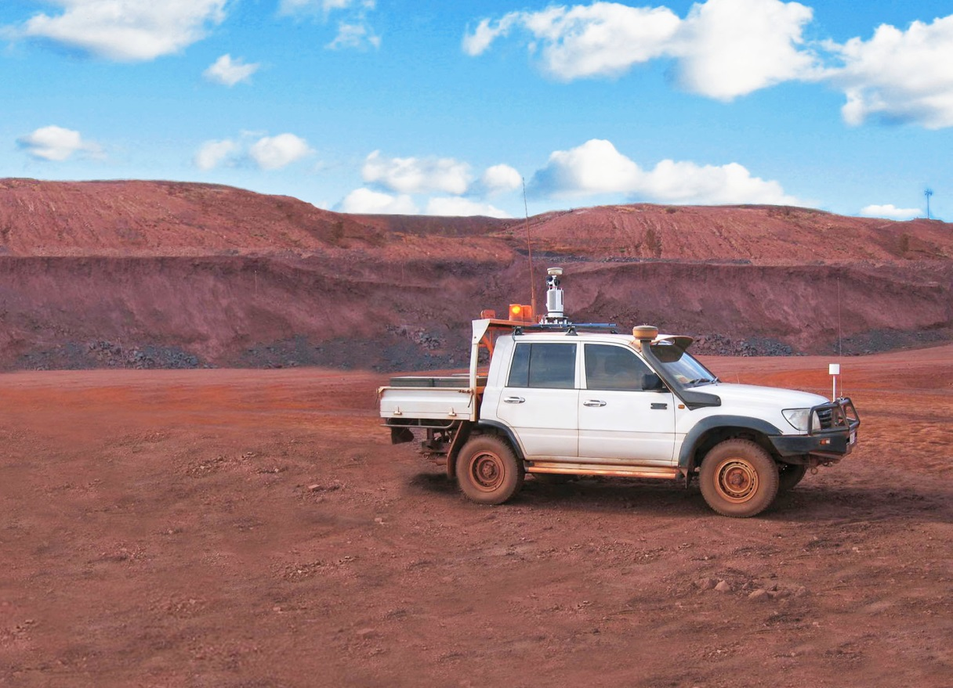
Mobile Mapping Systems (MMS)
The use of laser scanners makes it expensive;
Same Government requirements as LiDAR.

Slide 9
Developed Low-Cost Solution

Slide 10
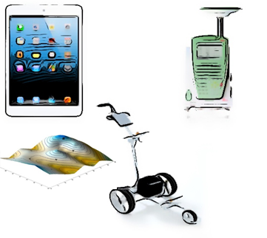
Trolley + GNSS + Tablet

Slide 11
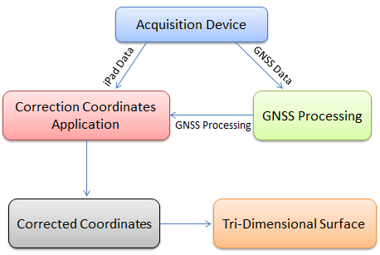
Methodology

Slide 12
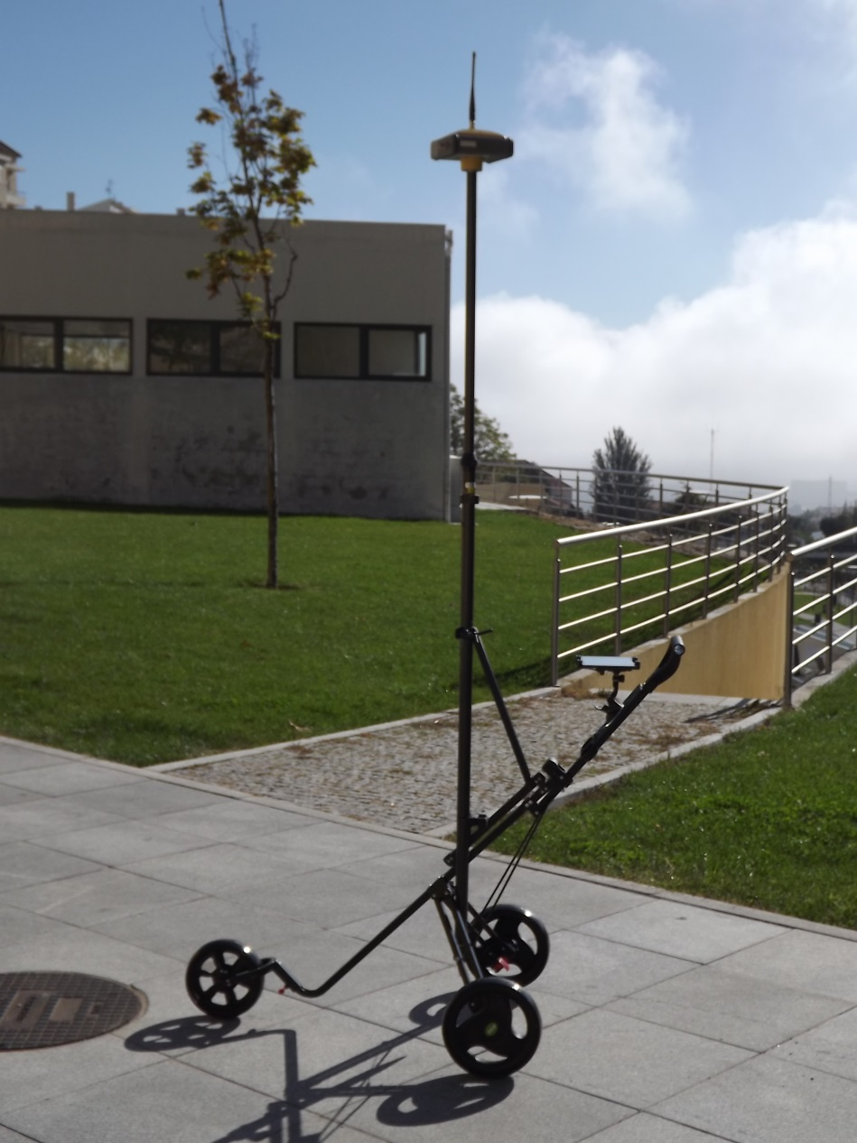
Acquisition Device
Integrated system developed to collect GNSS data and attitude angles simultaneously;
Simple storage and portability.

Slide 13
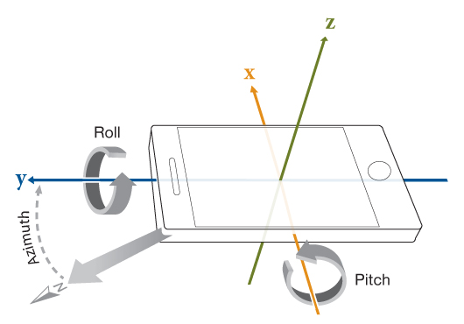
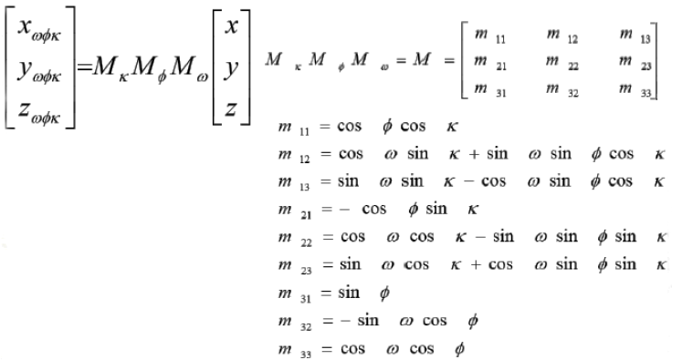
Antenna Corrections
Difficult to guarantee the verticality of antenna mast;
Correct acquired data using antenna attitude.

Slide 14
Air2Ground
Application developed and implemented in C# to correct the coordinates of the acquired data.
Inputs
Initial Time offset;
Height of the mast;
Mast distance to the ground;
Antenna coordinates in the IPad reference frame;
Two text files (from the GNSS data processing software and from the Tablet).
Outputs
Point ID;
Time of observation;
Pitch, Roll, Yaw;
X,Y,Z corrected coordinates.

Slide 15
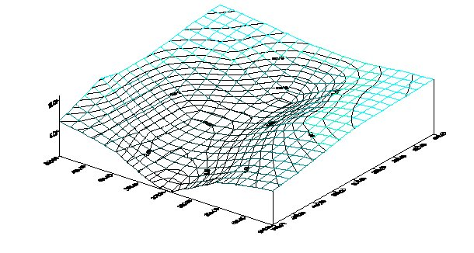
Surface Computation
With the corrected positions, we will be able to generate a three-dimensional surface estimated using interpolation techniques

Slide 16

Surface Computation
Finally, repeating the process at different times it will be possible to study the coastal line evolution in a time frame.
Repeat!!

Slide 17
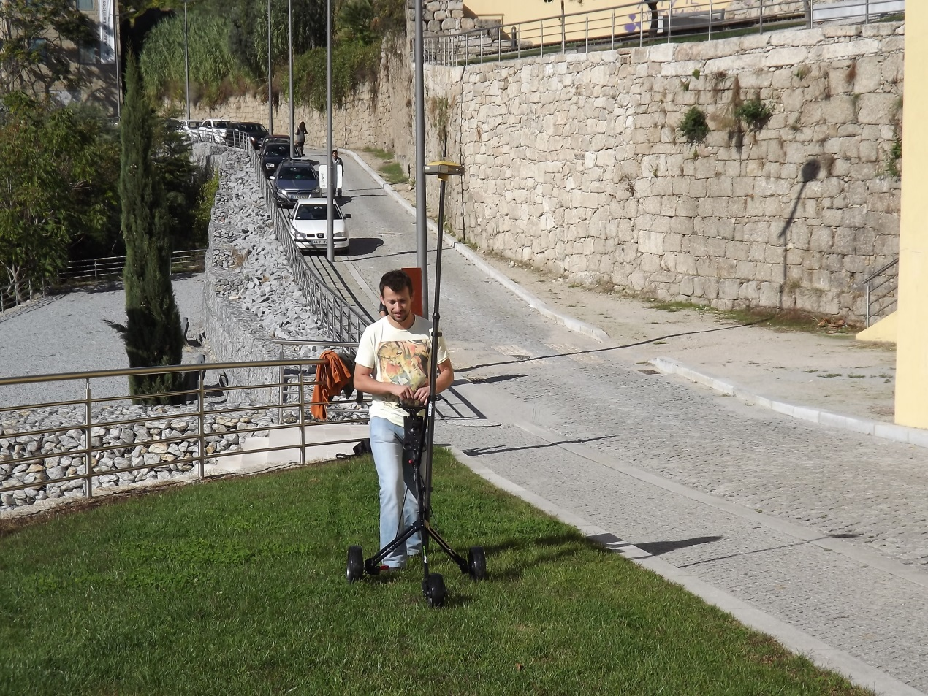
Progress Report
Conducting experiments in an irregular terrain;
Testing C# application to guarantee that the corrections are right;
In process to generate a 3D surface of the tested area.

Slide 18
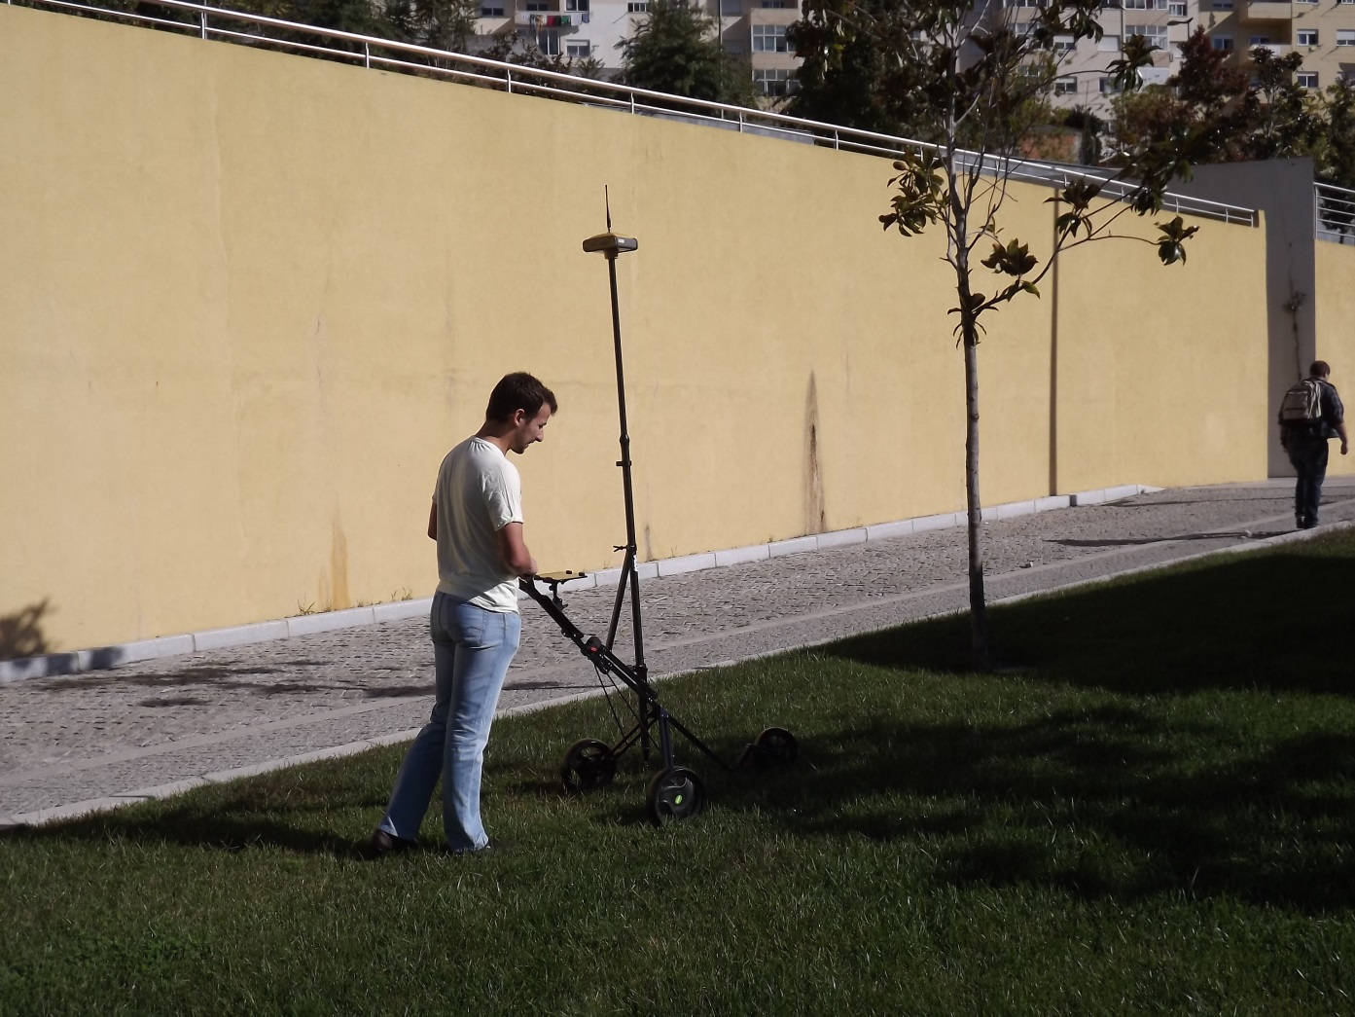
Thank you for your attention!

