Slide 1

FIG C7 – Presentation
04-10-2023
Surveying & the Dutch
Land Registry (‘’Kadaster’’)

Slide 2
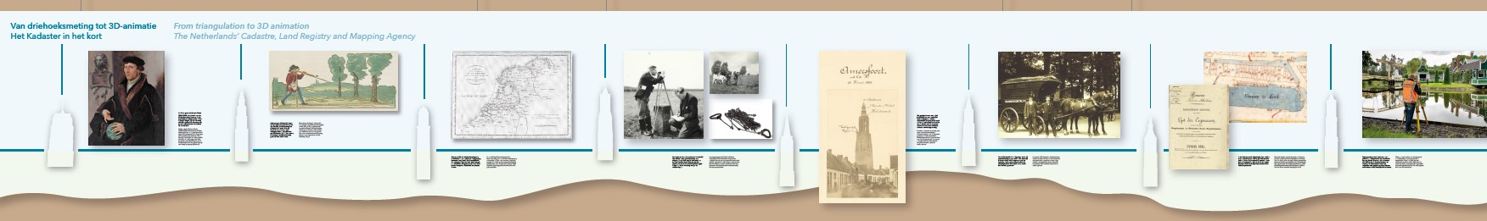
A Short history of the
Dutch Land Registry & Mapping Agency (’’Kadaster’’)

Slide 3
- Established in 1832, based largely on the French-system (a result of a period of occupation by France 1795-1813 - i.e., Napoleon);
- Originally registering land-owners and their land for tax purposes;
- Firstly a governmental body, closely alligned with the Ministry of Finance & Inland Revenue, later Ministry of Housing & Envrionment up until the mid 1990’s - now semi-governmental (however, tarrifs are still approved by the State);
- 8 offices in 7 locations throughout the Netherlands;
- Approx. 250 surveyors employed internally;
- Present day: tasked with providing legal security & clarity over landownership, registering & maintaining this in the public-record system.

Slide 4
Surveying tasks based on three main activities:
(i) Indication and registration of new boundary(’s) (“Aanwijs“) - after both passing of deeds (via a sollicitor) and entry into the Public records = appointment with (new)owners
(ii) Measuring new boundary(’s) - either by deed or division (“Splitsing“) by existing owners(s)
(iii) Reconstructing old/existing boundaries (“Grensreconstructie“) - on request by the legal owner (or via a representative of the legal owner).

Slide 5

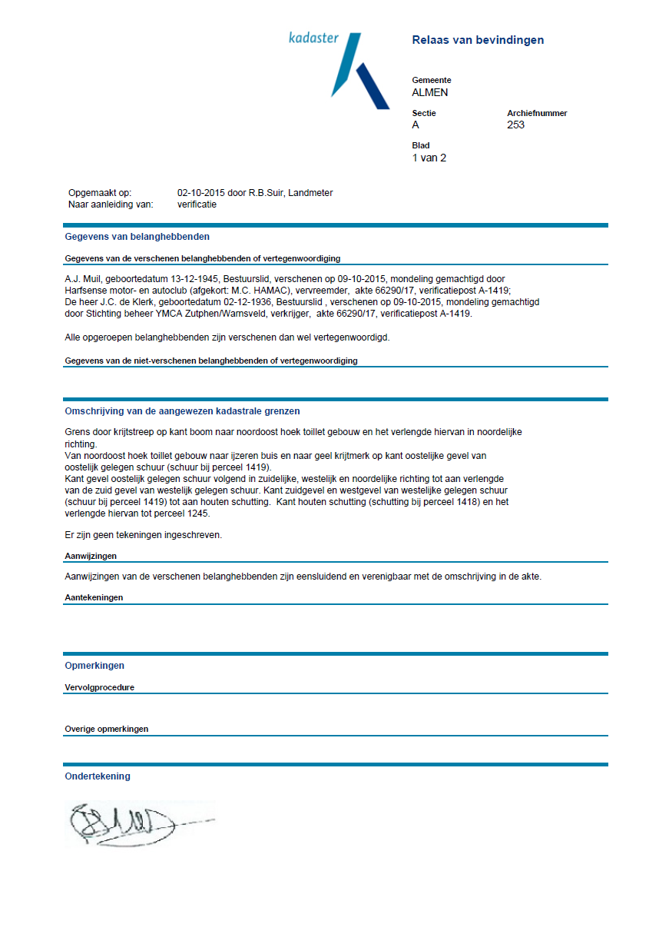
Indication and registration of new boundary(’s)
After both the passing of the deeds (via a sollicitor) and entry into the Public records, the transaction is made known to the Land Regsitry.
Subsequently an order is created, either as one of several individual addresses or alternatively a larger project, for example such as a new housing-estate.
This in turn results in a planning being made and an order (or several orders) are allocated to the surveyor, with an appointment with the (new)owners - usually made approx. 2 weeks in the future.
In the Netherlands, only Land Registry surveyors
are legally authorised to carry out this task.

Slide 6

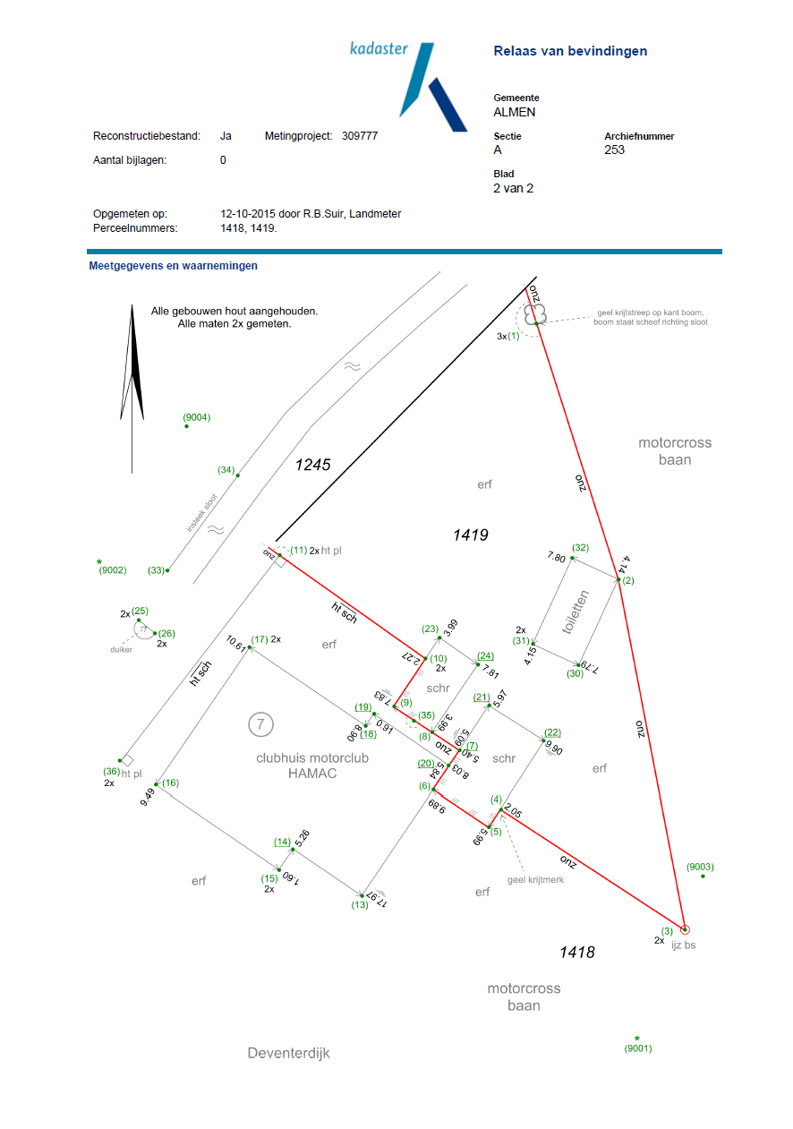
Measuring new boundary(’s)
Either as a result of passing of deed‘s (sale & purchase) or by division (“Splitsing“) by existing owners(s).
After indication of the position of the new boundary having been mutually agreed upon by buyer and seller, an appointment is made to survey the new boundary.
This is done either by Land Registry surveyor‘s or, one of our contract-partners, i.e. an (external),
land-registry approved surveying company.

Slide 7
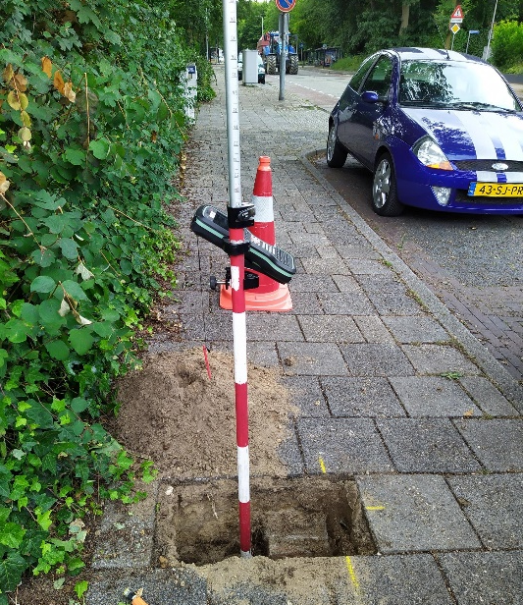
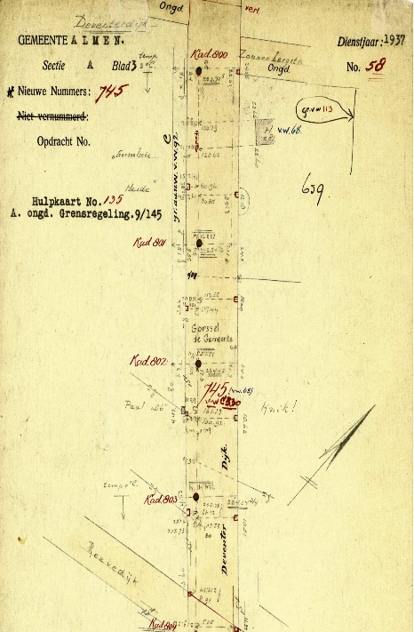
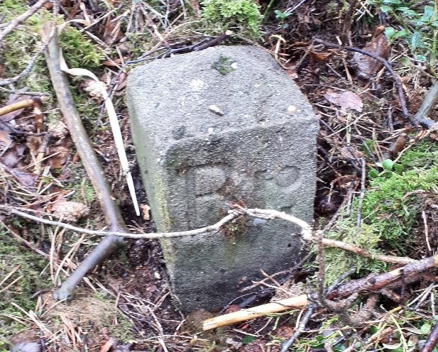
Reconstructing old/existing boundaries
On request from the legal owner (or via a representative of the legal owner).
Surveyor has direct contact with the client and largely arranges his/her own planning.
The land-registry surveyor refers to the cadastral archives, which go back as far as 1832 and as such, contain a large amount of analogue surveys as well as the more recent & present-day digital surveys (co-ordinates).
Once the surveyor is satisfied with the origin of the boundary (including any other, relevant information), an appointment is made to set out and survey the requested boundary - which may include preliminary surveys - prior to the definitive result (in co-ordinates) being presented to the client (= legal owner, or representative therof).

Slide 8
Thank you for your attention and enjoy your visit

